Slide 1
2017_ver 1.0

Slide 2
General Awareness Training Module
2017_ver 1.0
For Soldiers, Sailors, Airmen, Marines, and everyone in a base camp

Slide 3
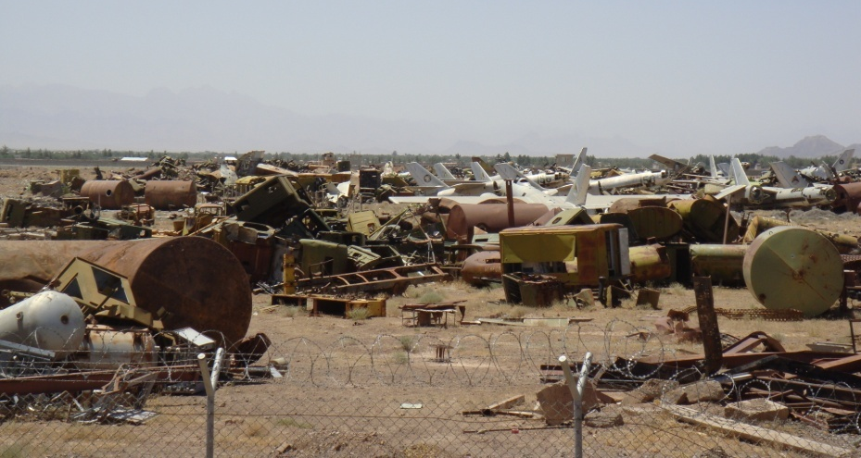
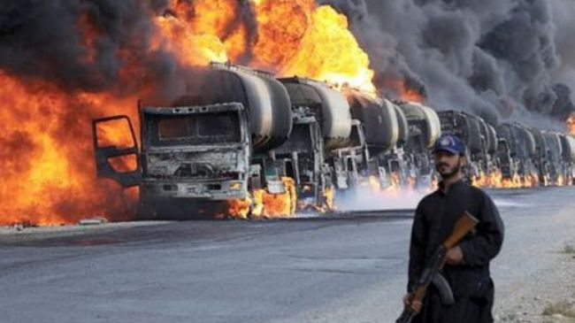
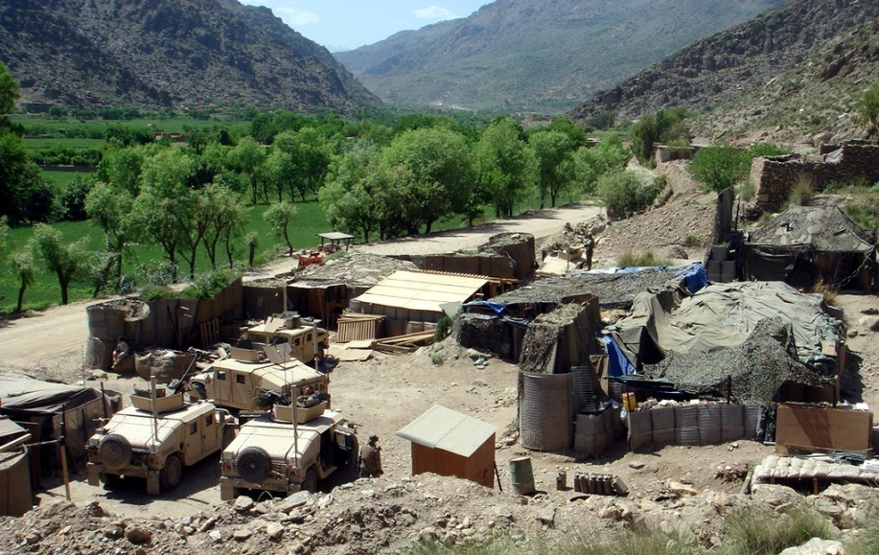
Environmental and Energy Considerations in Operations
2017_ver 1.0
Sound environmental and energy management during military operations helps you and your commander accomplish the mission by enhancing force protection and
reducing the logistical burden on the force
Notes:
Environmental and energy considerations must be part of the everyday lives of every service member. They do not go away or become unimportant because we are involved in operations. In fact, they may even enhance operational capabilities and security.
The integration of energy saving measures and environmental values into the military mission helps to:
sustain readiness,
enhance quality of life
improve safety at work
strengthen civil relations
conserve valuable natural resources
We ultimately perform in operations based on what we have done in training. These training materials will enhance your knowledge of what is expected of you environmentally and energy-wise.
The picture on the right illustrates the logistic burden and force protection requirements of delivering supplies to conflict areas. On the left, we see what can happen when there is a lack of sound environmental management practices. In the foreground is an example of a base camp meeting mission requirements, while seamlessly integrating into the surrounding environment. Importantly, environmental and energy considerations can help to ease the logistical burden and reduce force protection requirements.

Slide 4
Overview of This Briefing
2017_ver 1.0
Your responsibilities
Why environmental and energy considerations matter
Examples of good and bad practices
Handout materials, instructions, education
Notes:
This slide lists the important topics that will be covered in this briefing. First there is a listing of your responsibilities concerning environment and energy. It is important to understand that every person has responsibilities, not just the environmental officer or energy manager in your unit. Your most important environmental responsibilities are during the execution stage of the operation, and there are several people within your command to give you guidance about how to do this.
Next, the briefing explains what we mean by “environmental considerations in operations” (ECOps) and “energy considerations in operations” (EnCOps), why they are important to you and what your role is.
Most of the briefing looks at some examples of good and bad environmental and energy practices—from proper waste disposal to improved energy efficiency. Seeing how to do things correctly will help you know the right thing to do when you are deployed.
At the end, there are links to a few documents—things like a pocket guide for spill response—that you can use.
4

Slide 5
Your Responsibilities
2017_ver 1.0
Be familiar with policies, standard operating procedures (SOPs), field card instructions, etc.
Use resources responsibly; use only what is needed
Put your waste into appropriate containers
Save energy
Recycle and reuse when possible
Handle hazardous material and waste carefully and use personal protection equipment (PPE)
Conduct regular inspections and checks of your equipment and workspace
Be prepared to act in case of any environmental incident. Report spills, releases and contamination. Know the procedures!
Protect natural resources and cultural property
Ask questions if in doubt
Everyone has responsibility to protect the environment and use energy wisely!
Notes:
These are the main environmental responsibilities you—and everyone else in the base camp—has.
5

Slide 6
Definitions
2017_ver 1.0
Environmental Considerations in Operations (ECOps) are measures or processes put in place to avoid or minimize potentially adverse environmental impacts during military operations.
Energy Considerations in Operations (EnCOps) are measures or processes put in place to decrease energy consumption and improve energy efficiency during military operations
Focus areas addressed in this toolbox*:
  Solid waste management
  Hazardous material and hazardous waste management
  Water and wastewater management
  Spill prevention and response planning
  Natural resource and cultural property protection
  Energy Considerations
Notes:
6
The aims of Environmental Considerations are to:
avoid or minimize potentially adverse environmental impacts during military operations
enable advance planning instead of having to continuously intervene to mitigate impacts during the operation; this also helps ensure the future environmental viability of the host nation
mitigate and/or avoid pre-existing environmental contamination that may negatively impact the force or the mission
The aims of Energy Considerations are to:
use less energy to provide the same service
systematically achieve better energy efficiency and mission sustainability through technical solutions and by enhancing energy awareness and behavioral practices.
“Environmental Considerations in Operations (ECOps)” covers a broad range of issues. The focus areas addressed in this toolbox are:
Solid waste/hazardous material/hazardous waste management. Operations require a lot of material and generate large quantities of waste. Proper management of material and waste helps to minimize environmental pollution, protect health, and conserve resources and funding. For example, it is important to properly handle and store hazardous material or waste that is used when maintaining vehicles.
Water and wastewater management. Water is used in many aspects of an operation. It is necessary for drinking, personal hygiene, cleaning equipment, etc. Often operations occur in areas with limited water resources and water must be transported to military operations. Proper management of water and wastewater helps to ensure we have safe drinking water, reduces transportation requirements, and protects soldiers from diseases resulting from improper wastewater management.
Spill Prevention and Response Planning. Spills of petroleum, oils and lubricants (POL) and hazardous materials may occur during routine operations. Establishing preventive measures and ensuring that personnel know their roles and responsibilities for spill response helps to minimize exposure of personnel to hazards and the impacts of spills on the environment. Personnel must be able to act in the case of a spill.
Natural resource and cultural property protection. It is important for deploying forces to be respectful of historic sites, buildings, archeological sites, natural resources, wildlife and habitats that are important to the host nation. This helps to foster good relations with local populations and the host nation.
Energy consumption, supplies and availability are often critical for the operation. Energy use is also a financial and environmental issue.
Focus areas of the “Energy Consideration is Operations (EnCOps)” in the toolbox are:
planning considerations for optimal energy management
energy use in military operations
energy production, storage and distribution
energy efficiency practices

Slide 7
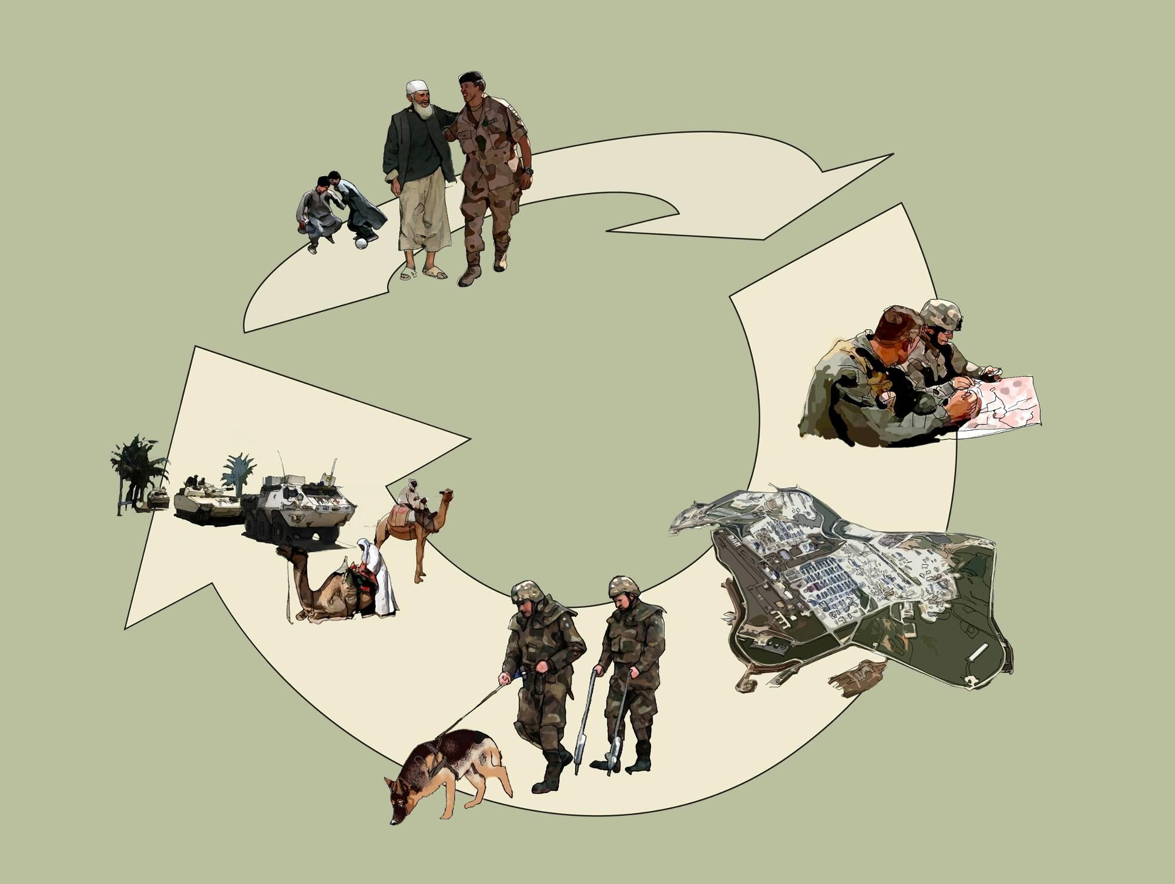
ECOps and EnCOps in the Life Cycle of Military Operations
2017_ver 1.0
Lessons Learned
Planning
Pre-deployment
Post-deployment
Re-deployment
Rotation
Deployment
Notes:
At each stage of the life cycle process, there are energy and environmental requirements and responsibilities at different levels of the command structure, from the highest strategic planning to the daily responsibilities of every soldier.
Your key involvement is during the deployment stage.

Slide 8
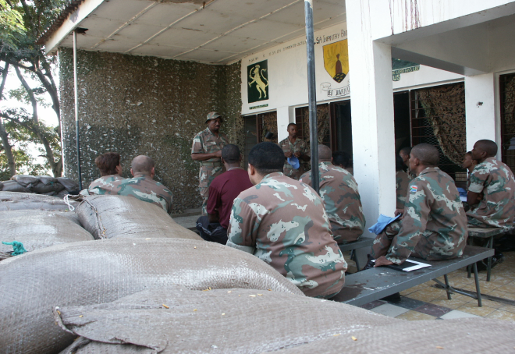
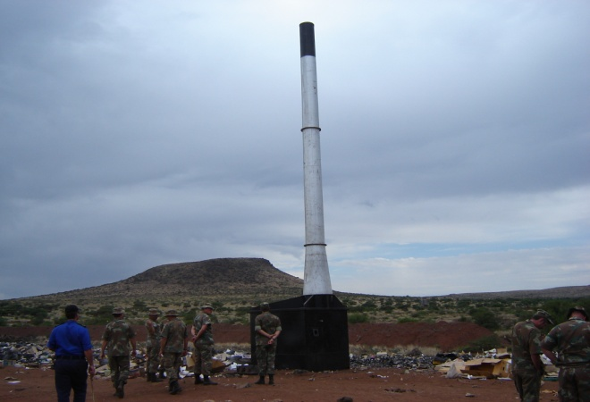
Personnel Who Provide Environmental and Energy Direction
2017_ver 1.0
Commanders (at all levels) – provide command emphasis on the importance of environmental and energy considerations
Staff Officers – may help integrate environmental and energy considerations
Environmental Officer / Energy manager - advocates and coordinates ECOps and EnCOps at the tactical level
Environmental and energy representatives at each unit and activity – carry out specific tasks, as directed by the Commander
ENVIRONMENTAL RESPONSIBILITY STARTS WITH YOU!
Notes:
8
There are many people you can turn to if you have environmental or energy questions or concerns. This slide lists some of these people and the roles they play. For example, staff officers could include legal, medical and logistics officers.
But remember, too, everyone has environmental responsibility!
Source: These pictures are taken from the US-South Africa Environmental Security Working Group, Environmental Considerations in Military Operations Guidebook.

Slide 9
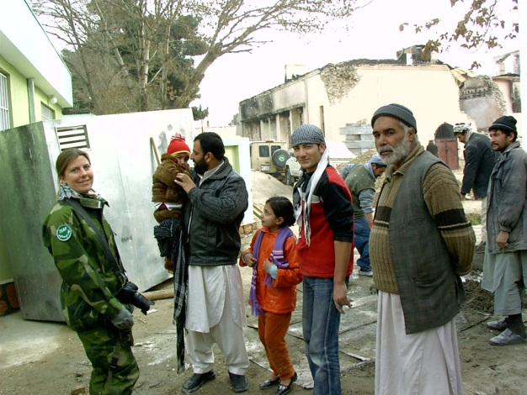
Why ECOps and EnCOps Matter to You
2017_ver 1.0
Protects soldier health
Reduces number of supply convoys needed
Reduces logistical requirements and costs
Reduces legal and financial liability
Promotes sustainability
  For the current mission
  For future deployments
  For the host nation
Enhances relations with local
community and host nation
Using resources wisely helps improve force protection!
Notes:
9
There are a number of reasons why it is important to think about energy and environmental considerations.
Force Protection (Safety and Health of Forces)
Planning for energy and environmental considerations prior to force deployment can help protect the safety and health of the troops. For example, it can help ensure troops are housed away from contaminated areas. Energy considerations help, for example, to reduce military supply demands, thereby reducing the risk troops face when conducting supply convoys.
Logistical, Financial and Legal Implications
Recent operations have shown that approximately 70% of logistic movement by weight is fuel and water. Energy efficiency and environmental considerations help to reduce the demand of these resources, which in turn help to decrease the overall cost of the mission.
Environmental damage requires money and man-hours to rehabilitate; this is money and manpower that could be used elsewhere in the operation. Failure to prevent or repair damage could result in unanticipated liabilities, both legal and political.
Poor energy management and environmental preparation can increase resource costs. For example, there is the cost of cleaning up the waste generated by a leaking fuel tanker as well as the cost of the spilled fuel itself.
Sustainable use of resources and the environment is important for several different reasons:
so that the current mission can continue (impacts to current operations are avoided)
so that future deployments can occur in the same areas; this depends on proper environmental care during the current deployment
so that the host nation can use the area after operations have ceased.
When proper consideration is given to energy and environmental considerations, this can help win the hearts and minds of the local population.
In the end, by doing things like reducing demand (of water, packaging, energy, etc.), and reuse and recycling resources and equipment, you will be helping to improve the safety and security of yourself and your fellow troops.

Slide 10
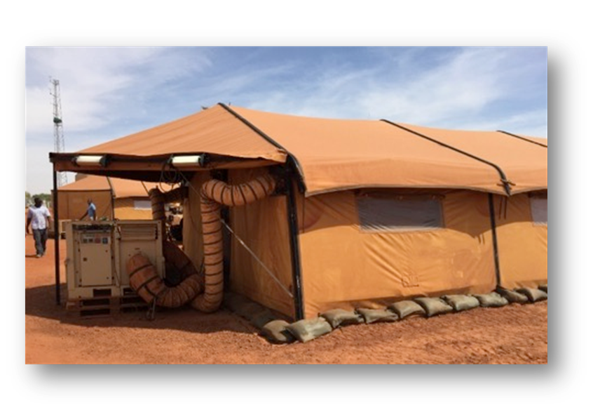
Energy Facts
2017_ver 1.0
Two thirds of the fuel that a conventional diesel generator burns is blown out as heat. Only one third is converted into electricity.
In a typical military camp, 60-70% of fuel is used to produce electricity to heat/cool water or air.
Advanced technology and higher standards of living in camps have led to increased energy demand.
Examples from Afghanistan:
      For each gallon of fuel up to 4 gallons were consumed for transport.
      Fully burdened cost of fuel can be over 90€ per liter.
      On average there has been one casualty for every 24 fuel resupply convoys.
Notes:
This slide and the next highlight the importance of operational energy and show ways that everyone can help conserve energy in daily life at the camp.
For general information about military energy use, see for example, US Army, “The Power Is in Your Hands,” https://www.army.mil/e2/c/downloads/316462.pdf.
Information about Afghanistan is drawn from several sources, including: http://www.natolibguides.info/smartenergy; http://www.nationaldefensemagazine.org/archive/2010/April/Pages/HowMuchforaGallonofGas.aspx; and https://protonex.com/blog/iraq-and-afghanistan-the-hidden-cost-of-fuel-convoys.

Slide 11
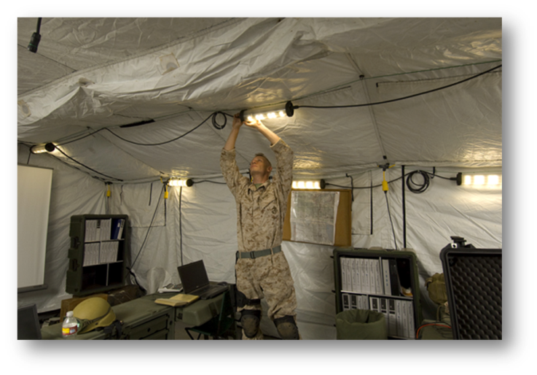
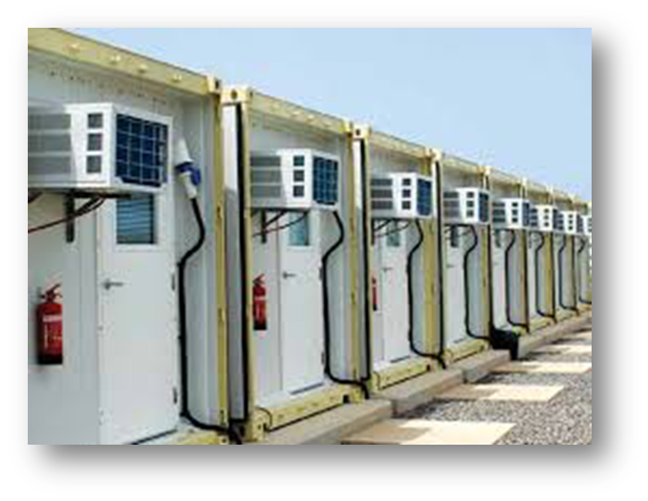
What you can do to save energy?
2017_ver 1.0
Keep doors and windows closed to prevent loss of conditioned air
Eliminate unnecessary vehicle use and idling
Use power management settings on computers and turn off lights when not needed
Use natural lightning when possible
Ensure dishwashing and laundry machines are full before being operated
Take shorter showers
Turn off the tap when brushing teeth or shaving
Notes:
Remember: resource conservation is ALSO energy conservation. It takes energy to move resources to where you are!

Slide 12
Good and Bad Examples
2017_ver 1.0
The following slides show a number of pictures of both good and bad environmental practices, from camp set-up to handling different kinds of wastes to protecting natural and cultural resources
Notes:
The next slides provide good visuals of some good and bad practices. They are meant to help each soldier know what to consider, how to handle hazardous materials and waste, how to dispose properly of solid waste and wastewater, etc. They also aim to raise awareness about protecting nature (wildlife, habitats, plants, etc.), natural resources (water, forests, etc.), and respecting cultural resources (such as burial sites and archeological sites).

Slide 13
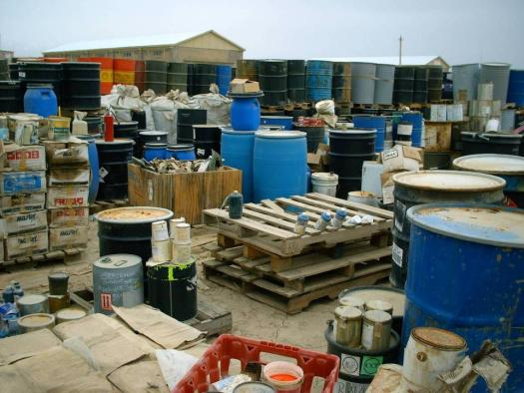
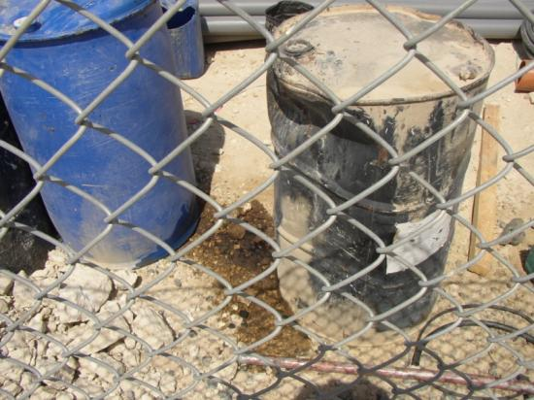
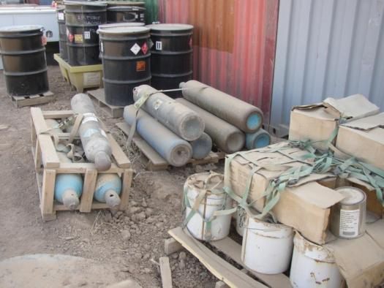
Bad Hazardous Waste Storage
2017_ver 1.0
Drums not labeled, materials not segregated, no secondary containment, no covered storage
Uses secondary containment, but it is too small and not durable. Canisters improperly stored
No secondary containment; leakage has contaminated soil
Notes:
13
Here are striking examples of how NOT to store hazardous material and wastes. The upper picture has countless examples of bad practices: drums are not labeled, incompatible materials are not segregated, there is no secondary containment nor is there any covered storage.
Similarly, the lower left picture shows a case of no secondary containment. Since the product has now leaked out of the barrel, it is causing contamination directly into the soil.
The picture on the right does show at least some secondary containment, but not of the best materials and not actually large enough. In addition, the compressed gas canisters are improperly stored: they should be standing so that something couldn’t bump into them and knock the tops off.

Slide 14
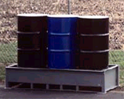
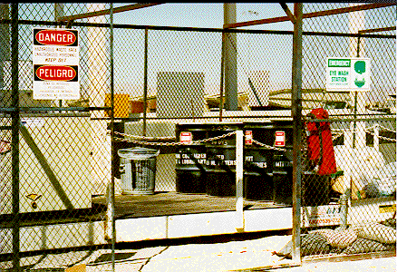
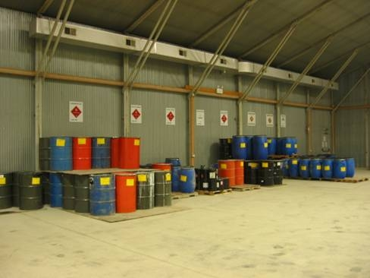
Good Hazardous Waste Storage
2017_ver 1.0
Good secondary containment, but should be labeled and covered
Well marked, fenced off. Good secondary containment,
protective gear handy
Wastes well marked, segregated; good overhead protection. Secondary containment could be better.
Notes:
14
In contrast to the previous slide, these next two slides illustrate improved storage for hazardous materials and hazardous wastes.
The three barrels are housed on a well-constructed secondary containment pallet. They should still be labeled and covered overhead, but this is at least a first step in improved storage procedures, and above all significantly reduces the chance of contaminating the ground.
Better still is the storage facility pictured on the right: it is well marked with warning labels and fenced off. The barrels are on a large secondary container pallet and they are appropriately marked. On the right side, there is protective gear available as well as an eyewash station in the event of exposure.
The lower left-hand picture shows barrels well labeled and segregated. There is fair-to-good secondary containment (in some cases, this is minimal, but it is also on a sealed floor rather than directly on top of soil). Finally, this example shows overhead protection (although more rudimentary protection from the elements is also acceptable).

Slide 15
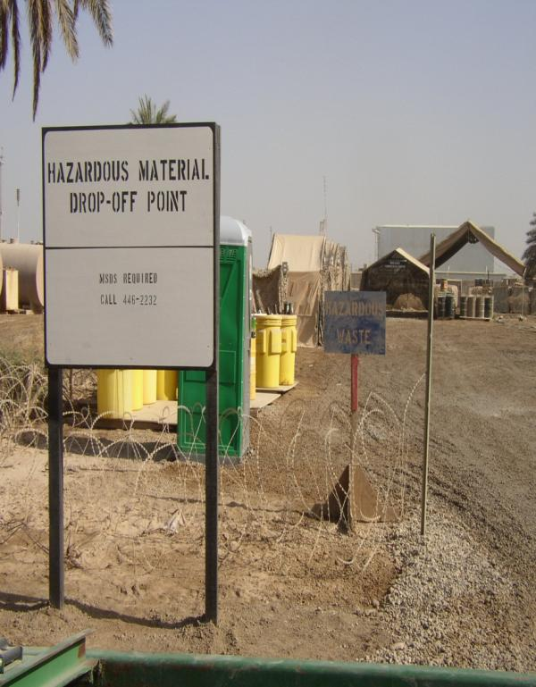
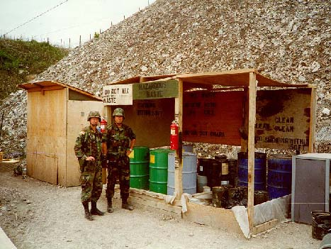
Good Hazardous Waste Storage
2017_ver 1.0
Low cost solutions offering good secondary containment, overhead protection, segregated and labeled.
Notes:
Here are other good examples of hazardous material collection points.
In the picture on the left, note that the sign stipulates the material must be documented (using data sheets) prior to being left here and whom to contact if that has not been done. The site has good secondary containment, overhead protection, segregated storage for different materials (which are labeled), and it is fenced off from other areas.
The picture on the right also shows proper labeling, good secondary containment, overhead protection, etc. It is also an example of what can be done without a lot of materials and labor.

Slide 16
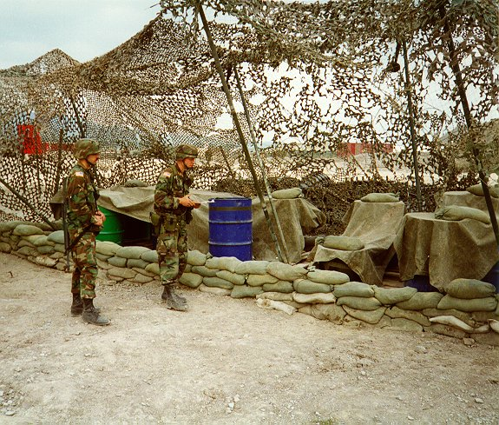
Good Hazardous Waste
Storage in Field Conditions
2017_ver 1.0
Tarps and sandbags as secondary containment, netting and tarps as overhead protection
Notes:
16
Obviously, out in the field, there are certain conditions under which troops cannot use manufactured secondary containment or more permanent overhead protection structures. This picture is a good illustration of hazardous waste storage using available materials: a combination of using a thick plastic tarp to serve as the “groundcover” under the barrels and the sandbags to contain (or minimize) the spread of any possible spill provides for secondary containment. The tarps, held in place by sandbags, and camouflage netting offer at least some protection from the elements. Different materials have to be segregated to avoid unexpected chemical reactions.

Slide 17

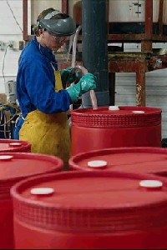
Good Hazardous
Material Handling
2017_ver 1.0
Use of protective clothing and equipment
Notes:
17
These pictures illustrate good practices in wearing appropriate clothing for hazardous tasks, such as decontamination gear (men in green suits) and protective clothing (including goggles/eyewear) when handling hazardous materials.

Slide 18
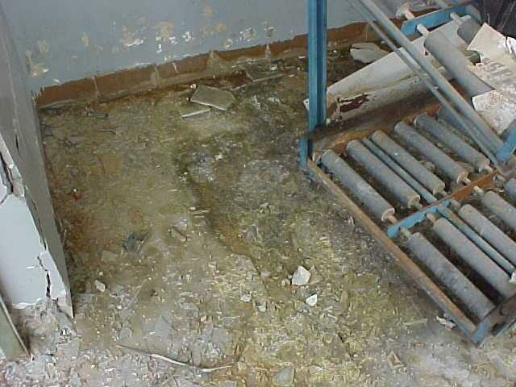
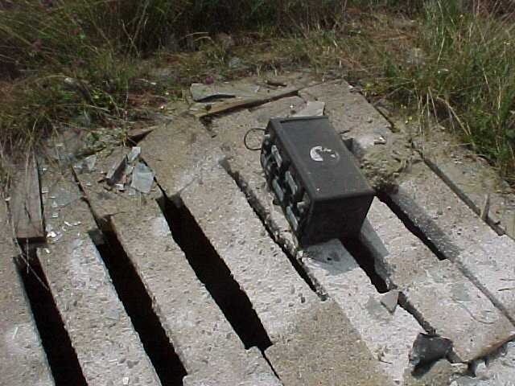
Bad Hazardous Material / Waste Storage (Battery Storage)
2017_ver 1.0
Batteries leaked acid, no secondary containment
Battery placed on top of crumbling storm water drain
Notes:
18
Improper storage of lead-containing batteries can cause serious health and environmental risks. The top picture shows the inside of a building where such batteries had been stored. The yellow stains on the floor are evidence that the batteries leaked acid and had not been placed on appropriate secondary containment structures. Hazardous waste must be clearly labeled and stored separate from other hazardous materials.
Even worse, the bottom picture shows a battery having been left on top of a crumbling concrete storm water drain. If the battery itself does not fall through the concrete into the water below, it is quite certain that the acid from the battery has done so and will continue to do so.
Proper storage of batteries includes appropriate secondary containment, labeling, and protection from the weather.

Slide 19
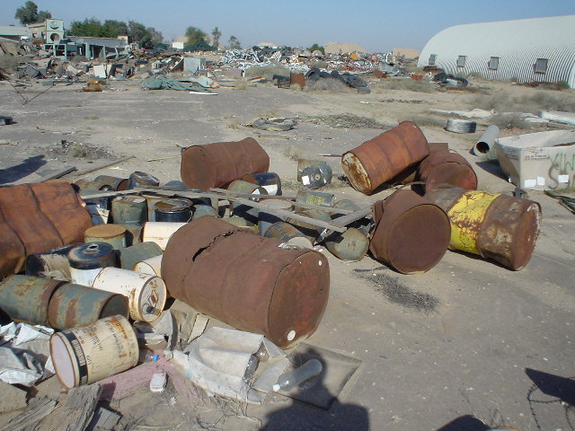
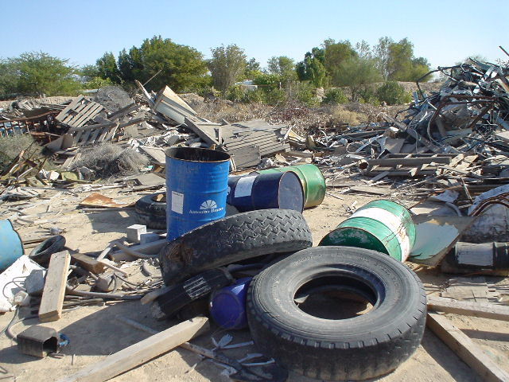
Bad Solid Waste Storage
2017_ver 1.0
Rusting and leaking containers
No segregation of materials
Notes:
19
These are clear examples of how you do NOT want waste to be disposed of. Rusting and leaking containers, no attempt at segregation of materials, and generally no plan at all. The stuff has just been DUMPED.

Slide 20
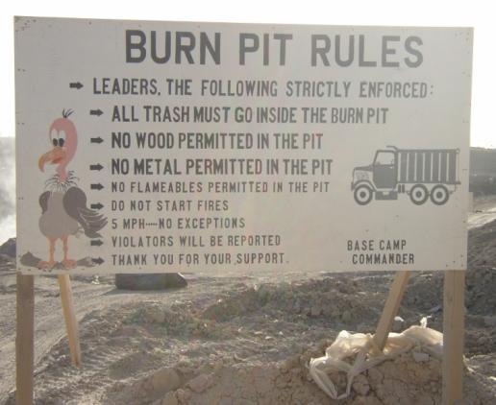
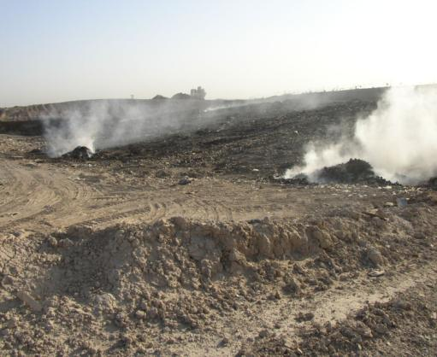
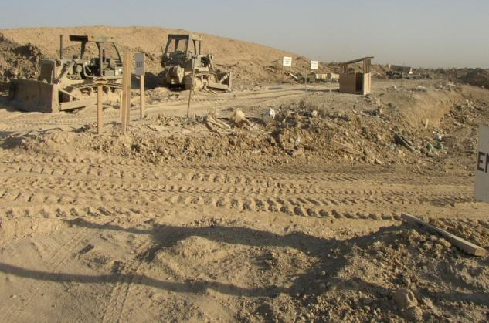
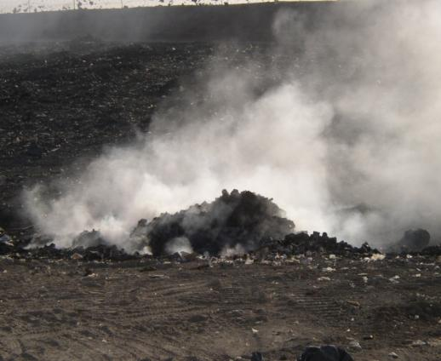
Solid Waste Disposal
2017_ver 1.0
Open burn pit often not preferred, but rules are appropriately posted
Notes:
20
While an open burn pit is often not the preferred method for the disposal of solid waste, if the operation requires this approach, this picture at least shows an appropriate posting of the rules to be followed in using the burn pit.

Slide 21

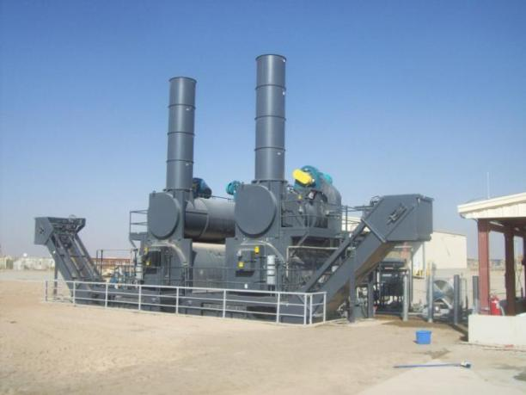
Incineration
2017_ver 1.0
Trash not contained in barrels or bags prior to disposal
Notes:
21
As an alternative to open burning, here are examples of the use of incinerators to dispose of solid waste.
For troops using an incinerator, trash should first be properly contained in barrels with covers or sealed bags (which was not done in the picture on the left). They should then be brought to the incinerator for disposal.

Slide 22
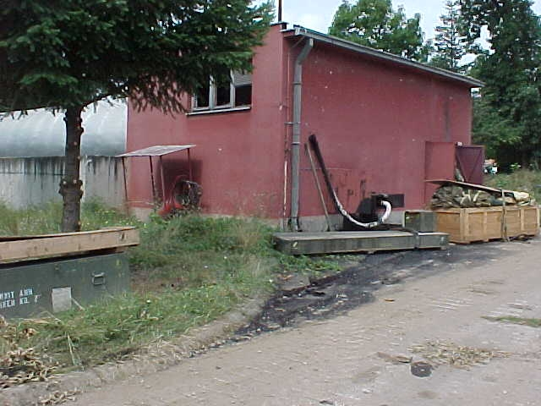
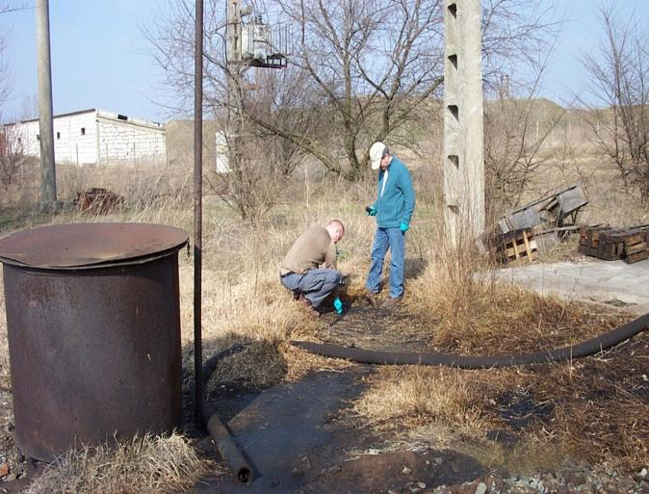
Bad Spill Containment
2017_ver 1.0
Oil leaking onto ground, no containment or clean-up
Oil contamination; taking samples to determine extent of contamination
Notes:
22
These two pictures show oil contamination on the ground. In the case on the left, the red building is a heating plant; the pipe coming out the back (and the ground underneath the pipe) shows that oil has been leaking into the ground and has not been contained or cleaned up.
The picture on the right shows oil contamination on the ground, coming out of the pipe. The two men are taking soil samples to determine the extent of the contamination.

Slide 23
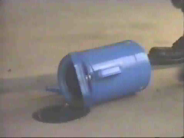
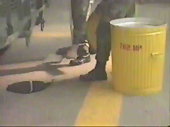

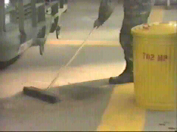
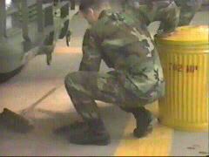
Good Spill Response Plan
2017_ver 1.0
Spill contained
Oil cleaned up using sand to absorb it
Sand placed in lidded container
Notes:
23
This series of pictures illustrates the proper execution of a spill response plan, in this case a spill of some oil. The spill is stopped (by picking up the blue container), contained, cleaned up (using sand to absorb it), the sand is then placed in a lidded container for appropriate subsequent disposal. However, instead of using sand as the absorbent material, there are more efficient industrial products (grains and granules) available.
Remember: used absorbent material is hazardous waste and must be disposed of as hazardous waste.

Slide 24
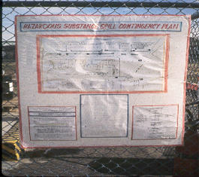
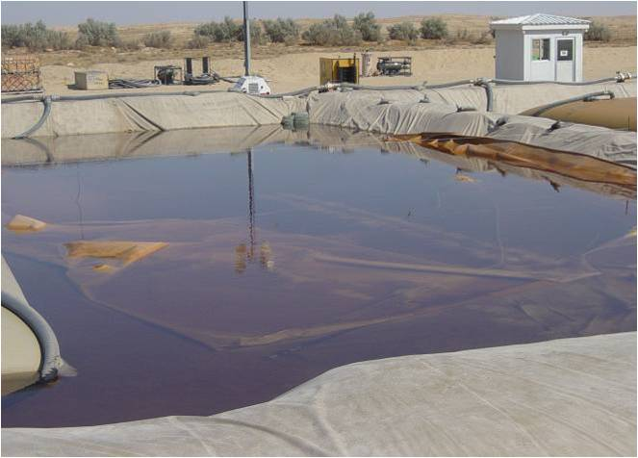
Good Spill Response Plan
2017_ver 1.0
Instructions posted in proper location, covered in plastic to protect it from weather
Intact bladder
Ruptured bladder
Good containment of oil spill—use of liner and raised sides
Notes:
24
While the details of the picture on the left are not very clear, it demonstrates a good practice of posting a contingency plan for a hazardous materials spill in a visible place just outside the hazardous materials collection area. The poster is (well) protected from the weather by a plastic covering. Ensure signage is written in host nation’s and contributing nations’ languages.
On the right is an example of a contained oil spill, which occurred as a result of a ruptured fuel bladder. It shows the use of a liner to prevent leakage into the ground and built-up walls around the pit to protect against spill-over.

Slide 25
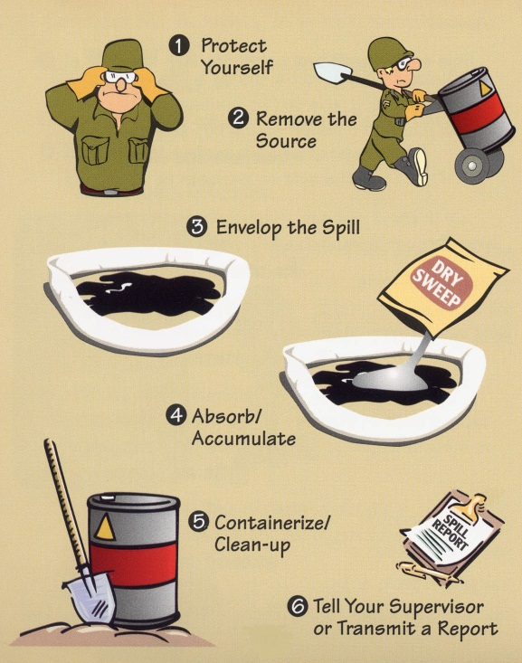
What to Do in Case of Spill or Leak?
2017_ver 1.0
REACT!
Remove the source
Envelop the spill
Absorb /Accumulate
Containerize / clean-up
Tell your supervisor or transmit a Report
Notes:
Here is a quick way to help you remember what to do in the event of a spill or leak. Above all, protect yourself! Safety is the first priority.
Do not respond unless trained. If you have been trained, it can be helpful to think of the word “REACT” and what each letter stands for:
Remove the Source: Determine how the source of the spill can be stopped to limit the amount spilled.
Envelop the spill: Circle the spill area with absorbent materials to stop the spread of the spill and to keep it from entering waterways.
Absorb/Accumulate: Use more absorbent material to soak up the spill from the spill area.
Containerize/clean-up: Collect the contaminated soil and absorbent materials and place in an appropriate container.
Tell your supervisor: Report what is spilled, where it occurred and what you did to respond to the spill. For intermediate or major spills, fill out a Spill Report Form. Report all incidents on the higher command network as well as to the Environmental Officer.
In short: REACT!

Slide 26
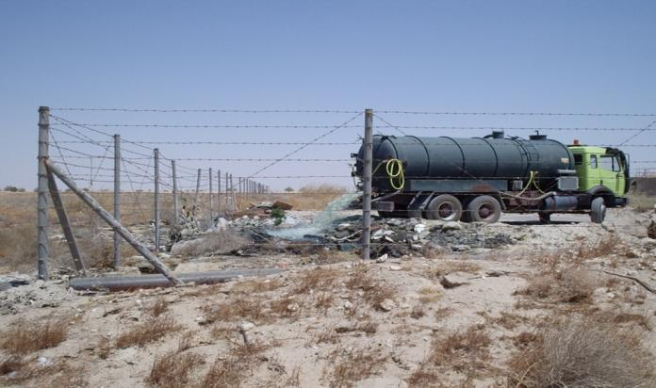
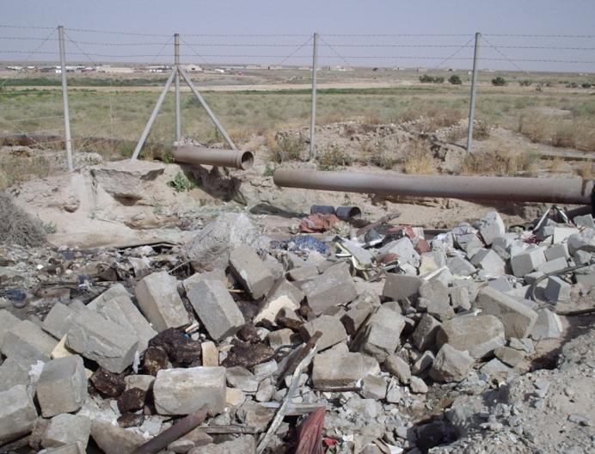
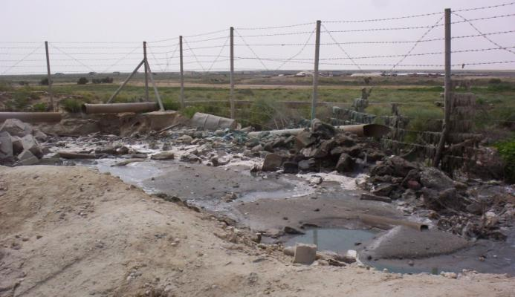
Bad Wastewater Disposal
2017_ver 1.0
Open dumping of wastewater
Broken waste water pipes
Resulting sewage discharge
Notes:
Improper handling of wastewater can pose health and environmental hazards for troops as well as the surrounding local community. On the left, you can see that pipes meant to manage wastewater flow have themselves broken apart.
As an “alternative,” (upper right) a truck is now simply dumping the wastewater onto the ground at the corner of the base. The (continuing) result of such sewerage discharge is evident in the picture below (lower right).
In cases where contractors are used, it is important to monitor their work to ensure performance work standards are met.

Slide 27
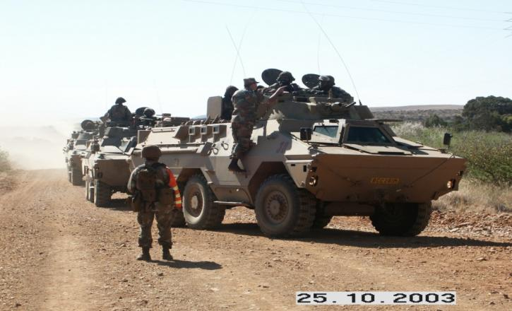
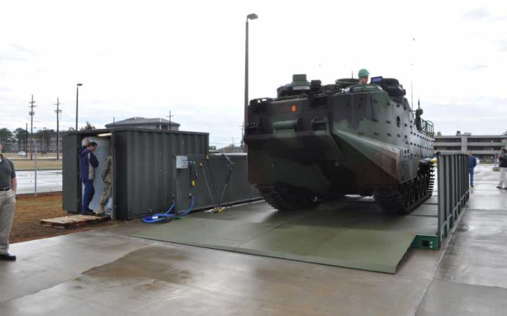
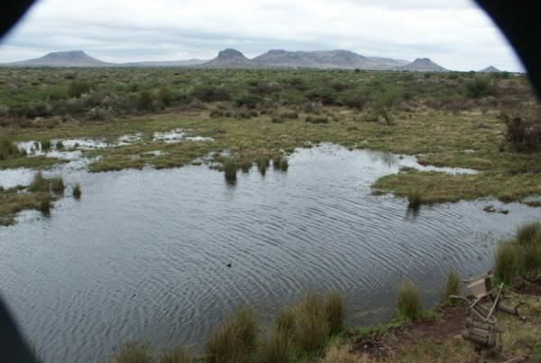
Proper Vehicle Procedures
2017_ver 1.0
Use only approved vehicle washracks
Drive on established roads, except when otherwise instructed
Don’t drive through wetlands
Notes:
27
During deployments (just as in exercises and training), it is important to drive on established roads (as shown on the left), except when instructed otherwise, because of safety considerations and because driving causes soil erosion.
Wetlands should not be driven through.
Vehicle maintenance, parking, and washing are allowed only in designated areas.

Slide 28
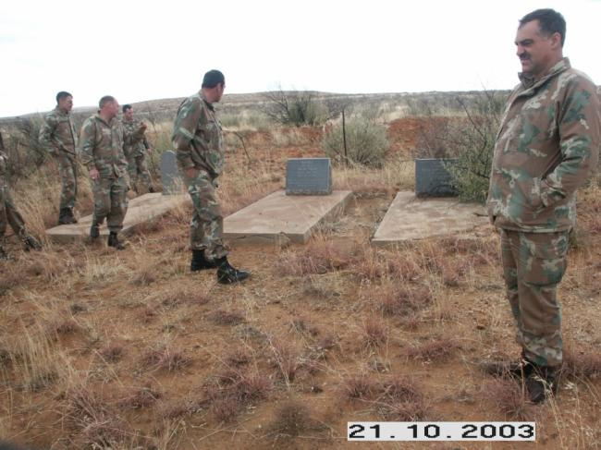
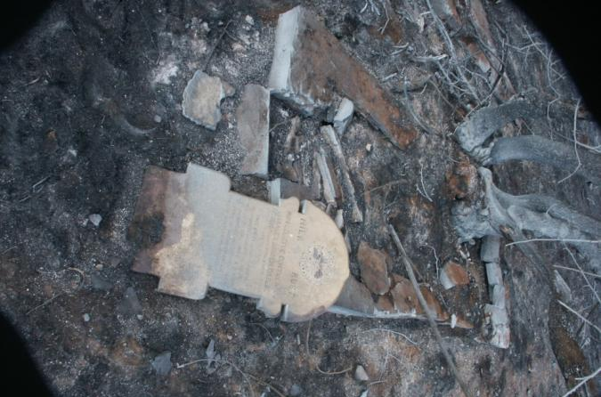
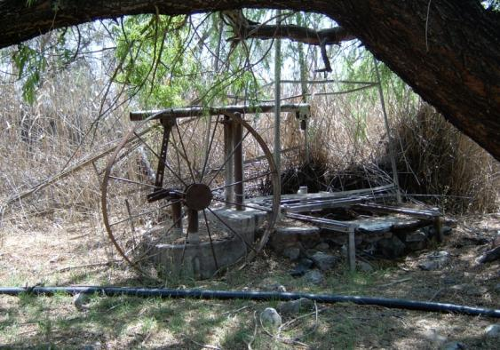
Cultural Property Protection
2017_ver 1.0
Damage done to burial site
Proper marking of burial site, old well
Notes:
28
The slide on the left shows damage done to a burial site by troops who did not follow guidance in terms of respect for cultural property.
The upper right-hand picture, in contrast shows a much greater appreciation by the troops for a burial site, marking its location so as to avoid entering the area during military activities.
While burial sites may be fairly easy to recognize and avoid, other cultural properties—such as this old well (bottom right)—are also important to be able to identify and avoid to the greatest extent possible.

Slide 29
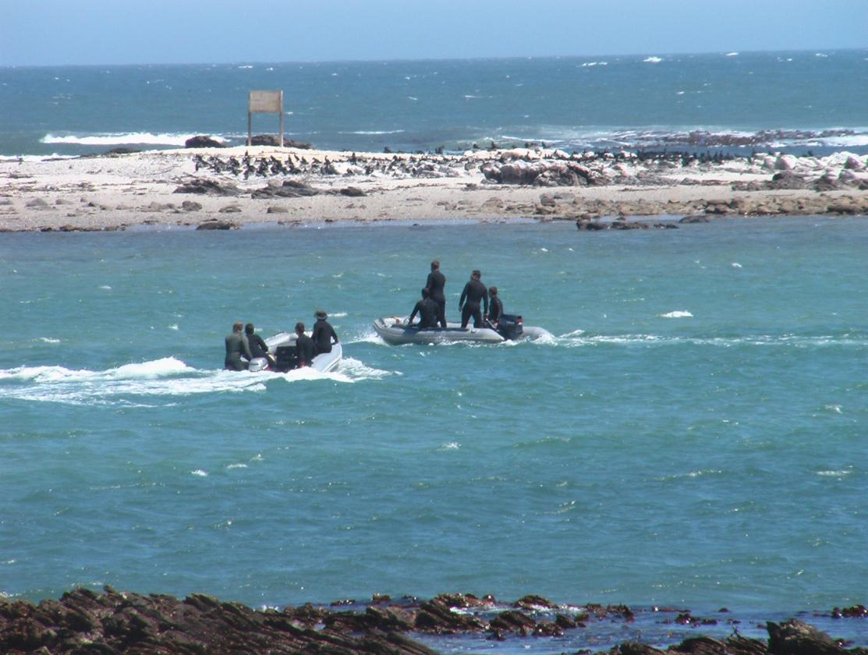
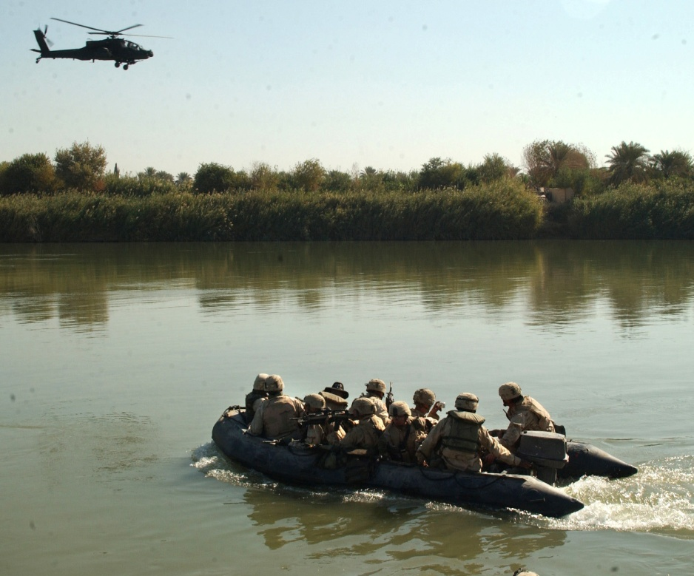
Natural Resource Protection
2017_ver 1.0
Notes:
29
Military operations can involve deployments to environmentally sensitive areas. Due care should be taken when operating in such areas.
In addition, one of the most important aspects of natural resource protection is analyzing the impact of military operations on natural resources. You need to consider the effects on the surrounding community when using natural resources, from water to forests to protected habitats.

Slide 30

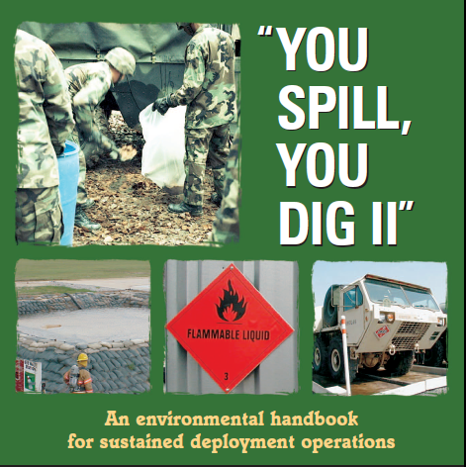
Handout Material, Instructions, Education
2017_ver 1.0
Notes:
These are samples of some of the informational aids that you might find useful. A more complete list and hyperlinks to them are in the ”Reference Module” section of this toolbox, under the ”Informational Aids” tab.
30

Slide 31
Conclusion
2017_ver 1.0
Your actions and awareness about energy and environmental considerations during the military operation will ensure your safety and health, proper execution of the mission, protection of the environment, and the wise use of resources
If you have concerns, comments or suggestions, be sure to let the appropriate people know
Notes:
31

