Slide 1
2017_ver 1.0

Slide 2
General Awareness Training Module
2017_ver 1.0
Environmental Officer and Energy Manager

Slide 3
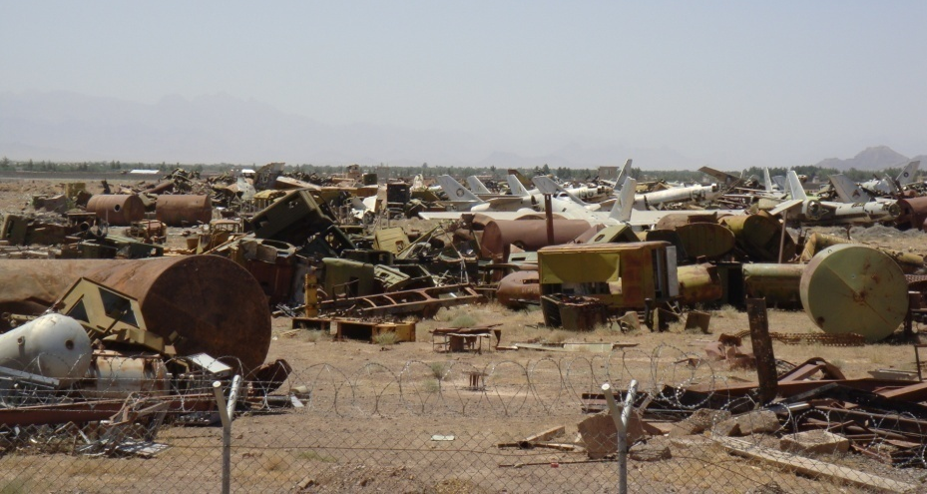
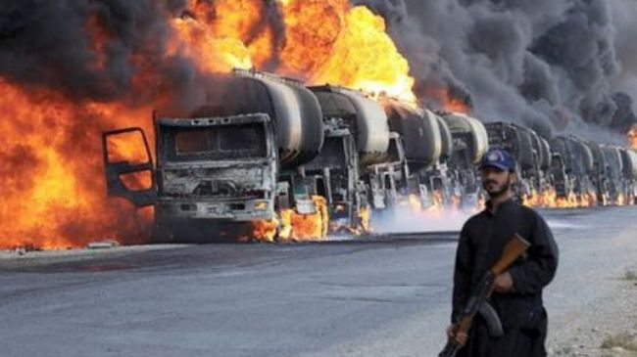
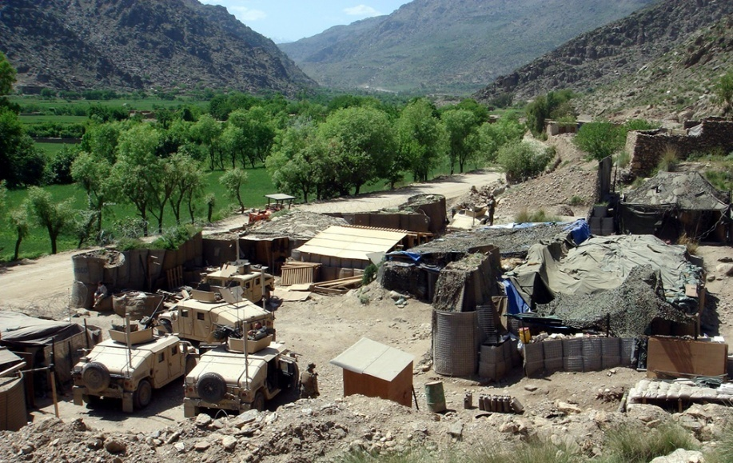
Environmental and Energy Considerations for Military Operations
2017_ver 1.0
Sound environmental and energy management during military operations enables the mission by enhancing force protection and reducing the logistical burden on the force
Notes:
Environmental and energy considerations comprise a broad spectrum of issues that require integration into the every day lives of all service members. They do not go away or become unimportant to consider because we are involved in operations. Environmental and energy considerations require integration into all phases of operations, from training to planning to execution. In fact, planning for environmental and energy issues should enhance operational capabilities and security.
There is an increasing appreciation for the interdependence between the military mission, the community, and the environment. As an environmental officer (EO) and/or Energy Manager (EnM), you are the primary action officer for integrating environmental and energy considerations, respectively, in military operations. Pursuing sound environmental and energy management practices during military operations helps support the mission, enhances force protection (the safety and security of our troops), and reduces logistical requirements. Because we ultimately perform in operations based on what we have done in training, these training materials are designed to enhance your knowledge of what is expected of the EO and EnM, the resources you have to draw upon, and the importance of the job you do.
The picture on the right illustrates the logistic burden and force protection requirements of delivering supplies to conflict areas. On the left, we see what can happen when there is a lack of sound environmental management practices. In the foreground is an example of a base camp meeting mission requirements, while seamlessly integrating into the surrounding environment. Importantly, environmental and energy considerations can help to ease the logistical burden and reduce force protection requirements.

Slide 4
Overview of This Briefing
2017_ver 1.0
Objectives of the Environmental Officer and Energy Manager
Why environmental considerations matter
Environmental Officer and Energy Manager responsibilities during:
  Planning, pre-deployment
  Deployment
  Rotation of forces
  Redeployment, post-deployment
Examples of good and bad environmental practices
Listing of technical modules on specific topics
Notes:
These topics outline the important points of this briefing.

Slide 5
Definitions
2017_ver 1.0
Environmental Considerations in Operations (ECOps) are measures or processes put in place to avoid or minimize potentially adverse environmental impacts during military operations.
Energy Considerations in Operations (EnCOps) are measures or processes put in place to decrease energy consumption and improve energy efficiency during military operations.
Focus areas addressed in the toolbox:
  Solid waste management
  Hazardous material and hazardous waste management
  Water and wastewater management
  Spill prevention and response planning
  Natural resource and cultural property protection
  Energy considerations
ECOps and EnCOps help you to use your resources in a sustainable manner to better support the mission
Notes:
The aims of Environmental Considerations are to:
avoid or minimize potentially adverse environmental impacts during military operations
enable advance planning instead of having to continuously intervene to mitigate impacts during the operation; this also helps ensure the future environmental viability of the host nation
mitigate and/or avoid pre-existing environmental contamination that may negatively impact the force or the mission
The aims of Energy Considerations are to:
use less energy to provide the same service
systematically achieve better energy efficiency and mission sustainability through technical solutions and by enhancing energy awareness and behavioral practices
“Environmental Considerations in Operations (ECOps)” covers a broad range of issues. The focus areas addressed in this toolbox are:
Solid waste/hazardous material/hazardous waste management. Operations require a lot of material and generate large quantities of waste. Proper management of material and waste helps to minimize environmental pollution, protect health, and conserve resources and funding. For example, it is important to properly handle and store hazardous material or waste that is used when maintaining vehicles.
Water and wastewater management. Water is used in many aspects of an operation. It is necessary for drinking, personal hygiene, cleaning equipment, etc. Often operations occur in areas with limited water resources and water must be transported to military operations. Proper management of water and wastewater helps to ensure we have safe drinking water, reduces transportation requirements, and protects soldiers from diseases resulting from improper wastewater management.
Spill Prevention and Response Planning. Spills of petroleum, oils and lubricants (POL) and hazardous materials may occur during routine operations. Establishing preventive measures and ensuring that personnel know their roles and responsibilities for spill response helps to minimize exposure of personnel to hazards and the impacts of spills on the environment. Personnel must be able to act in the case of a spill.
Natural resource and cultural property protection. It is important for deploying forces to be respectful of historic sites, buildings, archeological sites, natural resources, wildlife and habitats that are important to the host nation. This helps to foster good relations with local populations and the host nation.
Energy is another important consideration, but addressing all aspects of energy conservation and use could constitute a whole separate toolbox. As general guidelines, remember to use energy sustainably and responsibly. Energy consumption, supplies and availability is usually critical for the operation. Energy use is also a financial and environmental issue, so avoid unnecessary energy use.
Focus areas of the “Energy Considerations in Operations (EnCOps)” in the toolbox are:
planning considerations for optimal energy management
energy use in military operations
energy production, storage, and distribution
energy efficiency practices

Slide 6
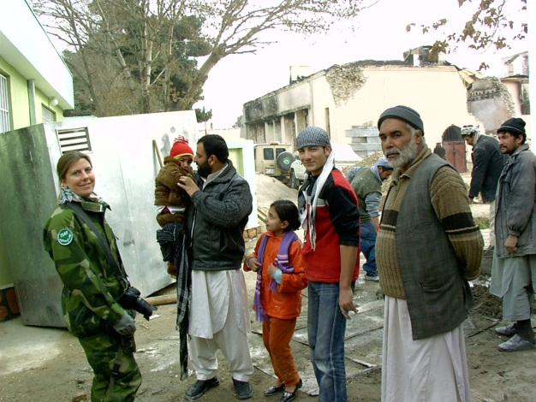
ECOps and EnCOps as a Force Multiplier
2017_ver 1.0
Enhances force protection
  Protects soldier health
  Reduces risk to supply convoys
Reduces logistical requirements and costs
Reduces legal and financial liability
Increases operational resilience
Promotes sustainability
  For the current mission
  For future deployments
  For the host nation
Potential geopolitical impacts
Wins hearts and minds
Notes:
There are a number of reasons why it is important to think about environmental and energy considerations.
Force Protection (Safety and Health of Forces)
Planning for energy and environmental considerations prior to force deployment can help protect the safety and health of the troops. For example, it can help ensure troops are housed away from contaminated areas. Energy and environmental considerations also help to reduce military supply demands, therefore reducing the risk troops face when conducting supply convoys.
Logistical, Financial and Legal Implications
Recent operations have shown that approximately 70% of logistic movement by weight is fuel and water. Environmental and energy considerations help to reduce the demand of these resources, which in turn help to decrease the overall cost of the mission.
Environmental damage requires money and man-hours to rehabilitate; this is money and manpower that could be used elsewhere in the operation. Failure to prevent or repair damage could result in unanticipated liabilities, both legal and political.
Poor environmental and energy preparation can increase resource costs. For example, it costs money to clean up the waste generated by a leaking fuel tanker as well as the cost of the spilled fuel itself. Energy supplies that are poorly managed means more energy must be delivered to the deployed location.
Sustainable use of the environment is important for several different reasons:
so that the current mission can continue (impacts to current operations are avoided)
so that future deployments can occur in the same areas; this depends on proper environmental care during the current deployment
so that the host nation can use the area after operations have ceased
When implementing environmental and energy considerations, you should consider possible environmental impacts on the geopolitical situation such as:
Environmental local resources as a cause of conflict, e.g., vying for access to water resources and agricultural land as well as host nation-supported electricity
Environmental threats, e.g., destruction of natural resources, contaminated farms lands, etc. could stress the economy
National strategic assets and security interests where implementation of considerations should be cognizant of the host nation’s resources and populace
When proper consideration is given, this can help win the hearts and minds of the local population by showing them that you respect host nation values and resources. All of this contributes to making a positive impact on psychological operations (PSYOPS).
In the end, by doing things like reducing demand (of water, packaging, energy, etc.), and reusing and recycling resources and equipment, you will be helping to improve the safety and security of yourself and your fellow troops.

Slide 7
Objectives of the Environmental
Officer and Energy Manager
2017_ver 1.0
Integrate ECOps and EnCOps into plans and procedures within the camp
Advocate for and execute ECOps and EnCOps at the tactical level
Assist the commander in mission accomplishment by
  sustaining readiness and supporting mission execution
  protecting the safety and health of deploying troops, host nation troops, civilian personnel, and local nationals
  facilitating coalition and international cooperation and interoperability
  ensuring legal compliance
  strengthening civil relations, and
  promoting efficient use of and conservation of valuable natural resources
Ensure sufficient environmental and energy training
Notes:
This briefing focuses on the integration of environmental and energy considerations in base camp operations, from the planning and pre-deployment stages through post-deployment. The integration and application of environmental and energy values into the military mission serve as a force multiplier.
As the environmental officer (EO) and/or energy manager (EnM), you will work with your commander to effectively integrate environmental and energy considerations into operations at the tactical level. In short, you will be the “eyes and ears” of the commander by identifying environmental and energy issues that impact your mission and developing practices and procedures that support mission accomplishment.
EOs and EnMs are also responsible for conducting training on environmental and energy matters.

Slide 8
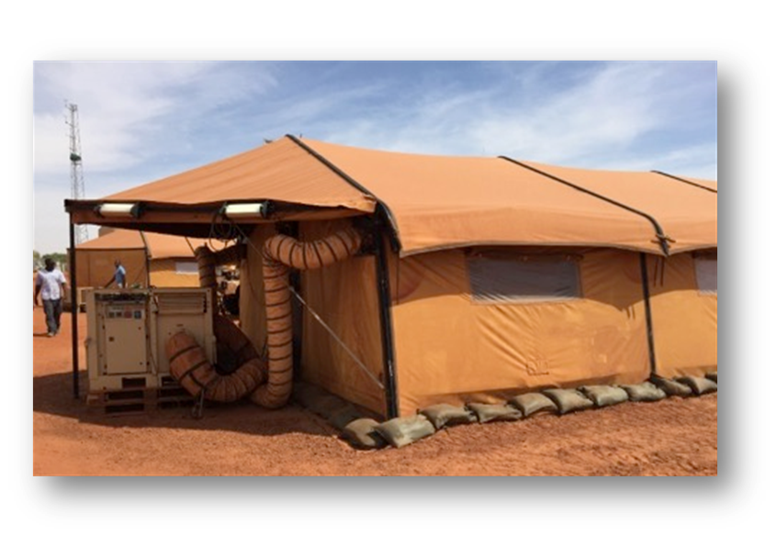
Energy Facts: Why Does Energy Matter?
2017_ver 1.0
Two thirds of the fuel that a conventional diesel generator burns is blown out as heat. Only one third is converted into electricity.
In a typical military camp, 60-70% of fuel is used to produce electricity to heat/cool water or air.
Advanced technology and higher standards of living in camps have led to increased energy demand.
Examples from Afghanistan:
      For each gallon of fuel used at a facility, up to 4 gallons were consumed during transport.
      The fully burdened cost of fuel can exceed 90€ per liter.
      On average, there has been one casualty for every 24 fuel resupply convoys.
Notes:
This and the next slide highlight the importance of operational energy and show ways to conserve energy in every-day life at a camp.
For general information about military energy use, see for example, US Army, “The Power Is in Your Hands,” https://www.army.mil/e2/c/downloads/316462.pdf.
Information about Afghanistan is drawn from several sources, including: http://www.natolibguides.info/smartenergy and http://www.nationaldefensemagazine.org/archive/2010/April/Pages/HowMuchforaGallonofGas.aspx and https://protonex.com/blog/iraq-and-afghanistan-the-hidden-cost-of-fuel-convoys.

Slide 9
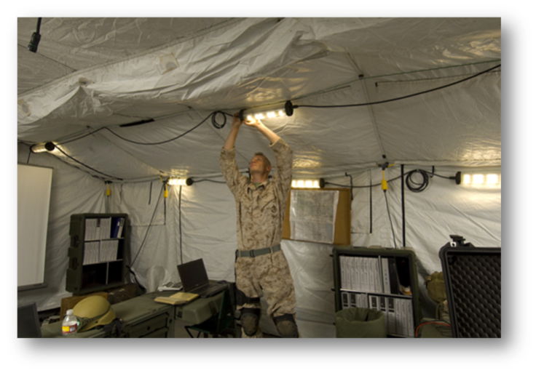
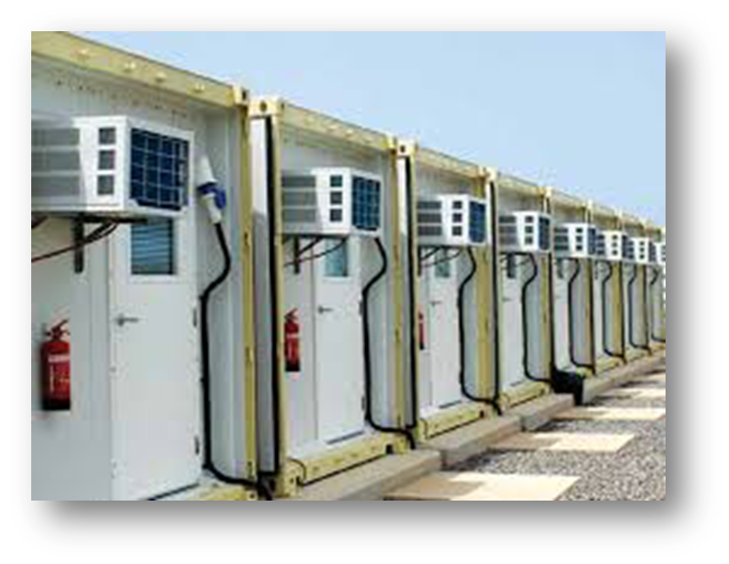
What Can You Do to Save Energy?
2017_ver 1.0
Keep doors and windows closed to prevent the loss of cooled or heated air.
Eliminate unnecessary vehicle use and idling.
Use power management settings on computers and turn off lights when not needed.
Use natural lightning when possible.
Ensure dishwashing and laundry machines are full before being operated.
Take shorter showers.
Turn off the tap when brushing teeth or shaving.
Notes:
Remember: resource conservation is ALSO energy conservation. It takes energy to move resources to where you are!
If available, use high-efficiency lighting such as LEDs or compact fluorescence lights.

Slide 10
Environmental Laws and Regulations
2017_ver 1.0
International laws and treaties
Agreements pertaining to deploying forces such as Status of Forces Agreements (SOFAs)
Own nation’s laws
Host nation laws
UN, NATO, EU, or coalition command standards – who controls the space?
Mission regulations
Compare and understand what governs the current operation.
Be prepared to implement the highest applicable environmental standard.
Notes:
As an environmental officer, you must work with your legal staff to determine applicable international treaties, your nation’s laws, host nation law, international or coalition laws or standards, or mission regulations that pertain to your operations. For international treaties or protocols such as the Basel Convention or the Kyoto Protocol, even if your country has not signed and ratified the agreement, the country you are deployed in may have done so, and this could impact your mission. Usually the most stringent regulations apply, if feasible and practical for the operation. EOs should keep in close communication with the legal office to ensure an understanding of all applicable treaties, laws, regulations, and standards.

Slide 11
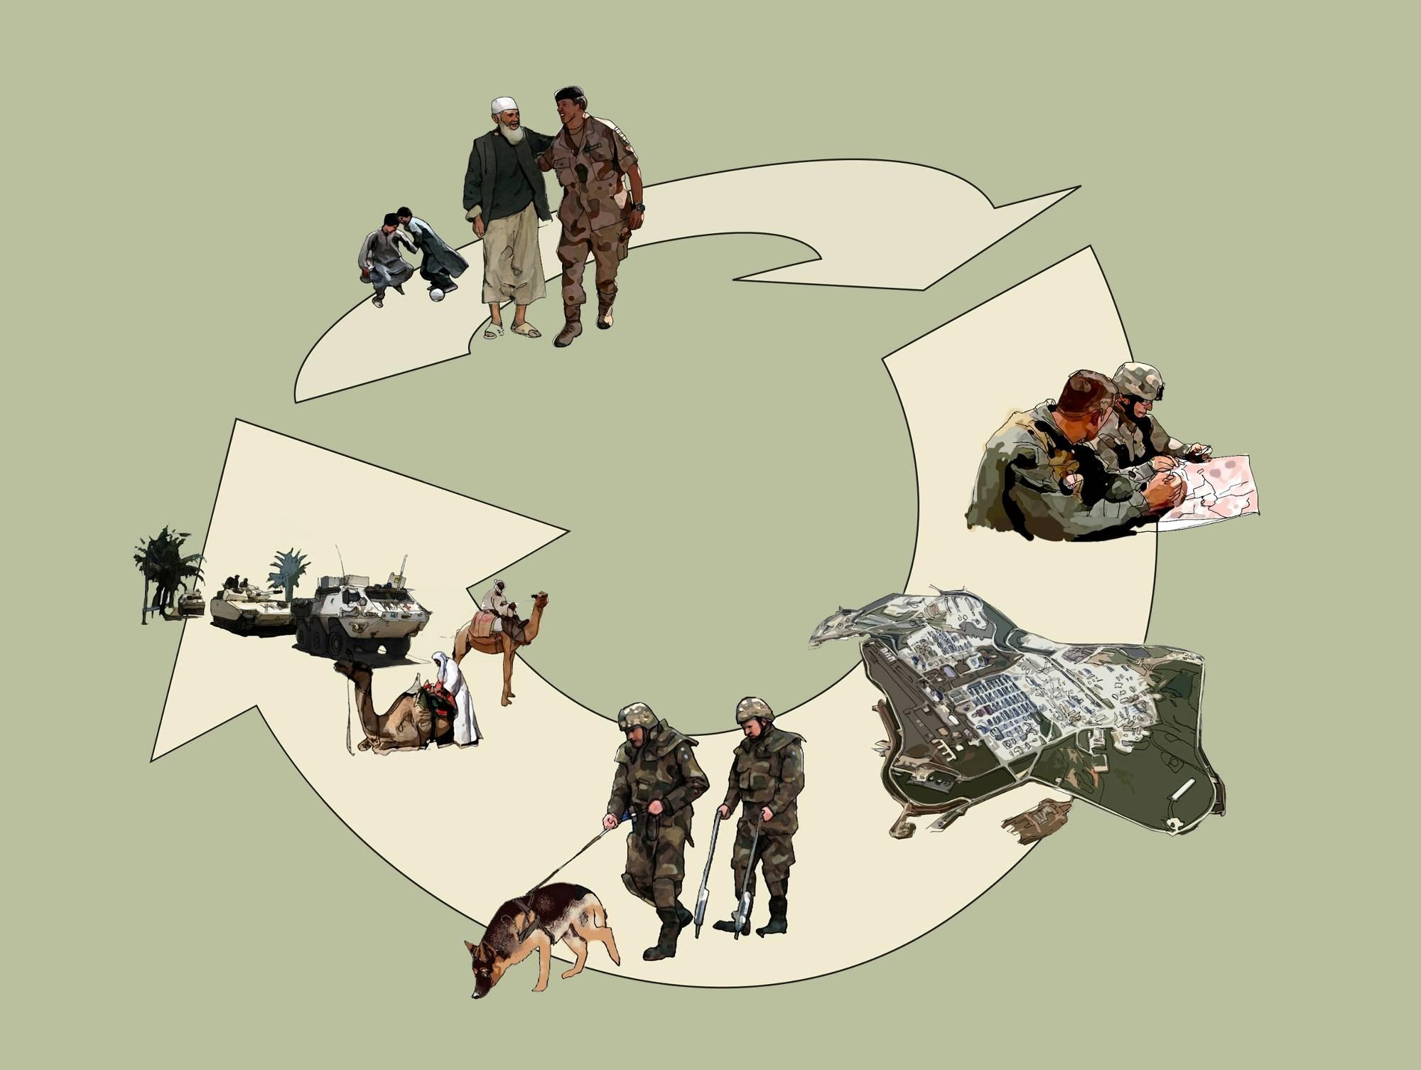
ECOps and EnCOps in the Life Cycle of Military Operations
2017_ver 1.0
Lessons Learned
Planning
Post-deployment
Pre-deployment
Re-deployment
Rotation
Deployment
Notes:
At each stage of the life cycle process, there are environmental and energy requirements and responsibilities at different levels of the command structure, from the highest strategic planning to the daily responsibilities of every soldier.
The environmental officer and energy manager have important roles to play in all stages of this life cycle. The following slides outline the roles for the EO and EnM to play in each of these stages.

Slide 12
Strategic Level Planning
2017_ver 1.0
  The Operation Plan (OPLAN) should contain an environmental annex. It should be based on an analysis of:
  The legal framework
  Critical environmental aspects that could constrain the effective achievement of the mission
  Critical environmental aspects that could affect force protection or increase financial risks
The EO must be familiar with this environmental guidance to incorporate into pre-deployment planning
  Energy Management issues need to be considered and integrated into all relevant parts of the OPLAN
  Pre-deployment planning will determine how energy efficient the operation will be
  An energy management plan should be developed as early as possible in the planning process
Notes:
Once a decision has been made that a military operation will be conducted, one part of an initial analysis should be environmental considerations that contribute to a successful mission. This analysis enables informed decisions to be made within the required timeframe.
There can be environmental factors that negatively affect the mission (e.g., different climate and terrain than the deploying forces are used to), that can affect the well-being of the forces (e.g., the presence of exotic diseases), and that can increase the cost of the mission (e.g., having to contract for waste management because of inadequate local infrastructure). All of these aspects, as well as the relevant legal framework, need to be identified and assessed. In short, the full range of these factors should be taken into consideration even at this initial planning stage.
This informed decision is formalized in the environmental annex of the OPLAN.
From an energy perspective, the planning/pre-deployment stage is when decisions are made that will determine how energy efficient the operation will be.
The energy management plan should be part of the OPLAN and should include at least:
Energy use profile (baseline assessment of energy needs): where, how much, timing
Energy production and distribution (energy budget/target, energy usage)
Resources needed and possible alternative energy sources and configurations
Responsible personnel
Monitoring plan for energy use

Slide 13
Pre-Deployment
2017_ver 1.0
When your unit is the initial entry unit
  Include environmental capability in recce/advance party
  Conduct Environmental Baseline Survey (EBS). This influences site selection, camp layout, feasible environmental systems
  Understand mission, duration, population, quality of life. This determines environmental and energy systems that will be implemented
When your unit assumes responsibility from a previous unit
  Review EBS
  Review master plan, standard operating procedures (SOPs) for both energy and environment
  Review relevant contracts and existing documentation
  Review intelligence reports
You should ensure all forces are informed about
their environmental and energy responsibilities
Notes:
If your unit is the initial entry unit, your decisions can have a major impact on health, environment, and the mission. Consider whether your recce/advance party has the environmental knowledge and skills to identify environmental areas of concerns or issues that may impact the mission or health of personnel. Information from an environmental health site assessment (EHSA) can be useful for the Environmental Baseline Survey (EBS).
Determine what knowledge is already available about environmental conditions (“environmental intelligence”) and establish a complete EBS, demarcating environmentally sensitive areas on maps. This information should be provided to the command as an input concerning where and how to site the camp. If an EBS has been conducted, check to see that it is accurate and current.
Environmental intelligence can include information from the following: classified and unclassified sources, “on the ground” observations (human intelligence), satellite imagery and analysis, government and non-government websites, reports, documents (from your own country and the host nation). This intelligence improves and becomes more in-depth as the operation develops. The intelligence and preventive medicine staffs can often assist in gathering environmental intelligence.
Information from the EBS and environmental intelligence can also help inform energy-related decisions. For example, the amount of sunlight, temperatures and average wind conditions can help shape decisions on building siting, potential use of renewable energy, etc.
For the longer term, the EO and EnM should establish liaison and coordinating mechanisms so that environmental and energy information is constantly updated. The status of existing and new environmental- and energy-related contracts must be tracked and efficient contract management established.
Understand that the selection of environmental and energy systems to be implemented depends on the mission, duration, population, and quality of life. For example, for a base that will only last for a few days, rudimentary and simple systems such as basic field sanitation methods may be the best choice. For longer durations, more complex systems with durability, capacity, and efficiency would be more optimal. The technical presentations in this toolbox describe a range of these options. It is important to verify what is needed in terms of environmental supplies and equipment and vehicle-specific equipment (e.g., drip trays, spill kits), availability of record keeping documentation, environmental-related permits and licenses (beach landing, border crossing, port entry, etc.) as well as requirements in terms of decontamination of vehicles and equipment.
If your unit assumes responsibility from another unit, be sure to communicate with the previous unit and review their documentation, to include issues such as energy usage and spill incidents. Determine what has been working effectively and what needs improvement.

Slide 14
Pre-Deployment
2017_ver 1.0
Plan for your end state: will base be closed/transferred or rotated with replacement unit?
Plan for surges or drawdowns
  Flexible systems
  Scalable for changes in mission
Obtain information about the host country and local community from your own government or open sources
  Friendly country or hostile? This affects force protection and security requirements
  Existing infrastructure for military use
  Local materials, methods
  Technical skills labor pool
  Community relations, economic impact
Understand and respect local cultural as well as environmental and energy norms and conditions
Notes:
Planning should cover the life-cycle of the base camp. “Backward planning” considers what your end state will be and determines the milestones and schedule to reach that end state.
Planning should also consider surges and drawdowns due to changes in mission. For example, during the relief in place/transfer of authority, there may be a temporary surge in population resulting in increased resource requirements.
Information regarding the host nation and local community can help to make decisions on the environmental and energy considerations required or that are feasible. For example, if the host nation has potable water available in quantities that will not negatively impact their water usage, you will not need to use water purification equipment, drill wells, or truck water to the camp. Also, local populations can provide information on locally available materials or methods. This can help to reduce transportation costs for things such as building materials and can also ensure that any infrastructure you may renovate or build could be used by the host nation after the mission is completed. It is important to demonstrate an understanding and respect for local culture, customs, practices, as well as environmental and energy conditions. All of this can contribute to good relations with the local community and have a favorable economic impact.

Slide 15
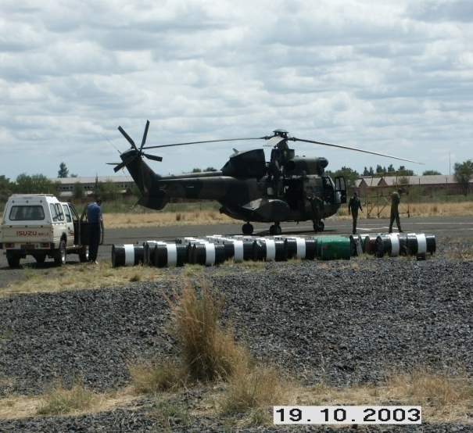

Pre-Deployment
2017_ver 1.0
Training
Mission-specific pre-deployment training should include relevant environmental and energy aspects
Mission-specific environmental and energy skills training (including on equipment) for personnel required to execute specific environmental and energy duties, including reporting procedures
During the movement of forces, consider:
Risk and impact management
Trans-boundary transportation of hazardous material (HM) and hazardous waste (HW)
Safe handling of HM and HW during movement
Incident reporting procedures
See task check-list at the end of this module
Notes:
Environmental and energy training should be conducted for all deploying personnel; additional training should be provided to those with specific environmental responsibilities.
Mission-specific pre-deployment training. An informed force is a strong force and environmental and energy awareness material should be included in the pre-deployment training package. Pre-deployment training is the mission-specific training given to all participating service members and should include relevant environmental and energy aspects identified in the planning process. This information is derived from the environmental annex of the Operations Order and SOPs. Cross-referencing the environmental and energy functions in relation to other functions during planning can strengthen the integration of ECOps and EnCOps.
Mission-specific environmental and energy skills training. There is additional training for leaders and service members requiring environmental and energy skills to execute specific duties, including reporting procedures. This may include training on newly acquired equipment. Mission readiness and levels of training should be evaluated and forces re-trained to meet required standards. Re-training can take place as a formal process or simply to address only areas that need improvement, depending on time frame and limitations.
During the movement of forces, there are several important environmental considerations that need to be planned for and executed.
Risk and impact management. Mass movements of troops unavoidably have larger impacts on the environment and carry greater environmental and financial risks. It is important to avoid or minimize adverse impacts on the environment during movement of forces by pre-planning staging and fuelling areas, and developing contingency plans for spills along the route.
Trans-boundary transportation of hazardous material (HM) and hazardous waste (HW). Ensure proper monitoring of movement according to international agreements in terms of permits/authority, etc. There is additional detailed discussion of HM and HW in the technical section of this toolbox.
Safe handling of HM and HW. It is important to ensure that different types of materials can be safely transported together.
Reporting procedures in terms of contingencies. Procedures have to be made known to all members and included in the Contingency Plans for all transportation and movement operations.

Slide 16
Deployment
2017_ver 1.0
Complete a detailed EBS at the specific site selected
Develop detailed planning for day-to-day operations and requirements of the base
  Solid waste management
  Hazardous material and hazardous waste management
  Water and wastewater management
  Spill prevention and response planning
  Natural resource and cultural property protection
  Energy usage
Create situation-driven plans and SOPs, which can make up an overall environmental and energy management plan
Facilitate the Energy and Environmental Management Board (EEMB)
Update environmental intelligence
Notes:
Each of the tasks listed on this and the next slide is a vital contribution by the EO and EnM to the overall success of the mission. For example, the inputs from the EO and EnM about proper base layout (taking into consideration location of water sources, ensuring latrines are placed an adequate distance from food supplies, storing hazardous wastes far from living quarters, making maximum energy use of the natural environment when siting buildings, etc.) will help ensure the safety and security of the troops. As another example, helping ensure contracts are properly executed can help prevent future liabilities.
During the deployment phase, information needs to be updated and new action plans should be adapted and revised (as additional environmental intelligence becomes available). Plans and procedures must be implemented and constantly reviewed in accordance with new findings, incidents, and risk assessments. All amendments must be included in the energy and environmental awareness program to ensure a high level of awareness is maintained by all the forces.
• Detailed EBS. A complete, detailed EBS is done once the specific site for the deploying force has been determined, but (ideally) before the base is established. If not completed before site occupation, conduct as quickly as practicable.
• Detailed planning. A suitably experienced EO and EnM must continue to participate in detailed planning to ensure environmental and energy considerations are included in day-to-day operations and requirements of the base. Examples of these are: resources required, base layout and mapping, record keeping, inventory, transport and logistic systems, responsibilities and delegation of responsibilities, and identification of ECOps and EnCOps requirements in the budget. This slide lists the main categories of environmental and energy management on the base.
• Situation-driven plans. Existing management plans and SOPs are not always ideally suited for the specific situation; plans and procedures should be adapted according to available capacity/capabilities. It is important to ensure that plans are established and in place as SOPs, including detail on tasking and responsibilities in terms of pollution, waste, HM, use of resources and protection of environmental resources (including natural and cultural resources).
Energy and Environmental Management Board –Although the commander is the chair, the EO and EnM have the responsibility of facilitating the EEMB meetings for the chair.
Environmental intelligence – the continuous collection of essential elements of information related to environmental considerations (with potential implications for energy usage) is used to update the EBS(s).

Slide 17
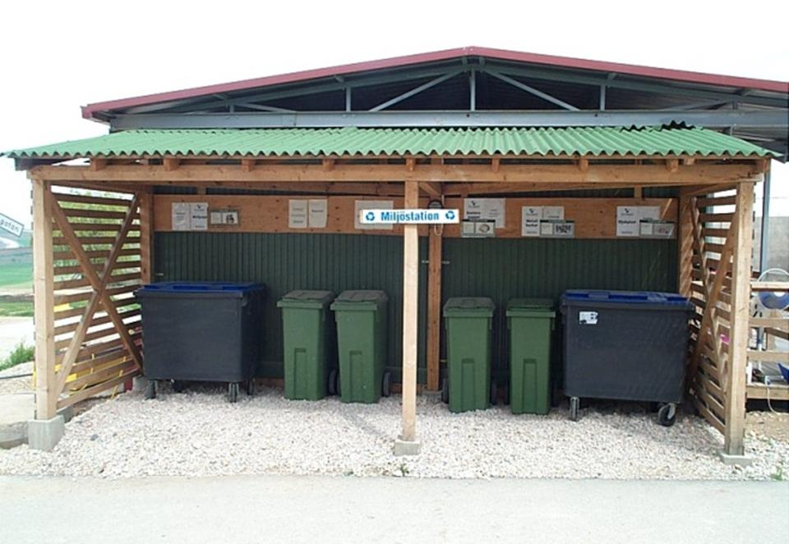
Deployment
2017_ver 1.0
Provide input for infrastructure
Help manage contracts
Implement and document plans and procedures
Provide training, enhance environmental and energy awareness
Monitor environmental and energy status
Ensure proper disposition of waste and excess materials
Test contingency plans
See task check-list at end of this module
Notes:
Provide input to the establishment and maintenance of infrastructure – oversee and coordinate base layout to ensure proper storage area(s), most energy-efficient building siting, waste collection points, mess facilities, and refuelling points
Help manage contracts – the EO and EnM support the contract officer by ensuring environmental and energy requirements are incorporated into contracts and contract obligations are being met (for example – conducting quality assurance to ensure the waste goes to the correct disposal point)
Implement plans and procedures –the EO and EnM must physically put plans into action, revise the plans to fit the situation, and continuously review and train personnel
Monitor environmental and energy status – the EO must continuously update the EBS using checklists, sampling, and the creation of a corrective action plan for non-conformance regarding contract compliance, HM status, waste streams and record keeping. The EnM must track energy usage, document the results of efficiency initiatives (including return on investment), etc.
Ensure proper disposition of waste and excess materials – Proper disposition can include turning excess materials over to the host nations, leaving materials for a replacement units, or utilizing return transport (shipping, trucks, and aircraft) to return excess, redundant materials waste to the point of ultimate disposal
Test Contingency Plans – a good plan is not enough; like any military plan, environmental and energy contingency plans must be exercised to make sure they work

Slide 18
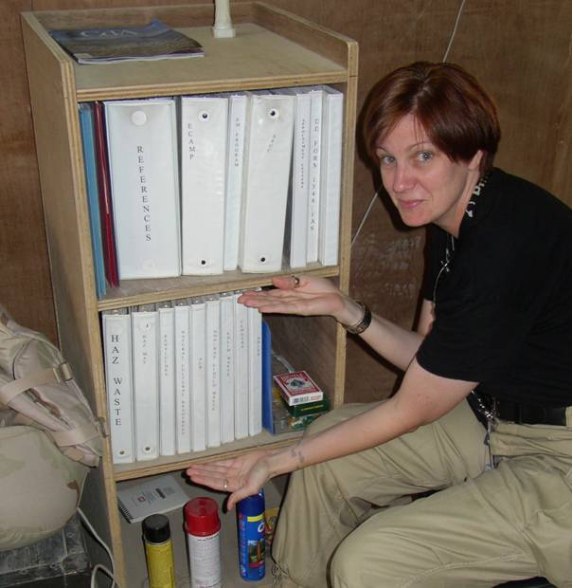
Documentation during Deployment
2017_ver 1.0
Types of documentation
  Scheduled reports
  Incident reports
  Feedback reports
  Closure reports
Recordkeeping requirements
  Maintain and file all documents logically, ensure accessibility
  Archive for historical record
Don’t forget - relevant information should be used to update maps and management information!
18
Notes:
There are a number of important documents that must be routinely kept and updated during deployment. These include:
• Scheduled reports. In order to keep information updated on all levels of operation, certain reports should be submitted at regular intervals e.g., Environmental Condition Report (ECR) and progress reports (in terms of monitoring or energy use, for example). The ECR is completed on a periodic basis to document conditions at the site (area) as well as any time a potentially significant environmental event occurs. See the Reference Module section of this toolbox for an ECR template.
• Incident reports. Environmental incidents should be reported to higher authority. All incidents that could occur should be addressed in formal documentation (e.g., Base SOPs). See the Reference Module section of this toolbox for an Incident Report template.
• Feedback reports. As a control measure, higher HQ might distribute feedback reports after receiving scheduled reports or incident reports. The same type of report will also be compiled after a monitoring inspection, indicating any corrective actions that should be implemented.
• Closure reports. As locations are vacated or activities cease, reports that detail environmental conditions and status should be finalized.
Maintenance of environmental and energy documentation is a critical element of good environmental and energy management. Such documentation, as well as all scheduled reports and incident reports, should be maintained and filed logically, in an accessible location. Record keeping should include archiving of documents to ensure continuity and provide a historical record.

Slide 19
Rotation of Forces
2017_ver 1.0
Units moving into or out of the area of operations are in one of three states: mobilization, handing and taking over, or demobilization
Proper “Handing and Taking Over”
requires good communication
  Plan for surge capacity
  Procedures must be completely understood by relieving forces
  Must be a structured process
  Documentation is critical to ensure continuity
See task check-list at the end of this module
Notes:
Proper “Handing and Taking Over” procedures are an important aspect to focus on during the rotation of forces. This is the critical area to ensure continuity in record keeping for documenting that environmental standards were met. Documentation is also important for tracking the history of energy usage at the site, the results of efficiency initiatives, etc.
Handing and Taking Over must use checklists in order to ensure that all equipment, skills and procedures have been established by the relieved forces and that they are completely understood by the relieving forces. Such understanding is vital for continuous implementation and monitoring. Checklists are furthermore effectively utilized to update the EBS and control the availability of various documents and records required by the EO and EnM.

Slide 20
Rotation of Forces
2017_ver 1.0
During “handing and taking over,” environmental and energy documentation and records developed by the initial deploying force or follow-on units will be turned over to the relieving EO and EnM. They should be relevant, well organized and easily accessible. These records include:
Operations and Fragmentary Orders
Management Plans
SOPs
Contingency Plans
Reports and Management Information (e.g., EBS)
Environmental Risk Analyses
Management Directives/Duty Sheets/Command Delegations
Logistics, Assets and Stores tracking (e.g., HM in/out flow)
Contracts
The job is not over until the paperwork is passed to the relieving unit!
Notes:
The importance of consistent and well-organized documentation cannot be over-emphasized. The relieving EO and EnM depend entirely on the files their predecessors leave behind in order to know what happened where and when.
The types of documents (although not all-inclusive) are listed on this slide.

Slide 21
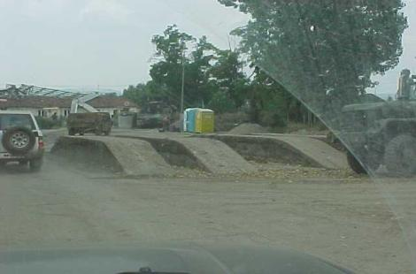

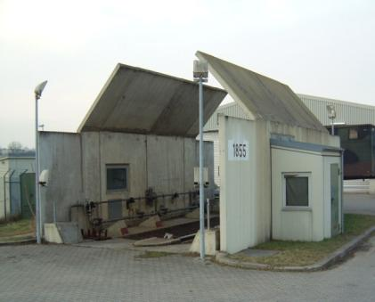
Re-Deployment
2017_ver 1.0
Disposing of obsolete equipment
Decontaminating equipment and vehicles
Environmental rehabilitation requirements and clearing of facilities
Environmental Closure Surveys and Reports
Handing back of land/facilities/ property
Termination of contracts
Closure documents should be coordinated with the appropriate legal advisors
Click here for link to task check-list during this stage
Notes:
In order to ensure control over management liabilities, the following aspects need to be considered when forces are redeploying:
Environmental implications when disposing of obsolete equipment. The EO should be part of the command’s decision on the disposal of used equipment, such as waste tires. It may be decided that the tires remain with the host nation or that they are returned to the home nation, but whatever the command’s decision, it should be made with the EO’s input.
Decontamination of equipment and vehicles. The EO should have input into the decontamination plan. For example, the EO should see if the decontamination plan includes managing the wastewater that will be generated from decontamination and if it provides for rehabilitation of decontamination areas.
Pictured on this slide are two examples of a “wash rack” to decontaminate vehicles. The upper picture shows a more rudimentary set-up, while the lower picture offers a good example of a wash rack at a semi-permanent or permanent site.
Environmental clean up and clearing of facilities. All environmental impacts must be surveyed and rehabilitated either immediately or a rehabilitation plan must be compiled where rehabilitation will take place over a longer term. Examples of rehabilitation include, but are not limited to, removal of abandoned equipment and stores, emptying of fuel storage, and clean-up of fuel spills.
Environmental Closure Surveys and Reports. A comprehensive Environmental Closure Survey is important to identify any areas that should be addressed before the Environmental Closure Report is submitted. This survey will identify the current status of the environment and compare it to the initial EBS. Through this comparison, it is possible to determine the level of standards, environmental successes achieved and possible future rehabilitation requirements.
Handing back of land/facilities/property. Environmental actions associated with the return of land, facilities, or property will be conducted in accordance with applicable contracts or agreements. Training may be necessary for the host nation personnel to understand operations and maintenance of facilities and equipment. Documentation with respect to confirmation of acceptance must be kept as a record.
Termination of contracts. Any existing environmental contracts that supported operations must be terminated.
Closure documentation must be coordinated with legal advisors, especially regarding closure actions and real estate issues.

Slide 22
Post-Deployment and
Lessons Learned
2017_ver 1.0
Conduct lessons learned or After Action Review; provide report
  Document what worked well and what did not work well
  Make recommendations for future improvements
Forward information to training developers for inclusion in future pre-deployment training
Notes:
For future operations, it is important to capture your experience as an Environmental Officer in Lessons Learned or After Action Reviews. Be sure to include what worked well, what didn’t work well, equipment that supported your actions, equipment that would have been helpful, or any other related issues. Ensure the Lessons Learned or After Action Review are accessible to doctrine and training developers to ensure the information on Environmental Considerations is integrated into the Soldier education system.
If you are part of the final closure/transfer to host nation team, ensure that documentation is archived where it can be easily accessed for future reference. If environmental closure actions require future monitoring, work with your legal staff to establish agreements with the host nation to develop a monitoring plan and schedule.
Communication with other special staff (such as legal officers, operations officers, safety officers, preventive medicine officers, etc.) help to ensure that transfer and closure actions stay on schedule, meet budget limitations, and meet the required standards. Communication is key to a successful conclusion of the mission.

Slide 23
Good and Bad Examples
2017_ver 1.0
The following slides show a number of pictures of both good and bad environmental practices, from camp set-up to handling different kinds of wastes to protecting natural resources and cultural property
Notes:
Having examined the various tasks the EO and EnM must undertake during all phases of the deployment, the next slides provide visual illustrations of some good and bad practices. They should help the EO identify what to think about, how to handle hazardous materials and wastes, how to dispose properly of solid waste and wastewater, etc. They also aim to raise awareness about protecting nature (wildlife, habitats, plants, etc.), natural resources (water, forests, etc.), and respecting cultural resources (such as burial sites and archeological sites). These are useful illustrations to provide during environmental training to other personnel in the deployed force as well.

Slide 24
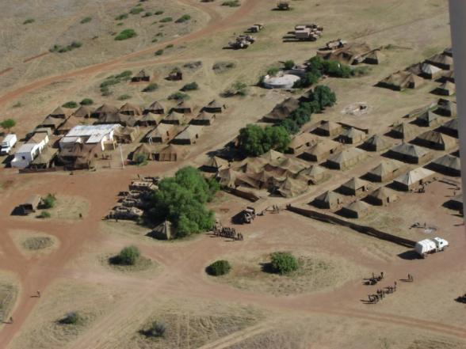
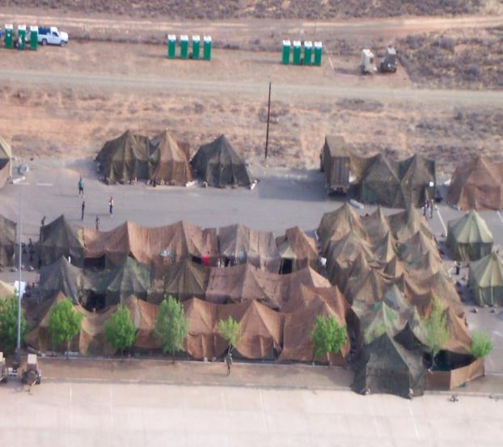
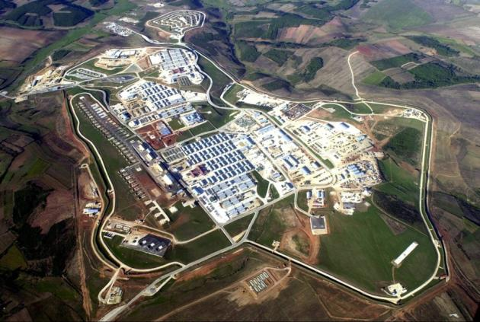
Good Base Camp Set-up
2017_ver 1.0
Rudimentary bases, but with good separation of functional areas
Semi-permanent base, with good separation of functional areas
Notes:
These pictures illustrate good planning practices when setting up camp. The picture on the upper left shows separation of functions—such as living space away from vehicle stationing points. The lower left picture provides an example of a well-developed, semi-permanent base, with similar functions grouped together, and noise-generating activities as well as waste treatment sites well separated from living and working areas.
The picture on the right illustrates appropriate location for porta-potties: accessible to living area, but not immediately next to it, and not near a water source.
Both show the use of camouflage netting.
From an energy perspective, the netting and trees may also help provide insulation (shade) from heat. The energy module in this toolbox describes in greater detail some of the energy design factors that should be taken into account when setting up a camp.

Slide 25
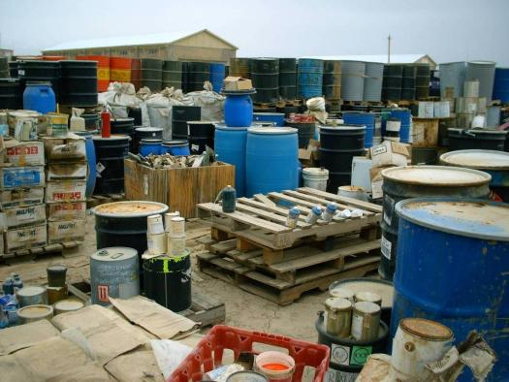
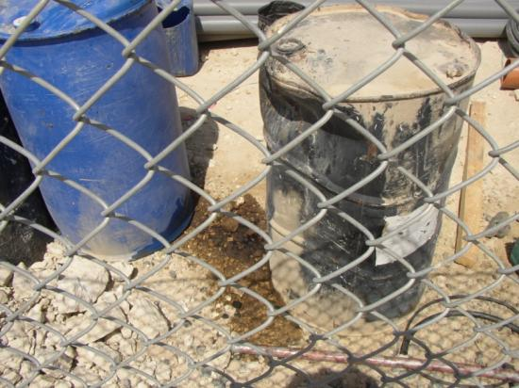
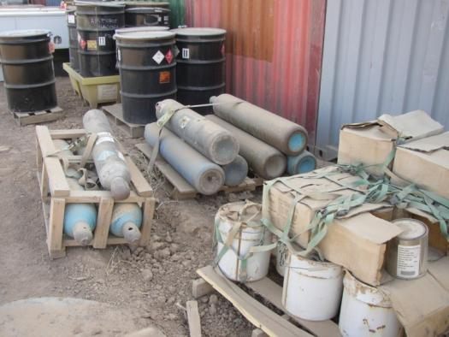
Bad Hazardous Waste Storage
2017_ver 1.0
Drums not labeled, materials not segregated, no secondary containment, no covered storage
Uses secondary containment, but it is too small and not durable. Canisters improperly stored
No secondary containment; leakage has contaminated soil
Notes:
Here are striking examples of how NOT to store hazardous material and wastes. The upper picture has countless examples of bad practices: drums are not labeled, incompatible materials are not segregated, there is no secondary containment nor is there any covered storage.
Similarly, the lower left picture shows an example of no secondary containment. Since the product has now leaked out of the barrel, it is causing contamination directly into the soil.
The picture on the right does show at least some secondary containment, but not of the best materials and not actually large enough. In addition, the compressed gas canisters are improperly stored: they should be standing so that something couldn’t bump into them and knock the tops off.

Slide 26
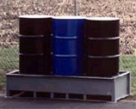
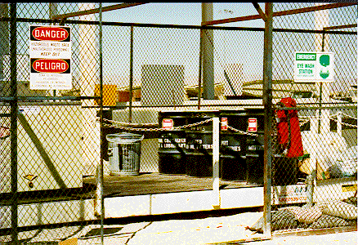
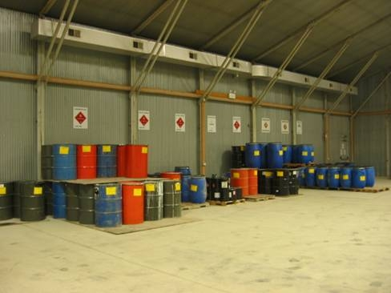
Better Hazardous Waste Storage
2017_ver 1.0
Good secondary containment, but should be labeled and covered
Well marked, fenced off. Good secondary containment,
protective gear handy
Wastes well marked, segregated; good overhead protection. Secondary containment could be better.
Notes:
In contrast to the previous slide, these next two slides illustrate improved storage for hazardous materials (HM) and hazardous waste (HW).
The three barrels are housed on a well-constructed secondary containment pallet. They should still be labeled and covered overhead, but this is at least a first step in improved storage procedures, and above all significantly reduces the chance of contaminating the ground.
Better still is the storage facility pictured on the right: it is well marked with warning labels and is fenced off. The barrels are on a large secondary container pallet and they are appropriately marked. On the right side, there is protective gear available as well as an eyewash station in the event of exposure.
The lower left-hand picture shows barrels well labeled and segregated. There is fair-to-good secondary containment (in some cases, this is minimal, but it is also on a sealed floor rather than directly on top of soil). Finally, this example shows overhead protection (although more rudimentary protection from the elements is also acceptable).

Slide 27
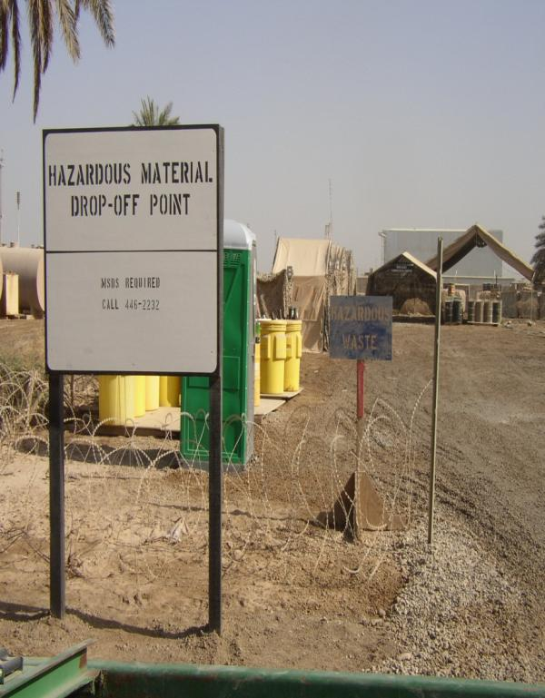
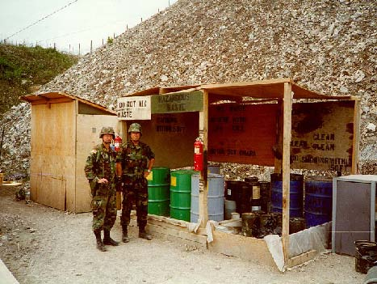
Good Hazardous Waste Storage
2017_ver 1.0
Low cost solutions offering good secondary containment, overhead protection, segregated and labeled.
Notes:
Here are other good examples of hazardous material collection points.
In the picture on the left, note that the sign stipulates the material must be documented (using data sheets) prior to being left here and whom to contact if that has not been done. The site has good secondary containment, overhead protection, segregated storage for different materials (which are labeled), and it is fenced off from other areas.
The picture on the right also shows proper labeling, good secondary containment, overhead protection, etc. It is also an example of what can be done without a lot of materials and labor.

Slide 28
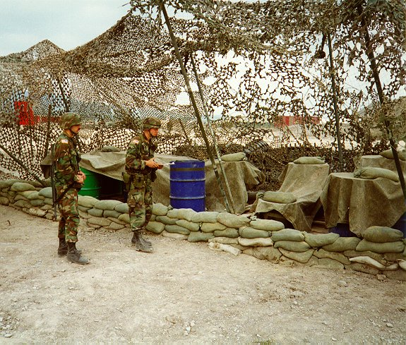
Good Hazardous Waste
Storage in Field Conditions
2017_ver 1.0
Tarps and sandbags as secondary containment, netting and tarps as overhead protection
Notes:
Obviously, out in the field, there are certain conditions under which troops cannot use manufactured secondary containment or more permanent overhead protection structures. This picture is a good illustration of HW storage using available materials: a combination of using a thick plastic tarp to serve as the “groundcover” under the barrels and the sandbags to contain (or minimize) the spread of any possible spill provides for secondary containment. The tarps, held in place by sandbags, and camouflage netting offer at least some protection from the elements. Different materials have to be segregated to avoid unexpected chemical reactions.

Slide 29


Good Hazardous
Material Handling
2017_ver 1.0
Use of protective clothing and equipment
Notes:
These pictures illustrate good practices in wearing appropriate clothing for hazardous tasks, such as decontamination gear (men in green suits) and protective clothing (including goggles/eyewear) when handling hazardous materials.

Slide 30
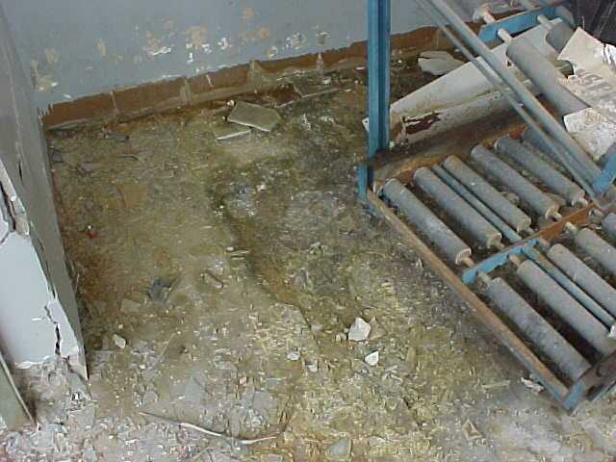
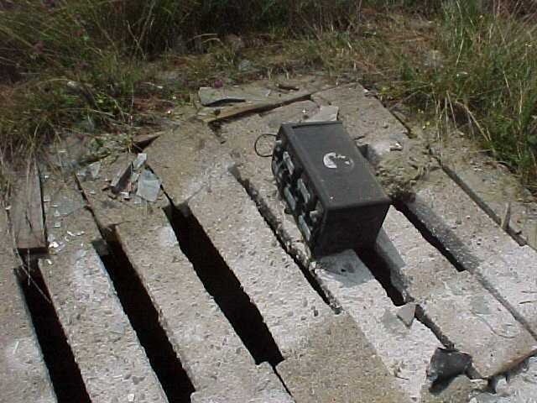
Bad Hazardous Material/
Waste Storage (Battery Storage)
2017_ver 1.0
Batteries leaked acid, no secondary containment
Battery placed on top of crumbling storm water drain
Notes:
Improper storage of lead-containing batteries can cause serious health and environmental risks. The top picture shows the inside of a building where such batteries had been stored. The yellow stains on the floor are evidence that the batteries leaked acid and had not been placed on appropriate secondary containment structures. Hazardous waste must be clearly labeled and stored separate from other hazardous materials.
Even worse, the bottom picture shows a battery having been left on top of a crumbling concrete storm water drain. If the battery itself does not fall through the concrete into the water below, it is quite certain that the acid from the battery has done so and will continue to do so.
Proper storage of batteries includes appropriate secondary containment, labeling, and protection from the weather.

Slide 31
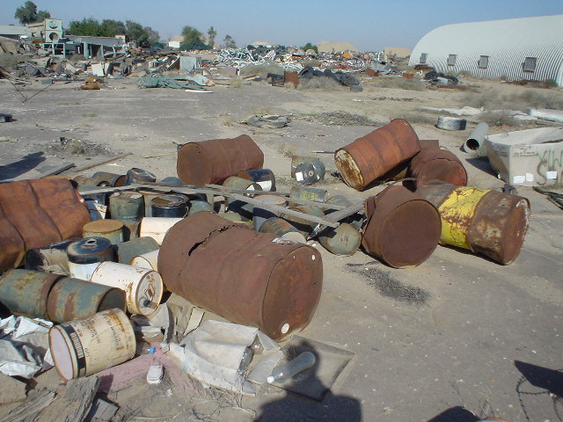
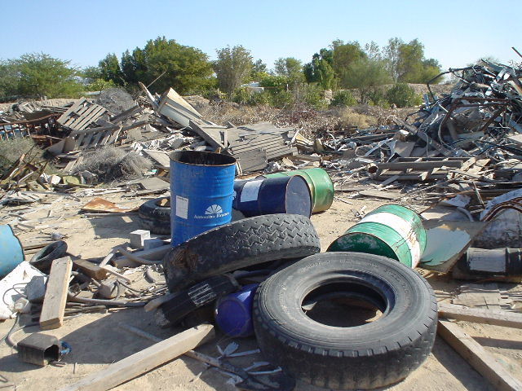
Bad Solid Waste Storage
2017_ver 1.0
Rusting and leaking containers
No segregation of materials
Notes:
These are clear examples of how you do NOT want waste to be disposed of. Rusting and leaking containers, no attempt at segregation of materials, and generally no plan at all. The stuff has just been DUMPED.

Slide 32
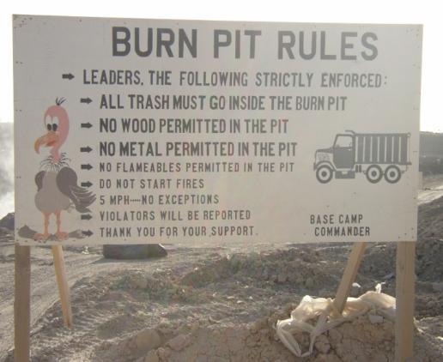
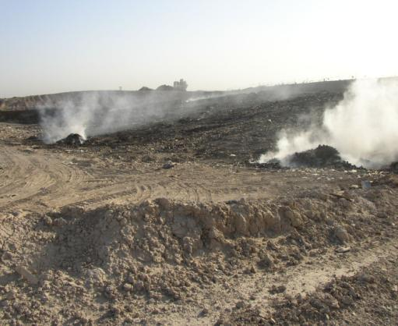
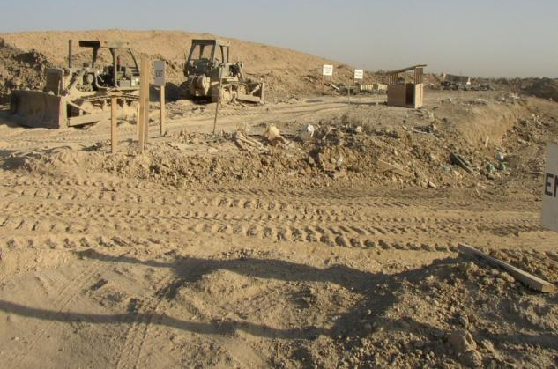
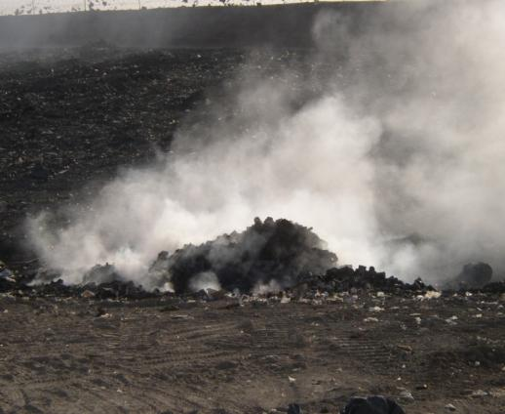
Solid Waste Disposal
2017_ver 1.0
Open burn pit often not preferred, but rules are appropriately posted
Notes:
While an open burn pit is often not the preferred method for the disposal of solid waste, if the operation requires this approach, this picture at least shows an appropriate posting of the rules to be followed when using the burn pit.

Slide 33
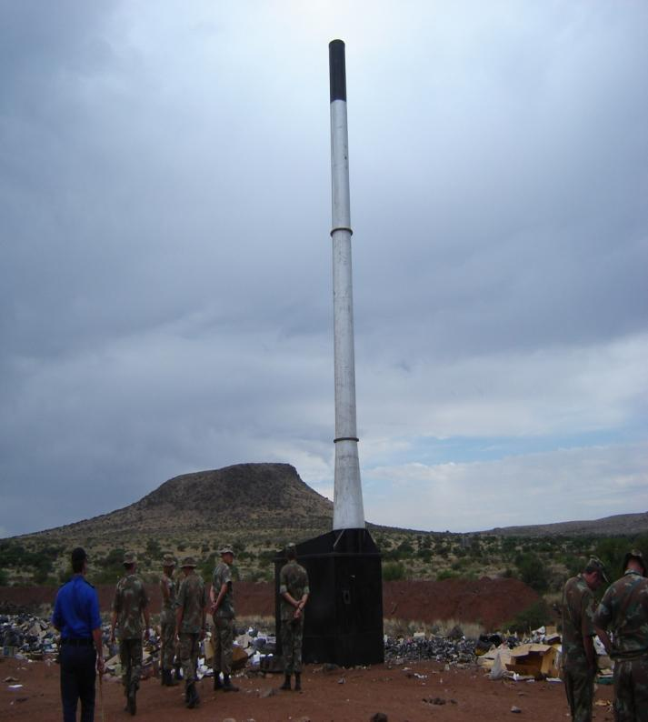
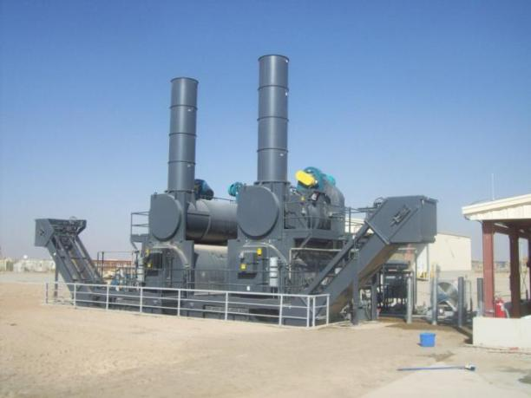
Incineration
2017_ver 1.0
Trash not contained in barrels or bags prior to disposal
Notes:
33
As an alternative to open burning, here are examples of the use of incinerators to dispose of solid waste.
For troops using an incinerator, trash should first be properly contained in barrels with covers or sealed bags (which was not done in the picture on the left). They should then be brought to the incinerator for disposal.

Slide 34
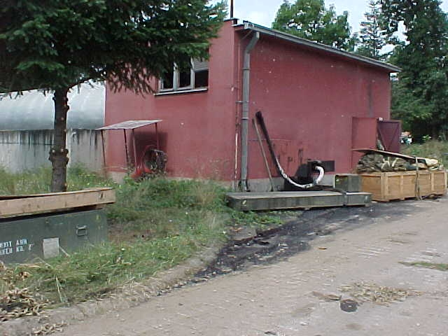
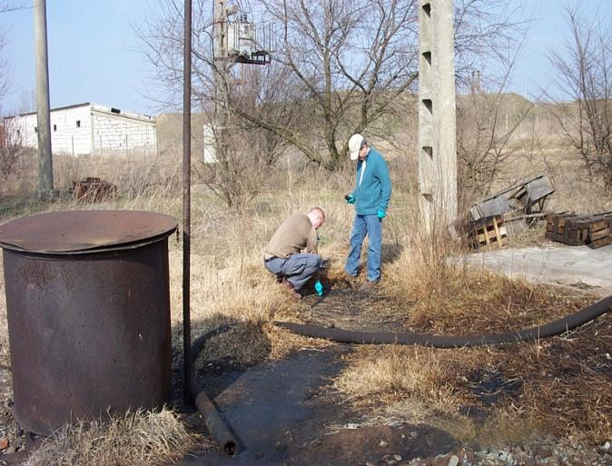
Bad Spill Containment
2017_ver 1.0
Oil leaking onto ground, no containment or clean-up
Oil contamination; taking samples to determine extent of contamination
Notes:
These two pictures show oil contamination on the ground. In the case on the left, the red building is a heating plant; the pipe coming out the back (and the ground underneath the pipe) shows that oil has been leaking into the ground and has not been contained or cleaned up.
The picture on the right shows oil contamination on the ground, coming out of the pipe. The two men are taking soil samples to determine the extent of the contamination.

Slide 35
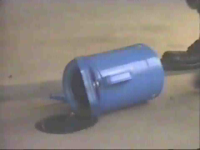



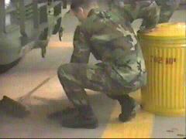
Good Spill Response Plan
2017_ver 1.0
Spill contained
Oil cleaned up using sand to absorb it
Sand placed in lidded container
Notes:
This series of pictures illustrates the proper execution of a spill response plan, in this case a spill of some oil. The spill is stopped (by picking up the blue container), contained, cleaned up (using sand to absorb it), the sand is then placed in a lidded container for appropriate subsequent disposal. However, it should be noted that instead of using sand as the absorbent material, there are more efficient industrial products (grains and granules) available.
Remember: used absorbent material is hazardous waste and must be disposed of as hazardous waste

Slide 36
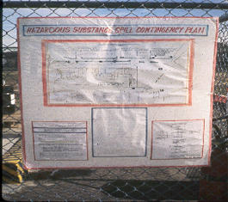
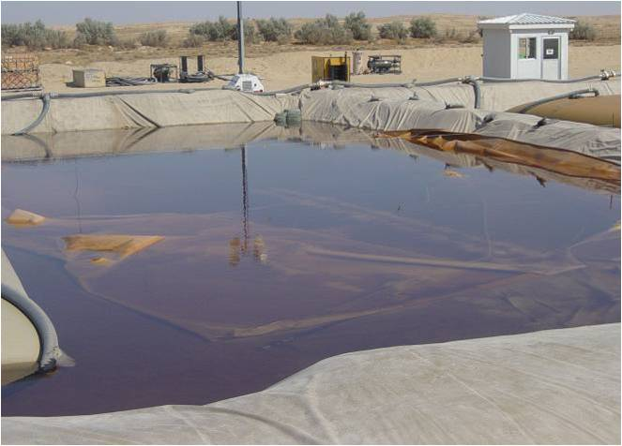
Good Spill Response Plan
2017_ver 1.0
Instructions posted in proper location, covered in plastic to protect it from weather
Intact bladder
Ruptured bladder
Good containment of oil spill—use of liner and raised sides
Notes:
36
While the details of the picture on the left are not very clear, it demonstrates a good practice of posting a contingency plan for a hazardous materials spill in a visible place just outside the hazardous materials collection area. The poster is (well) protected from the weather by a plastic covering. Signs should be written in the host nation’s and contributing nations’ languages.
On the right is an example of a contained oil spill, which occurred as a result of a ruptured fuel bladder. It shows the use of a liner to prevent leakage into the ground and built-up walls around the pit to protect against spill-over.

Slide 37
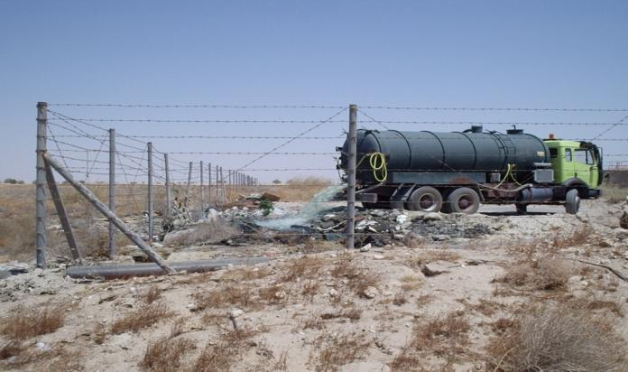
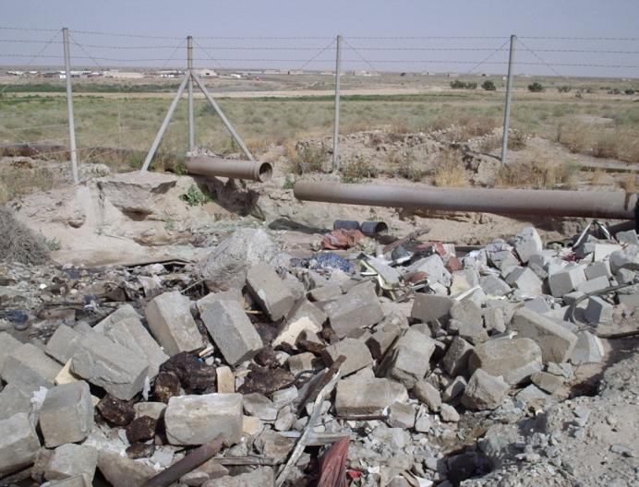
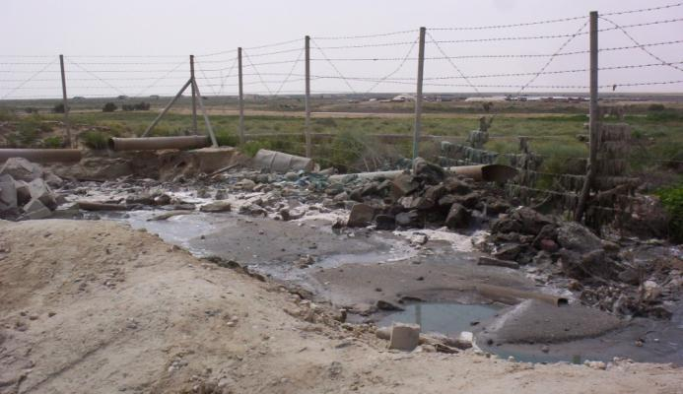
Bad Wastewater Disposal
2017_ver 1.0
Open dumping of wastewater
Broken waste water pipes
Resulting sewage discharge
Notes:
Improper handling of wastewater can pose health and environmental hazards for troops as well as the surrounding local community. On the left, you can see that pipes meant to manage wastewater flow have themselves broken apart.
As an “alternative,” (upper right) a truck is now simply dumping the wastewater onto the ground at the corner of the base. The (continuing) result of such sewerage discharge is evident in the picture below (lower right).
In cases where contractors are used, it is important to monitor their work to ensure performance work standards are met.

Slide 38
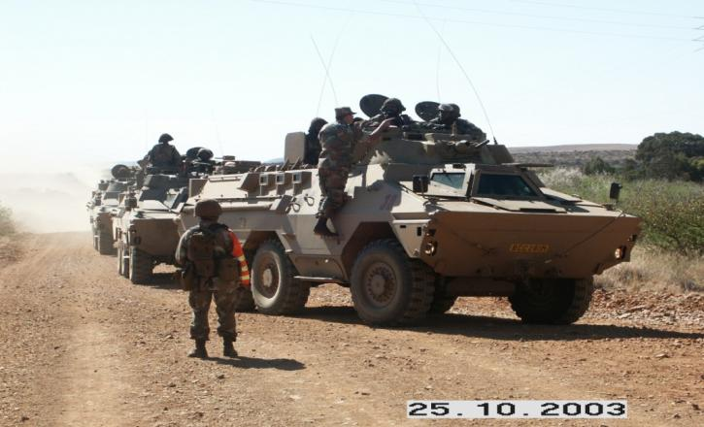
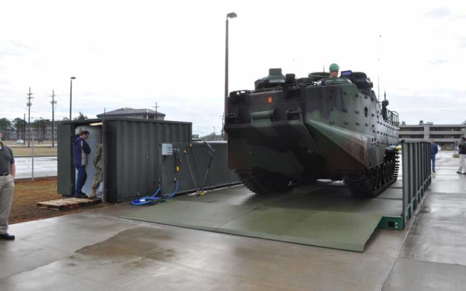
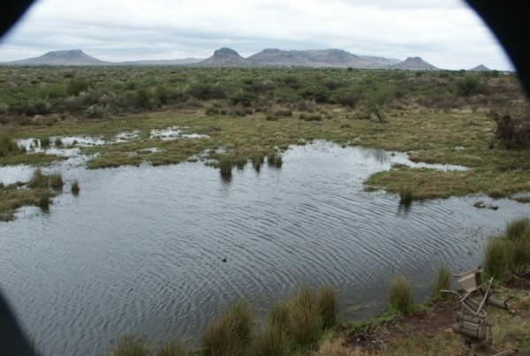
Proper Vehicle Procedures
2017_ver 1.0
Use only approved vehicle washracks
Drive on established roads, except when otherwise instructed
Don’t drive through wetlands
Notes:
38
During deployments (just as in exercises and training), it is important to drive on established roads (as shown on the left), except when instructed otherwise, because of safety considerations and because driving causes soil erosion.
Wetlands should not be driven through.
Vehicle maintenance, parking, and washing are allowed only in designated areas.

Slide 39
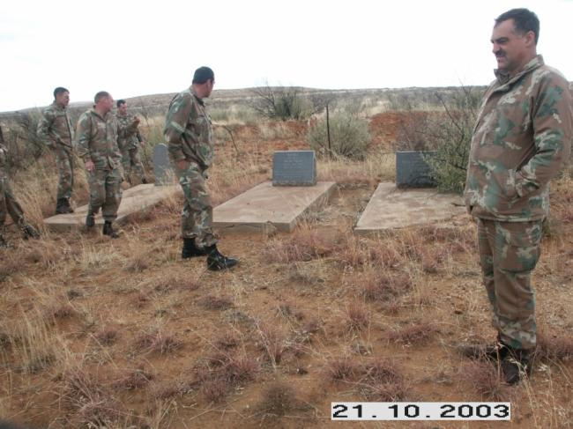
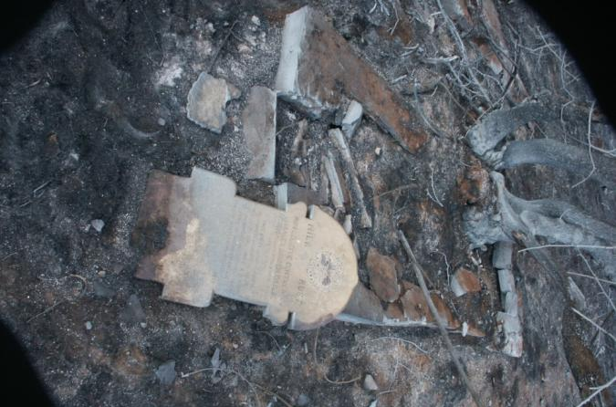
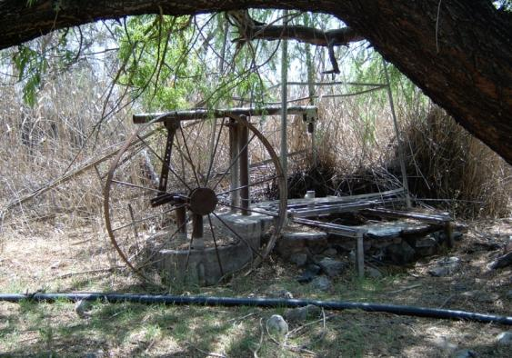
Cultural Property Protection
2017_ver 1.0
Damage done to burial site
Proper marking of burial site, old well
Notes:
The slide on the left shows damage done to a burial site by troops who did not follow guidance in terms of respect for cultural property.
The upper right-hand picture, in contrast shows a much greater appreciation by the troops for a burial site, marking its location so as to avoid entering the area during military activities.
While burial sites may be fairly easy to recognize and avoid, other cultural properties—such as the old well pictured at the bottom right—are also important to be able to identify and avoid to the greatest extent possible.

Slide 40


Natural Resource Protection
2017_ver 1.0
Notes:
Military operations can involve deployments to environmentally sensitive areas. Due care should be taken when operating in such areas.
In addition, one of the most important aspects of natural resource protection is analyzing the impact of military operations on natural resources. You need to consider the effects on the surrounding community when using natural resources, from water to forests to protected habitats.

Slide 41
Technical Modules
2017_ver 1.0
Detailed modules on the following subjects are available in the technical module section of this toolbox:
  Solid waste management
  Hazardous material and hazardous waste management
  Water and wastewater management
  Spill prevention and response planning
  Cultural property protection
  Natural resource protection
  Energy considerations

Slide 42
Conclusion
2017_ver 1.0
Your actions as an environmental officer and/or energy manager will have contributed to the mission’s goals and its success by
reducing adverse impacts to the health of the force and the local population
reducing adverse impacts to the environment
minimizing energy demands and the associated logistics requirements
enhancing the reputation of your military and your nation

Slide 43
EO TASK LISTS
2017_ver 1.0
The following slides include the EO task lists by the operational phase.

Slide 44
Environmental Officer Task List for Predeployment
2017_ver 1.0
Tasks during Predeployment | Initial activity to prepare to deploy with main force
Preparation
Environmental technical equipment and vehicle-specific equipment | Check
Environmental Plans in place | Check
Environmental mission specific readiness | Check
Record keeping documentation in place | Check
Environmental related permits/licences in place | Check
Decontamination of vehicles and equipment | Check
Compliance with customs regulations in terms of plant material and animal transport | Control
Environmental Intelligence | Confirm
Liaison/co-ordination platforms | Establish with host nation
EBS | Do complete EBS
Demarcating environmentally sensitive areas on maps | Execute
Existing and new contracts | Environmental inputs
Contract Management | Environmental inputs
Mission-Specific Preparation
Environmental information from Operations Order available for distribution in terms of awareness | Convey Content
Mission-Specific Environmental Skills Training
Evaluation towards mission readiness | Check
Re-train | Train
Documentation | Check
Notes:
This table informs you of the initial activity during mobilisation for deployment with the main force. Keep in mind that if your unit is assuming responsibility from a previous unit (rotation of forces), your role as an Environmental Officer may be to confirm or update the tasks on this list. Rotation responsibilities will be discussed later in this briefing. One of the main areas of emphasis is the EBS, namely updating or increasing the level of detail of the EBS. This is a continuous process that occurs as more information becomes available.
This table can ideally be used as a checklist to confirm the execution of tasks.

Slide 45
2017_ver 1.0
Environmental Officer Task List During
Deployment and Rotation of Forces
Mobilisation Tasks | Initial activity to deploy with main force | Activity preceding rotation of forces
Preparation
Environmental technical equipment and vehicle-specific equipment | Check | Update
Environmental Plans in place | Check | Update
Environmental mission specific readiness | Check | Update
Record keeping documentation in place | Check | Update
Environmental related permits/licences in place | Check | Review/renew/ confirm
Decontamination of vehicles and equipment | Check | Check
Compliance with customs regulations in terms of plant material and animal transport | Control | Control
Environmental Intelligence | Confirm | Update
Liaison/co-ordination platforms | Establish with host nation | Between in going and outgoing forces
EBS | Do complete EBS | Update
Demarcating environmentally sensitive areas on maps | Execute | Confirm
Existing and new contracts | Environmental inputs | Review and manage
Contract Management | Environmental inputs | Confirm procedures
Mission-Specific Preparation
Environmental information from Operations Order available for distribution in terms of awareness | Convey Content | Convey Content
Mission-Specific Environmental Skills Training
Evaluation towards mission readiness | Check | Check
Re-train | Train | Train
Documentation | Check | Update
Notes:
This table lists the common tasks during the rotation of forces in comparison to the common tasks during initial mobilization.
The Environmental Officer of the relieving unit at this point is still in his home country and preparing for the rotation. He may be confirming or updating the required equipment is up to standard.
For example: The Environmental Officer should verify that petroleum, oils and lubricant (POL) equipment deploying with the relieving force has serviceable spill kits.

Slide 46
2017_ver 1.0
Environmental Officer Tasks
during Force Rotation Demobilization
Typical Tasks | Rotation of forces
Mapping of infrastructure and sites of impact | Confirm status during handing and taking over
Water purification, sewerage facilities, dumping sites, borrow pits, etc. | Confirm status during handing and taking over
Environmental technical equipment | Confirm application and serviceability
Environmental implications of disposal decisions of obsolete equipment | Confirm procedures
Environmental Clean up/ Clearing of: | Confirm status during handing and taking over
- Facilities | Confirm status during handing and taking over
- Unserviceable or redundant equipment/stores | Confirm status during handing and taking over
- Unexploded Ordnance (UXOs) | Confirm status during handing and taking over
- Emptying of fuel storage | Confirm status during handing and taking over
- Remediate fuel spills, etc. | Confirm status during handing and taking over
Decontamination of equipment/vehicles | Establish in both host and home country
Notes:
This table (on this slide and the next) lists the common tasks for the Environmental Officer during the demobilization. Keep in mind that during rotation of forces, your role as an Environmental Officer may be confirming or updating the tasks.
Demobilization during redeployment will be discussed later in the brief. These tasks are being executed to avoid claims that the departing unit acted inappropriately.

Slide 47
2017_ver 1.0
Environmental Officer Tasks during
Force Rotation Demobilization (Con’t)
Typical Tasks | Rotation of forces
Compliance with customs regulations for plant material and animal transport | Control
Policy and procedures | Confirm and implement
EBS | Update
Transfer of property/land/ facilities (dump site) | Between incoming and outgoing forces
Back loading of waste | Handle according to Environmental Management Plan
Transfer/Agreement with regards to cultural resources created in the host nation during ops | Confirm status during handing and taking over
Implement/terminate agreements | Confirm status during handing and taking over
- Finalising and Closing of contracts | Confirm status during handing and taking over
- Follow up responsibilities | Confirm status during handing and taking over
Documentation for transportation | Transport permits e.g., Shipment manifest
Documentation (general) | N/A
Debrief | Utilize information for future corrective action

Slide 48
Environmental Officer Task
Comparison during Demobilization
2017_ver 1.0
Tasks | Rotation of forces | Re-deployment
Mapping of infrastructure and sites of impact | Confirm status during handing and taking over | Confirm
Water purification, sewerage facilities, dumping sites, borrow pits, etc. | Confirm status during handing and taking over | Closure
Environmental technical equipment | Confirm application and serviceability | Improve equipment according to new technological requirements
Environmental implications of disposal decisions of obsolete equipment | Confirm procedures | Environmental Inputs
Environmental Clean up/ Clearing of: | Confirm status during handing and taking over | Implement Rehabilitation Plan
- Facilities | Confirm status during handing and taking over | Implement Rehabilitation Plan
- Unserviceable or redundant equipment/stores | Confirm status during handing and taking over | Repair or Dispose
- Unexploded Ordnance (UXOs) | Confirm status during handing and taking over | Implement Rehabilitation Plan
- Emptying of fuel storage | Confirm status during handing and taking over | Implement Rehabilitation Plan
- Remediate fuel spills, etc. | Confirm status during handing and taking over | Implement Rehabilitation Plan
Decontamination of equipment/vehicles | Establish in both host and home country | Establish in both host and home country
Notes:
Note that although the tasks are similar during demobilization (see this slide and the next), they are being finalized and terminated rather than being updated and confirmed (as they were during rotation). To ensure that demobilization tasks are completed properly and meet the appropriate standards, the Environmental Officer must be diligent in inspecting, documenting, and communicating the status of these tasks. This will facilitate closure or transfer actions and will help to limit liability issues.

Slide 49
2017_ver 1.0
Environmental Officer Task Comparison
during Demobilization (Con’t)
Demobilisation | Rotation of forces | Re-deployment
Decontamination of equipment/vehicles | Establish in both host and home country | Establish in both host and home country
Compliance with customs regulations for plant material and animal transport | Control | Control
Policy and procedures | Confirm and implement | Amend and update
EBS | Update | Finalise and exit
Transfer of property/land/ facilities (dump site) | Between incoming and outgoing forces | Back to host nation
Back loading of waste | Handle according to Environmental Management Plan | Handle according to home country legislation
Transfer/Agreement with regards to cultural resources created in the host nation during ops | Confirm status during handing and taking over | Environmental Inputs and liaison with host nation
Implement/terminate agreements | Confirm status during handing and taking over | Terminate
- Finalising and Closing of contracts | Confirm status during handing and taking over | Closure
- Follow up responsibilities | Confirm status during handing and taking over | Liaison with host nation on possible long term rehabilitation
Documentation for transportation | Transport permits e.g., Shipment manifest | Transport permits e.g., Shipment manifest
Documentation (general) | N/A | Closure document including confirmation of rehabilitation
Debrief | Utilise information for future corrective action | Learn from mistakes/successes and update SOPs

