Slide 1
2017_ver 1.0

Slide 2
General Awareness Training Module
2017_ver 1.0
Commanding Officer

Slide 3
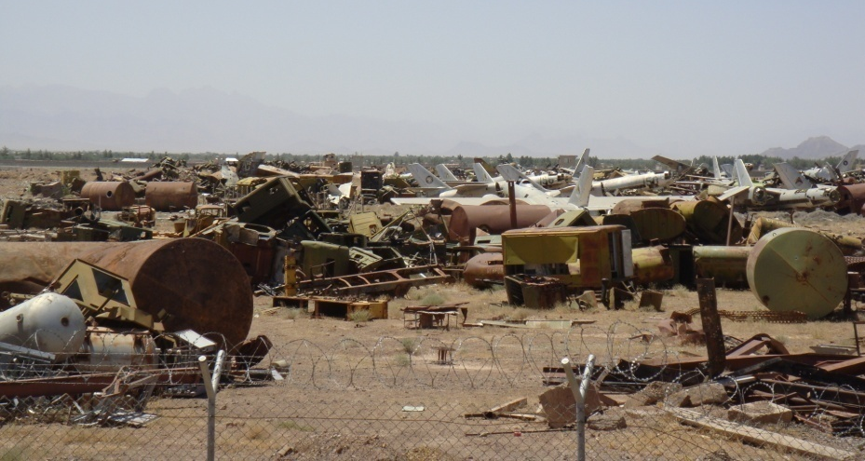
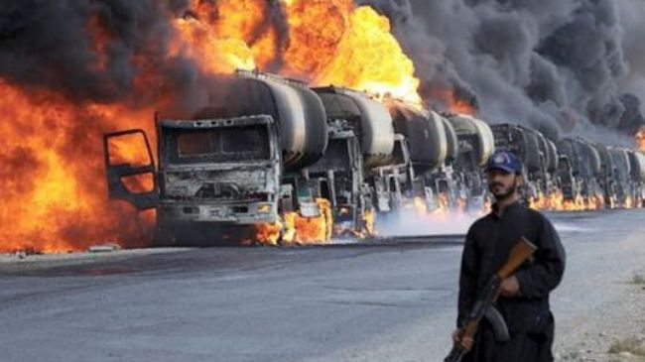
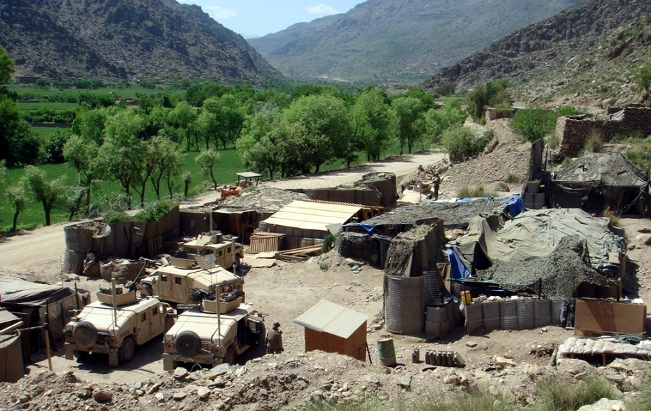
Environmental and Energy Considerations for Military Operations
2017_ver 1.0
Sound environmental and energy management during military operations enables the mission by enhancing force protection and reducing the logistical burden on the force
Notes:
Environmental and energy considerations comprise a broad spectrum of issues that require integration into the every day lives of all service members. They do not go away or become unimportant to consider because we are involved in operations. In fact, planning for environmental and energy issues should enhance operational capabilities and security.
Leaders need to always integrate environmental and energy considerations into training, the planning processes, and all execution phases of an operation. The integration and application of environmental values into the military mission are force multipliers that help:
sustain readiness and ensure mission execution
protect the safety and health of deploying troops, host nation troops, civilian personnel, and local nationals
facilitate coalition and international cooperation and interoperability
ensure legal compliance
strengthen civil relations, and
promote efficient and sustainable use of valuable natural resources and infrastructure
There is an increasing appreciation for the interdependence between the military mission, the community, and the environment. The picture on the right illustrates the logistical burden and force protection requirements of delivering supplies to conflict areas. On the left, we see what can happen when there is a lack of sound environmental management practices. In the foreground is an example of a base camp meeting mission requirements while seamlessly integrating into the surrounding environment. Importantly, environmental and energy considerations can help to ease the logistical burden and reduce force protection requirements.

Slide 4
Overview of This Briefing
2017_ver 1.0
Environmental Considerations in Operations (ECOps) and Energy Considerations in Operations (EnCOps) and their benefits
Environmental planning and energy considerations throughout a deployment
Commander responsibilities
What the Environmental Officer (EO) and Energy Manager (EnM) can do for you!
Notes:
The commander is responsible and accountable for adherence to environmental rules and regulations.
It is of great importance to be informed about all the rules governing the deployment — mission-specific, United Nations, EU, NATO, national, etc. — and to implement them in the correct phases.
The environmental officer (EO) is the commander’s support for implementing environmental rules and regulations during the various phases of the mission. The duties of the EO include planning, educating, and promoting adherence to environmental considerations, and giving advice to the commander on these issues. The energy manager (EnM) coordinates energy management and supports the command staff in achieving greater energy efficiency.

Slide 5
Definitions
2017_ver 1.0
Environmental Considerations in Operations are measures or processes put in place to avoid or minimize potentially adverse environmental impacts during military operations.
Energy Considerations in Operations are measures or processes put in place to decrease energy consumption and improve energy efficiency during military operations.
Focus areas addressed in the toolbox:
  Solid waste management
  Hazardous material and hazardous waste management
  Water and wastewater management
  Spill prevention and response planning
  Natural resource and cultural property protection
  Energy Considerations
  ECOps and EnCOPs help you to use your resources in a sustainable manner to better support your mission!
Notes:
The aims of Environmental Considerations are to:
avoid or minimize potentially adverse environmental impacts during military operations
enable advance planning instead of having to continuously intervene to mitigate impacts during the operation; this also helps ensure the future environmental viability of the host nation
mitigate and/or avoid pre-existing environmental contamination that may negatively impact the force or the mission
The aims of Energy Considerations are to:
use less energy to provide the same service
systematically achieve better energy efficiency and mission sustainability through technical solutions and by enhancing energy awareness and behavioral practices
“Environmental Considerations in Operations (ECOps)” covers a broad range of issues. The focus areas addressed in this toolbox are:
Solid waste/hazardous material/hazardous waste management. Operations require a lot of material and generate large quantities of waste. Proper management of material and waste helps to minimize environmental pollution, protect health, and conserve resources and funding. For example, it is important to properly handle and store hazardous material or waste that is used when maintaining vehicles.
Water and wastewater management. Water is used in many aspects of an operation. It is necessary for drinking, personal hygiene, cleaning equipment, etc. Often operations occur in areas with limited water resources and water must be transported to military operations. Proper management of water and wastewater helps to ensure we have safe drinking water, reduces transportation requirements, and protects soldiers from diseases resulting from improper wastewater management.
Spill Prevention and Response Planning. Spills of petroleum, oils and lubricants (POL) and hazardous materials may occur during routine operations. Establishing preventive measures and ensuring that personnel know their roles and responsibilities for spill response helps to minimize exposure of personnel to hazards and the impacts of spills on the environment. Personnel must be able to act in the case of a spill.
Natural resource and cultural property protection. It is important for deploying forces to be respectful of historic sites, buildings, archeological sites, natural resources, wildlife and habitats that are important to the host nation. This helps to foster good relations with local populations and the host nation.
Energy is another important consideration, but addressing all aspects of energy conservation and use could constitute a whole separate toolbox. As general guidelines, remember to use energy sustainably and responsibly.
Energy consumption, supplies, and availability are often critical factors for military operations. Energy use is also a financial and environmental issue, so avoid unnecessary energy use.
Focus areas of the “Energy Considerations in Operations (EnCOps)” in the toolbox are:
planning considerations for optimal energy management
energy use in military operations
energy production, storage, and distribution
energy efficiency practices

Slide 6
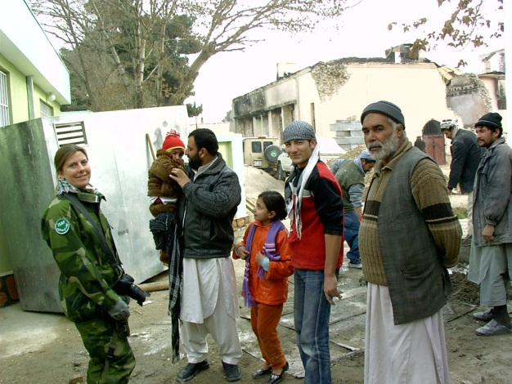
ECOps and EnCOps as a Force Multiplier
2017_ver 1.0
Enhances force protection
  Protects soldier health
  Reduces risk to supply convoys
Reduces logistical requirements and costs
Reduces legal and financial liability
Increases operational resilience
Promotes sustainability
  For the current mission
  For future deployments
  For the host nation
Potential geopolitical impacts
Wins hearts and minds
Notes:
It is important to provide examples to your troops to highlight the importance of ECOps and EnCOps. Such examples could include the bed-down of forces in areas of high industrial pollution, chemical storage facilities or swampy areas – all of these are real examples that have affected the health of personnel in deployed locations, resulting in negative mission impacts.
There are a number of reasons why it is important to think about environmental and energy considerations.
Force Protection (Safety and Health of Forces)
Planning for energy and environmental considerations prior to force deployment can help protect the safety and health of the troops. For example, it can help ensure troops are housed away from contaminated areas. Energy and environment considerations also help to reduce military supply demands, therefore reducing the risk troops face when convoying supplies.
Logistical, Financial and Legal Implications
Recent operations have shown that approximately 70% of logistic movement by weight is fuel and water. Environmental and energy considerations help to reduce the demand of these resources, which in turn help to decrease the overall cost of the mission.
Environmental damage requires money and man-hours to rehabilitate; this is money and manpower that could be used elsewhere in the operation. Failure to prevent or repair damage could result in unanticipated liabilities, both legal and political.
Poor environmental and energy management preparation can increase resource costs. For example, it costs money to clean up the waste generated by a leaking fuel tanker as well as the cost of the spilled fuel itself. Energy supplies that are poorly managed means more energy must be delivered to the deployed location.
Sustainable use of the environment is important for several different reasons:
so that the current mission can continue (impacts to current operations are avoided)
so that future deployments can occur in the same areas; this depends on proper environmental care during the current deployment
so that the host nation can use the area after operations have ceased
When implementing environmental and energy considerations, you should consider possible environmental impacts on the geopolitical situation such as:
Environmental local resources as a cause of conflict, e.g., vying for access to water resources and agricultural land as well as host nation-supported electricity.
Environmental threats, e.g., destruction of natural resources, contamination of farms lands, etc. could stress the economy.
National strategic assets and security interests where implementation of considerations should be cognizant of the host nation’s resources and populace
When proper consideration is given, this can help win the hearts and minds of the local population by showing them that you respect host nation values and resources. All of this contributes to making a positive impact on psychological operations (PSYOPS).
In the end, by doing things like reducing demand (of water, packaging, energy, etc.), and reusing and recycling resources and equipment, you will be helping to improve the safety and security of yourself and your troops.

Slide 7
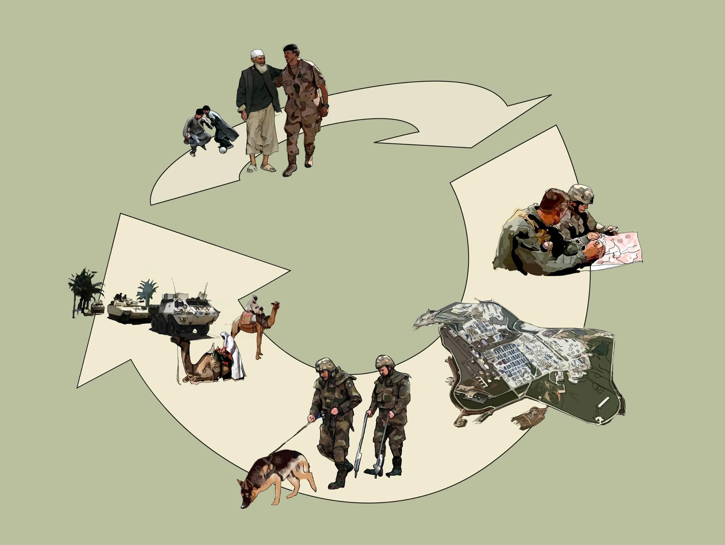
ECOps and EnCOps in the Life Cycle of Military Operations
2017_ver 1.0
Lessons Learned
Planning
Pre-deployment
Post-deployment
Re-deployment
Rotation
Deployment
Notes:
At each stage of the life cycle process, there are environmental and energy requirements and responsibilities at different levels of the command structure, from the highest strategic planning to the daily responsibilities of every soldier.
The commanding officer has an important role to play in all stages of this life cycle, with assistance from the EO and EnM. What you do sets an example for all others in your command to follow.

Slide 8
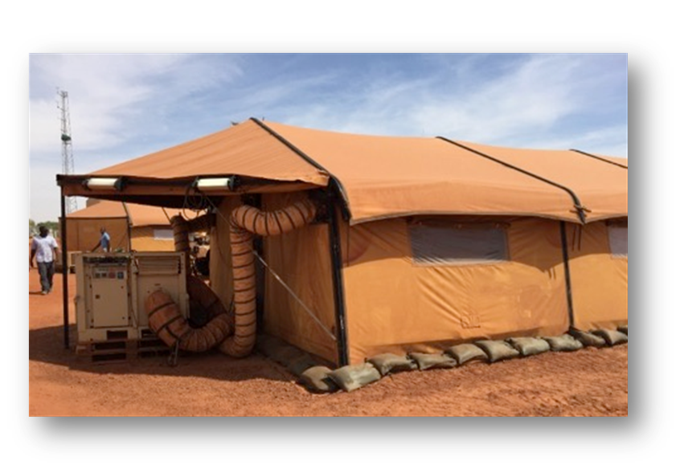
Energy Facts
2017_ver 1.0
Two thirds of the fuel that a conventional diesel generator burns is blown out as heat. Only one third is converted into electricity.
In a typical military camp, 60-70% of fuel is used to produce electricity to heat/cool water or air.
Advanced technology and higher standards of living in camps have led to increased energy demand.
Examples from Afghanistan:
      For each gallon of fuel used at a facility, up to 4 gallons were consumed during transport.
      The fully burdened cost of fuel can exceed 90€ per liter.
      On average, there has been one casualty for every 24 fuel resupply convoys.
Notes:
For general information about military energy use, see for example, US Army, “The Power Is in Your Hands,” https://www.army.mil/e2/c/downloads/316462.pdf.
Information about Afghanistan is drawn from several sources, including: http://www.natolibguides.info/smartenergy and http://www.nationaldefensemagazine.org/archive/2010/April/Pages/HowMuchforaGallonofGas.aspx and https://protonex.com/blog/iraq-and-afghanistan-the-hidden-cost-of-fuel-convoys.

Slide 9
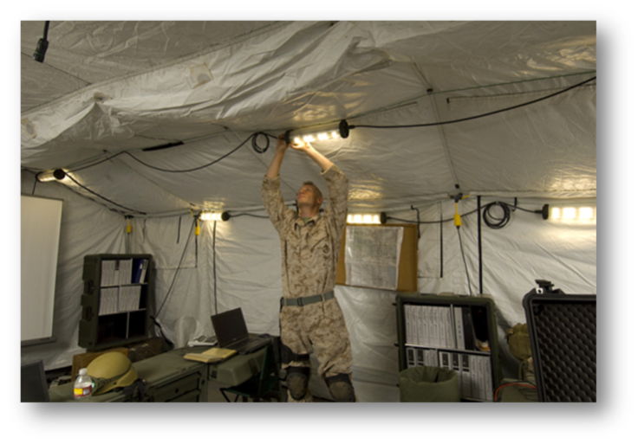
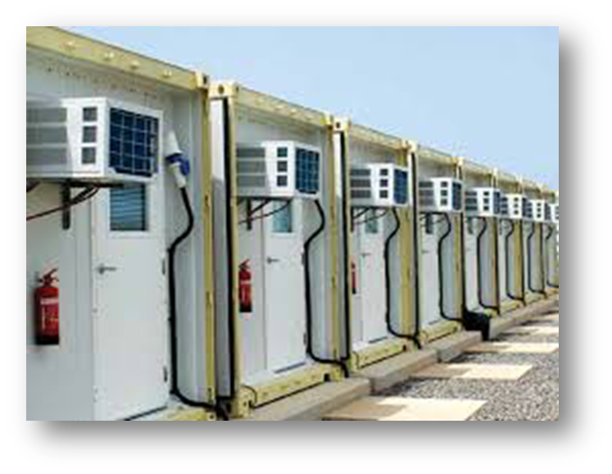
What Can You Do to Save Energy?
2017_ver 1.0
Keep doors and windows closed to prevent the loss of cooled or heated air.
Eliminate unnecessary vehicle use and idling.
Use power management settings on computers and turn off lights when not needed.
Use natural lightning when possible.
Ensure dishwashing and laundry machines are full before being operated.
Take shorter showers.
Turn off the tap when brushing teeth or shaving.
Notes:
Remember: resource conservation is ALSO energy conservation. It takes energy to move resources to where you are!
If available, use high-efficiency lighting such as LEDs or compact fluorescence lights.

Slide 10
Commander Responsibilities
2017_ver 1.0
Understand and enforce the legal requirements and responsibilities
Provide command emphasis on environmental and energy considerations through the lifecycle of operations, from strategic planning to after action reports (AARs)
Designate a specific energy manager (EnM), likely within the engineer staff, and authorize the EnM to coordinate with all other staff as necessary
Chair the Energy and Environmental Management Board (EEMB) to ensure policies, priorities and resources are available for energy and environmental management (manpower, money, equipment)
Notes:
There are many sources of legal environmental requirements, ranging from international to host nation, in a military operation. As with other legal issues, your legal staff (with its reach-back capability) is responsible for determining what environmental requirements apply to your area of operations. Legal requirements and responsibilities define the boundaries by which operations will be conducted.
As the commander, part of your responsibility in providing for the well-being of your personnel includes ensuring that there are the necessary resources (people, money and equipment) available for environmental and energy management. Your command emphasis on environmental and energy considerations is vital. The ideal situation is to have an approved structure of personnel with environmental and energy responsibilities, at each level within the force, from headquarters down to the deployed unit.
The responsibilities and composition of the Energy and Environmental Management Board (EEMB) are described in more detail later in this briefing, but its main purpose is to address necessary energy and environmental management tasks within your command. Importantly, the EEMB is comprised of a range of camp personnel—not only the EO and EnM, but also logisticians, legal officers, public affairs, etc. While your EO and EnM can facilitate this Board, you need to stress the importance of this program and your commitment to environmental considerations throughout the command.

Slide 11
Laws and Regulations
2017_ver 1.0
International laws and treaties
Agreements pertaining to deploying forces such as Status of Forces Agreements (SOFAs)
Own nation’s laws
Host nation laws
UN, NATO, EU, or coalition command standards – who controls the space?
Mission regulations
Compare and understand what governs the current operation.
Be prepared to implement the highest applicable environmental standard.
Notes:
As the commanding officer, it is essential to know what is legally applicable to the mission, including from an environmental perspective. This can involve international treaties, your nation’s laws, host nation law, international or coalition laws or standards, or mission regulations that pertain to your operations.
For example, North Atlantic Treaty Organization (NATO) and European Union (EU) regulations are applicable to their respective missions, while some United Nations (UN) regulations are treaties and conventions that are globally valid if your country has signed them (for example, the Basel Convention). For international treaties or protocols such as the Basel Convention or the Kyoto Protocol, even if your country has not signed and ratified the agreement, the country you are in may have done so, and this could impact your mission. Usually the most stringent regulations apply, if feasible and practical for the operation.
In a multinational mission, if you are a tenant on another nation’s facility, you might have to implement environmental standards to comply with that Sending Nation’s (SN) requirements.
Close communication with the legal office is necessary to ensure an understanding of all applicable treaties, laws, regulations, and standards.

Slide 12
Strategic Level Planning
2017_ver 1.0
  The Operation Plan (OPLAN) should contain an environmental annex. It should be based on an analysis of:
  The legal framework
  Critical environmental aspects that could constrain the effective achievement of the mission
  Critical environmental aspects that could affect force protection or increase financial risks
  Energy Management issues need to be considered and integrated into all relevant parts of the OPLAN.
  Pre-deployment planning will determine how energy efficient the operation will be
  An energy management plan should be developed as early as possible in the planning process
Notes:
Once a decision has been made that a military operation will be conducted, one part of an initial analysis should be environmental considerations that contribute to a successful mission. This analysis enables informed decisions to be made within the required timeframe.
There can be environmental factors that negatively affect the mission (e.g., different climate and terrain than the deploying forces are used to), that can affect the well-being of the forces (e.g., the presence of exotic diseases), and that can increase the cost of the mission (e.g., having to contract for waste management because of inadequate local infrastructure). All of these aspects, as well as the relevant legal framework, need to be identified and assessed. In short, the full range of these factors should be taken into consideration even at this initial planning stage.
This informed decision is formalized in the environmental annex of the OPLAN.
From an energy perspective, the planning/pre-deployment stage is when decisions are made that will determine how energy efficient the operation will be.
The energy management plan should be part of the OPLAN and include at least:
Energy use profile (baseline assessment of energy needs): where, how much, timing
Energy production and distribution (energy budget/target, energy usage)
Resources needed and possible alternative energy sources and configurations
Responsible personnel
Monitoring plan for energy use

Slide 13
Environmental and Energy Management
2017_ver 1.0
Environmental and energy issues should be addressed regularly in relevant existing management groups. The EnM and EO should participate when energy and environmental issues are “on the table.”
The Environmental and Energy Management Board (EEMB) advises the Commander in establishing policies, procedures, practices, priorities and overall direction for environmental management requirements
The Commander’s responsibility is to chair the EEMB
Suggested EEMB participants:
Environmental and Energy Officers | Legal
Medical | Engineering
Logistics | Real estate
Contracting officer | Public affairs
Financial | Key equipment/plant operators
Civil-military | Troop Contributing Nations
Notes:
You are the one to set the tone on the importance of energy and environmental considerations during the deployment.
Energy-related issues should be included in existing management processes and addressed in existing steering groups. Invite the Energy Manager to these management group meetings so that the EnM can provide necessary information to the group.
An important initial step is to create an Environmental and Energy Management Board (EEMB), which is comprised of a range of camp personnel—not only the EO and EnM, but also logisticians, legal officers, public affairs, etc. While your EO and EnM can do much of the administrative work of this Board, you need to stress throughout the command the importance that you attach to this work. You will set the standard for ensuring that energy and environmental policies and procedures are enforced. To that end, it is your responsibility to dedicate the necessary resources—people, money, and equipment—to do the job.
Some of the functions of the EEMB include:
• Determination of applicable standards
• Identification of resources
• Oversight of environmental actions
• Evaluation of energy and environmental programs
• Review of internal and external audits
• Oversight and review of energy and environmental contracts
This EEMB construct is also laid out in NATO Standardization Agreement (STANAG) 2583, Ed. 1, AJEPP-3 Environmental Management System in NATO Operations, 17 August 2011.

Slide 14

What the EO Does for You (1 of 2)
2017_ver 1.0
Advises commander on environmental issues and solutions for the lifecycle of the operation
Integrates environmental considerations into base camp master plan by:
  Conducting environmental risk assessments
  Completing Environmental Baseline Survey and associated updates and reports
  Coordinating with engineers to site utilities, materials and waste management operations
  Providing contingency planning for surges and drawdowns
Facilitates, with the EnM, the Energy and Environmental Management Board (EEMB)
Notes:
The Environmental Officer has a range of responsibilities. He/she:
Advises commander on environmental issues and solutions. The EO has primary responsibility for identifying environmental issues and raising these issues, as warranted, with you. Your EO should routinely update you on environmental issues, such as waste management, spill prevention and response, and any cultural or natural resource protection measures. The EO should also offer solutions to problems that arise.
Integrates Environmental Considerations. Assessments need to be done to identify environmentally-related risk, ways to eliminate or reduce the risk, how to measure the effectiveness of the methods, and how to develop corrective actions. The EO oversees the conduct (or updating) of an Environmental Baseline Survey (EBS), provides input on environmental considerations for master planning, and prepares for surges and drawdowns.
Facilitates the Energy and Environmental Management Board. Facilitation is needed to coordinate energy and environmental considerations with other activities and organizations on the base camp. The EEMB includes representatives from across the command. While it is headed by the commander, it is the EO and EnM who are responsible for facilitating the Board’s work.

Slide 15

What the EO Does for You (2 of 2)
2017_ver 1.0
Provides environmental training and awareness
Establishes environmental reporting procedures and maintains environmental records
Ensures availability and serviceability of environmental management supplies and equipment
Integrates environmental considerations into contracting process and documentation
Maintains spill prevention and response plan
Oversees and coordinates inspections,
implements corrective actions
Manages environmental closure actions
Becomes familiar with local environmental regulations
Notes:
Provides environmental training and awareness. Environmental training and awareness on issues impacting the base camp is needed to help personnel integrate environmental considerations into their daily operations. This may include formal and informal training, certifications, refreshers, pocket guides, posters, signs, etc.
Establishes Environmental Reporting Procedures. Channels for reporting environmental contingencies must be established and confirmed.
Ensures availability and serviceability of supplies and equipment. Supplies needed for environmental practices and procedures should be available and in good condition. This can include supplies and equipment for hazardous material (HM) and hazardous waste (HW) management, spill response, personal protective equipment (PPE), etc.
Integrates environmental considerations into contracting process and documentation. The EO will ensure that contracts specify necessary environmental standards and requirements. The EO will conduct quality assurance and quality control inspections and monitoring throughout the contract performance period.
Coordinates spill prevention planning. A spill prevention and response plan must be developed and practiced.
Oversees and coordinates inspections, corrective actions. Inspections are needed to ensure environmental considerations are implemented correctly. Corrective actions should be developed to resolve any gaps or shortfalls.
Manages environmental closure actions. The EO will be responsible for completing the site closure survey and coordinating with the Command to complete any required site closure actions.
Becomes familiar with local environmental regulations. The EO will responsible, often in collaboration with legal staff, to identify and become familiar with local environmental regulations and their potential applicability.

Slide 16
What the EnM Does for You
2017_ver 1.0
Advises commander on energy issues and solutions for the lifecycle of the operation
Implements the energy management plan
Facilitates, with the EO, the Energy and Environmental Management Board (EEMB)
Coordinates with engineers to ensure efficient use of equipment and facilities.
Trains personnel on energy management requirements, behavioral practices, and responsibilities
Monitors the performance of energy systems
Implements corrective actions or resets the energy usage goals
Maintains documentation
Notes:
Energy management is a balanced combination of energy awareness, behavioral practices, and technology to systematically achieve energy efficiency for optimal military operations. The EnM provides information to achieve better energy management in operations.

Slide 17
Conclusion
2017_ver 1.0
Command emphasis on environmental and energy considerations throughout the life-cycle of the military operation is critical. It will help:
Support the mission
Increase operational resilience
Promote force/health protection
Ensure legal compliance
Manage resources wisely
Protect the environment
Enhance the image and reputation of your nation and its forces
Notes:
Environmental and energy considerations are well worth the effort and must be included in all stages of the operational life cycle. Such an approach will help make the operation more efficient, prevent negative mission impacts, and promote force/health protection.

