Slide 1
SOLDIER FIELD CARD TEMPLATE
Instructions:
The field cards for the Soldier and EPO capture the key environmental guidance and procedures for an exercise. The intent of the Soldier Field Card is to provide concise information to the Soldier on the emergency procedures, environmental protection restrictions and key exercise guidance. The EPO Card will be a more detailed document outlining the specific guidance and procedures for environmental protection during the exercise. For both the cards, most of this information is relevant to all exercises and the field cards should require only minor adjustments and modifications to include site-specific information for the exercise, such as maps, information about restricted areas and operations, etc. The EPO and Soldier Field Card templates are posted on the APAN website, and the type of information to insert have been identified on power point slides. This information can then be tailored and pasted into the template to create a field card for the specific exercise.
How to use make soldiers card:
Fill the exercise information into the PowerPoint card template
Save the PowerPoint as PDF when ready
Copy one page at the time with "take a snapshot"
Paste the pages to this PowerPoint overview template
Print it to the size A3, fold it to 8 panels
Proposed content:
Front – soldiers field card
Hazardous Material and Hazardous Waste
Spill response
Natural and cultural protection
Waste handling
Specific instructions; groundwater / safety and health information
Blank page for notes / Special maps
Back – Important contact information
Layout:
A3, folded 8x8 panels - printed in water resistant paper (if possible)

Slide 2
1
2
BACK
FRONT
3
4
5
6

Slide 3
BACK - Map over training area
MAP of the training area/ex-area
Example of map information:
Restricted areas (no go, foot traffic only, tactical vehicle movement restrictions, ground/surface water, points/polygons)
Hazmat/HW collection/disposal points
Solid waste collection points
Refueling points
Key points in the legend (e.g. avoid residential areas, planted fields, gardens etc.)
Ranges, range ops, training facilities, impact areas, Drop Zones/Landing Zones

Slide 4
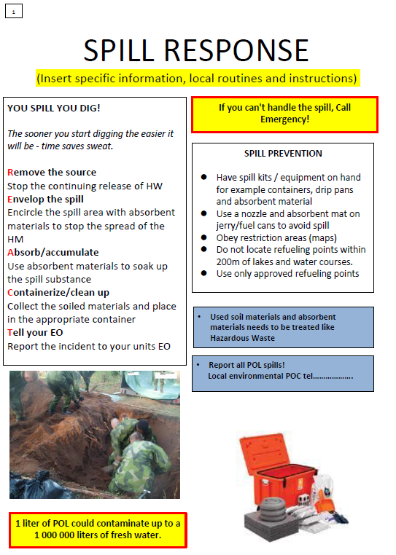
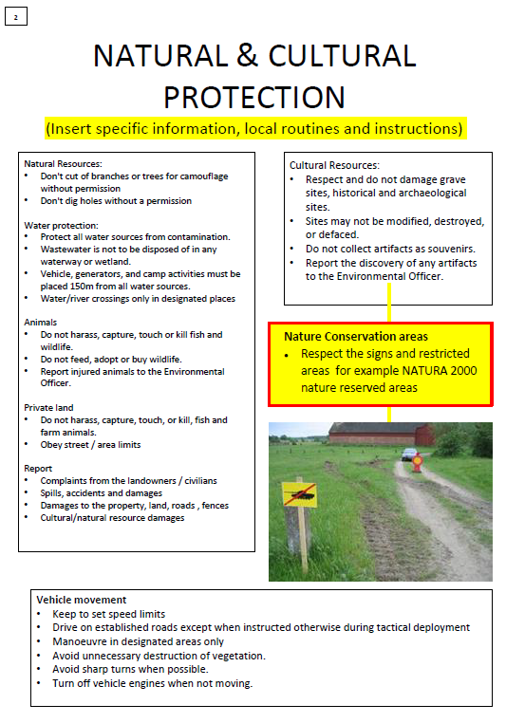
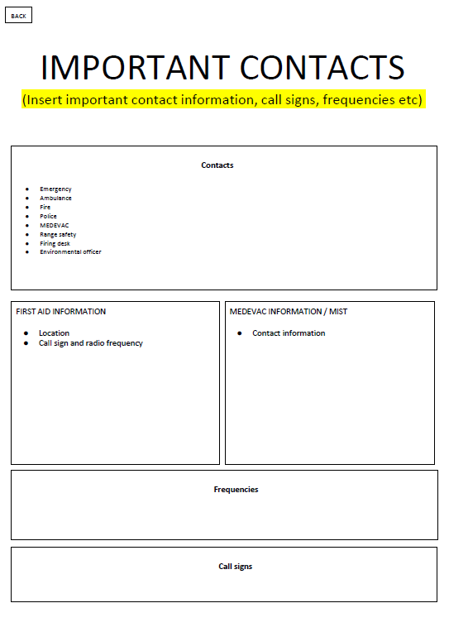
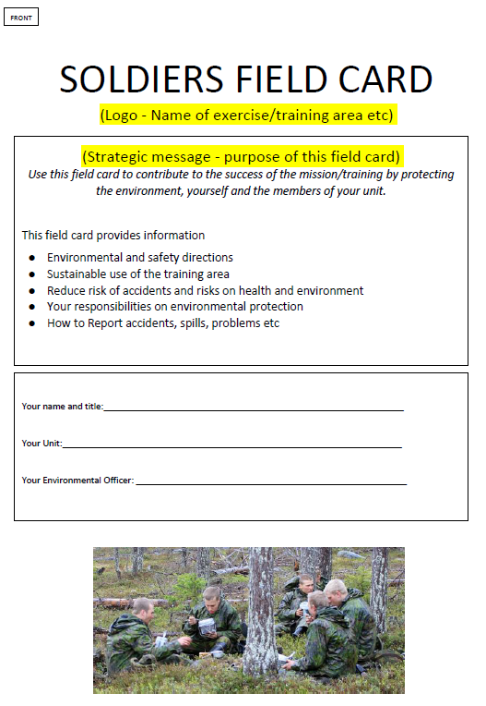
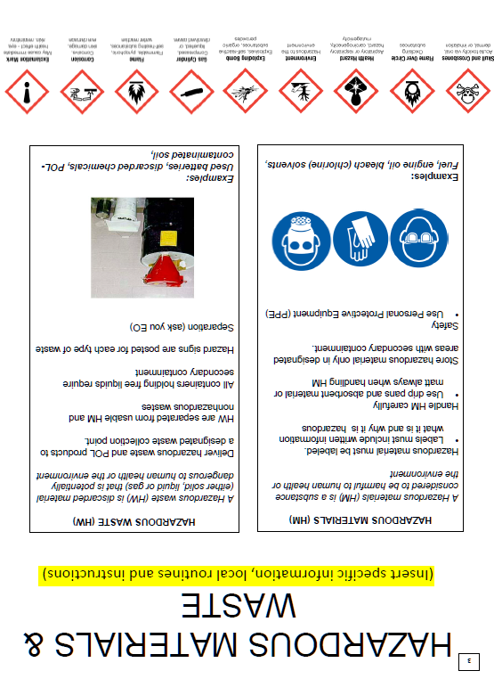
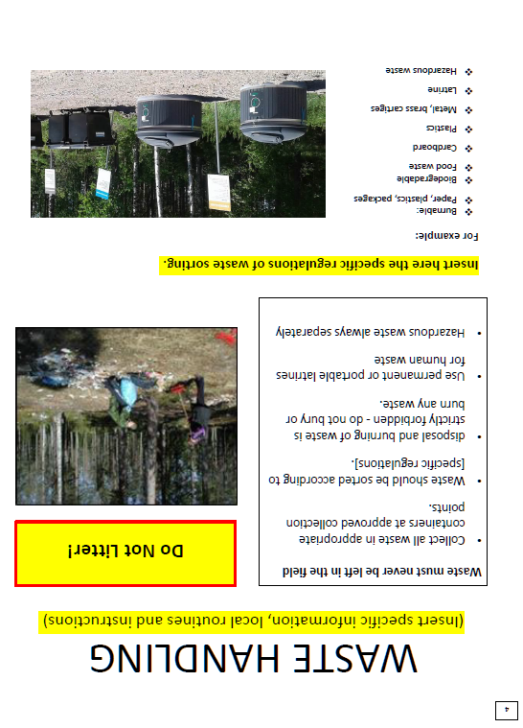

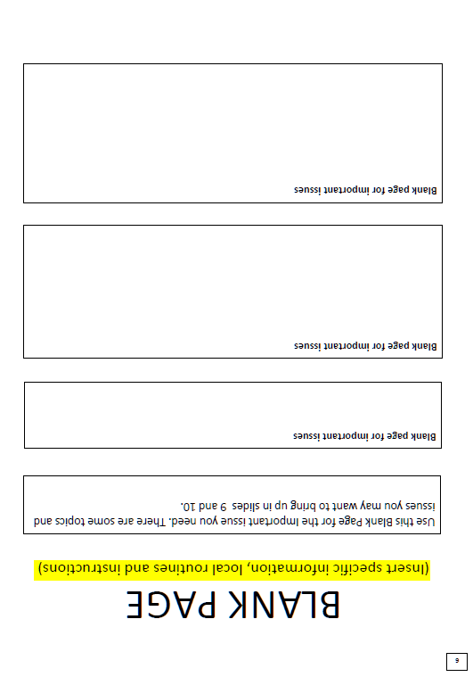
1
2
BACK
FRONT
3
4
5
6

Slide 5
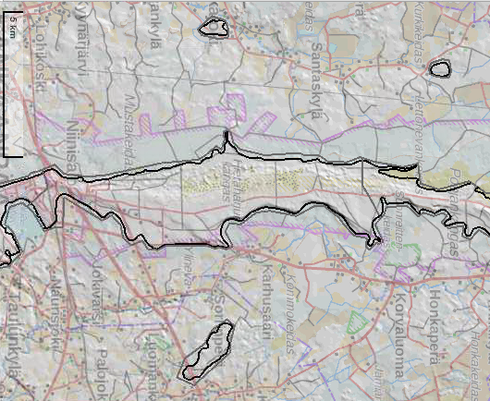
BACK - Map over training area
EXAMPLE
MAP of the training area/ex-area
Example of map information:
Restricted areas (no go, foot traffic only, tactical vehicle movement restrictions, ground/surface water, points/polygons)
Hazmat/HW collection/disposal points
Solid waste collection points
Refueling points
Key points in the legend (e.g. avoid residential areas, planted fields, gardens etc.)
Ranges, range ops, training facilities, impact areas, Drop Zones/Landing Zones

