Slide 1

Environmental Protection Officer Card
Instructions:
The field cards for the Soldier and EPO capture the key environmental guidance and procedures for an exercise. The intent of the Soldier Field Card is to provide concise information to the Soldier on emergency procedures, environmental protection restrictions and key exercise guidance. The EPO Card will be a more detailed document outlining the specific guidance and procedures for environmental protection during the exercise. For both the cards, most of this information is relevant to all exercises and the field cards should require only minor adjustments and modifications to include site-specific information for the exercise, such as maps, information about restricted areas and operations, etc. The EPO and Soldier Field Card templates are posted on the APAN website, and the type of information to insert have been identified on power point slides. This information can then be tailored and pasted into the template to create a field card for the specific exercise.
Content:
Key Roles and Responsibilities
Important contact numbers
Petroleum, Oils and Lubricants (POL)
Spill response
Hazardous Material and Hazardous Waste Management
Waste handling
Cultural Property and Natural Resource Protection
Vehicle Movement
Noise Management
Redeployment Considerations

Slide 2
Key Roles and Responsibilities
This document is to assist the Environmental Protection Officer to further understand the role they assume during the exercise. To allow them to correctly guide leaders, assist soldiers, and document any unforeseen issues that occur during the training exercise. Below are some of the areas that the EPO should be knowledgeable about and be able to access or pull information to provide to the training units
Why we do this
  It’s the law!
  It supports Mission Readiness
  It supports civil/military public relations
References/documentation
  AJEPPS, HN Laws, EP Tool Box, TA, OPORD, EXORD
  Safety Data Shield, field cards
  GIS tools (Geographic Information System)
Reporting Requirements
Risk Analysis
Educate the Soldiers
Monitoring
Restricted areas (no go, foot traffic only, tactical vehicle movement restrictions, ground/surface water, points/polygons)
Hazardous Material (HM/Hazmat)/Hazardous Waste (HW) collection/disposal points
Solid waste collection points
Refueling points
Key points in the legend (e.g. avoid residential areas, planted fields, gardens, etc.)
Ranges, range ops, training facilities, impact areas, Drop Zones/Landing Zones

Slide 3
Important Contact Numbers
Environmental/Damage/Safety Officer
Range Control (Exercise or training area) NOTE: Understand emergency, spill response, wildland fire, etc. procedures.
Emergency Response
Hazmat/HW collection/disposal POC
Blank lines to be filled in with exercise or training area specific POCs
Environmental Protection Officer
Name:____________________
Tel:_______________________
Alternative Environmental Protection Officer
Name:____________________
Tel:_______________________
Emergency
Tel:_______________________
Notify Emergency Services immediately if:
You cannot contain the spill
A poisonous gas is spilled
The release is dangerous to human health and/or the environment
The hazmat has been released in or near water
Emergency Contacts
EMERGENCY POCs
Medical Emergencies in Europe:
112 or 999
TRICARE INTERNATIONAL:
+44 (0) 22-8762-8133
Host Nation Emergency Number:________________________
* Enter HN specific information as necessary

Slide 4
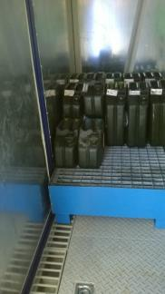
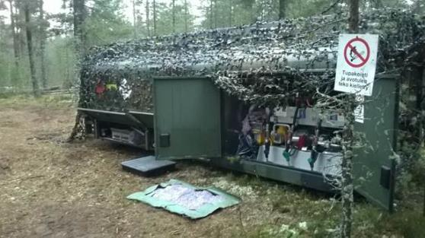
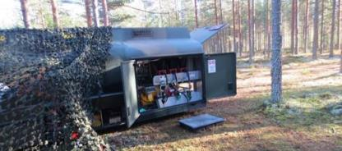
Petroleum, Oil and Lubricants (POL)
Refueling points and procedures
  Surface or groundwater restrictions
  Specified refueling locations
  Report locations or accidents
Storage and transportation
  Secondary containment
Vehicle maintenance guideline
Inspect fueling locations to ensure that secondary containment is in place
If possible ensure that rain cover is in place to limit the amount of snow/rain entering the secondary containment
Secondary containment should be constructed of materials capable of containing a spill and it must be compatible with the stored material
* Enter HN specific information as necessary

Slide 5
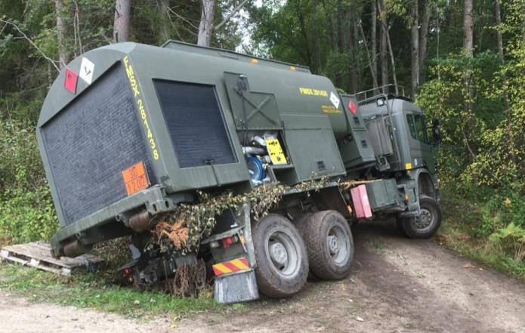
Spill Response
YOU SPILL YOU DIG!
The sooner you start digging the easier it will be - time saves sweat.
Remove the source
Stop the continuing release of HW
Envelop the spill
Encircle the spill area with absorbent materials to stop the spread of the hazmat/HM
Absorb/accumulate
Use absorbent materials to soak up the spill substance
Containerize/clean up
Collect the soiled materials and place in the appropriate container
Tell your Host Nation representative
Report the incident and steps for remediation etc. to the Host Nation representative

Slide 6
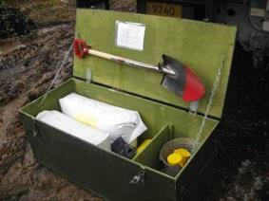
Spill Response
REACT
Remove the source, Envelop the spill, Absorb/accumulate, Containerize/clean up, Tell your Host Nation representative
You spill, You dig!
If you can deal with the spill with a shovel, do it. Anything more: contact the Host Nation or Emergency and follow their guidance.
Personal Protective Equipment (PPE) available that is compatible for the type(s) of hazmat used
Effects of spills (graphic, environmental damage, description), HN Reporting Requirements
Spill response kits should meet the following criteria:
• Readily available in all areas where hazmat/HW are used, accumulated and handled
• Readily available in all areas where POL is handled
• Specific to the type and volume of hazmat/HW at each site.
Spill kits:
Absorbents such as spill pads, pillows, socks, and or loose absorbents (what kind do you have, where are they located, how many do you have, etc.)
Sanitizers such as waste bags, sealing tape, HW labels, and detergent
Tools such as broom or brush, plastic scoop, dust pan, non-spark shovel, and tongs
At a minimum, the spill response kits
will contain the following:
• Absorbents
• Fire extinguishers (type ABC)
• Non-sparking shovels
• Push brooms
• waste bags for HW
The EPO is required to inspect all spills and report the extent of the spill and steps for remediation. The EPO will need to ensure the information has been uploaded to used GIS tool either by the EPO or Host Nation representative, if needed.

Slide 7
Spill Response Kits and Reporting
Spill response kits should be stocked with the appropriate equipment for a particular hazard and items.
Common hazards and their associated clean up equipment include:
Gather important data about the spill to report to your EPO or Host Nation representative:
Your Name: ________________________________________
Your Unit: _________________________________________
Your Phone Number:_________________________________
Local Time an Date of Spill: ____________________________
Spill Location (site, exercise name and grid coordinates): _____
___________________________________________________
Source of Spill (tanker truck, unknown, etc.)________________ ___________________________________________________
Estimate of how much was spilled (gallons or liters): _________ Material spilled (gasoline, diesel, etc.): ____________________
Operation underway when spill occurred (fueling, repair work, etc): ________________________________________________
Cause of Spill (faulty tank level indicator, monitoring error, collision, etc.): _______________________________________
____________________________________________________
Movement of Spill (direction, rate, etc.): ___________________
Description of area (proximity to water; any damage to health, property, wildlife, etc. whether inside or outside the site perimeter): __________________________________________
____________________________________________________
Description of action taken: _____________________________
____________________________________________________
____________________________________________________
BATTERIES
Chemical-resistant PPE
Acid neutralizer
Absorbent
Clean-up tools
Durable, waterproof container
FUELS & OILS
Chemical-resistant PPE
Water-repellent absorbents
Clean-up tools
Durable, waterproof container
CHEMICALS
Chemical-resistant PPE
Chemical absorbents
Non-sparking clean-up tools
Corrosion-resistant container

Slide 8
Hazardous Material Management
Health hazard
Explosive
A Hazardous materials (Hazmat) is a substance considered to be harmful to human health or the environment.
When hazmat are not stored, used or disposed of correctly, You and the members of your unit are in danger of being exposed to the harmful materials. Exposure can lead to health problems that will affect your and your unit members' physical readiness.
Hazards: Short-term (acute hazards) and/or long-term (chronic hazards) effects
Examples: Antifreeze, methanol, and pesticides
Hazards: Physical injuries from the sudden release, harm or injury from the mixture formed during the explosion, potential inhalation danger; re-ignition can occur after extinguished
Examples: Picric acid, TNT, ammunition, and lithium batteries
Flammable
    Hazards: Heat/burns can be poisonous, and evaporate easily and may make the area unsafe
    Examples: Methanol, solvent, and fuel
Oxidizer
Hazards: Skin and eye irritation, corrosive potential and fires may produce toxic fumes
Examples: Nitric acid, ammonium nitrate, calcium hypochlorite and oxygen
Irritant
    Hazards: General discomfort, acute toxicity, and allergic reaction
    Examples: Degreasing agents, solvents, lubricating oils, ammonia, and acetic acid
Common hazardous materials include the following:
  • Fuel
  • Engine oil
  • Bleach
  • Solvent
  • Antifreeze
  • Transmission and brake fluid
  • Batteries
  • Meals Ready to Eat (MRE) Heaters
Environmental
  Hazards: Contaminants can be ingested through groundwater or through other consumables (for example, animals and plants); potential for costly cleanup or fines
  Examples: Oils, fuels, and chlorine
Gas cylinder
Hazards: Rupture and rapid release; contents can be hazardous
Examples: Oxygen gas, propane, and ammonia
Corrosive
Acute toxicity
    Hazards: Cause damage to the skin and eyes and irreversible damage to metals; can be harmful if in-haled, can produce toxic and/or corrosive fumes if burned, and may react with water
    Examples: Battery acid, hydrochloric acid, spent bleach, sulfuric acid, and ammonium hydroxide
Hazards: Symptoms typically include those of a sudden illness; short-term exposure can produce irreversible and/or fatal results, or can contribute to chronic illnesses
Examples: Fluorine, hydrogen sulfide, nitrobenzene, pesticides, antifreeze, and poison

Slide 9
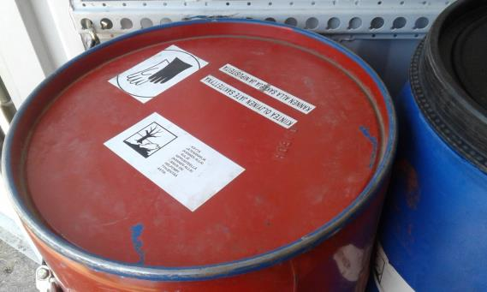
Hazardous Material Documentation
Key Environmental Protection sections of the Safety Data Sheets
Labeling, lists of chemicals.
Pictures of safety labels
EPO must:
understand and communicate the precautions must be taken for the different Hazardous materials involved in the exercise,
know how to access the information
to hold soldiers accountable that they are using secondary containment when available
Photo: You Spill, You Dig, 2018, Forces in Europe

Slide 10
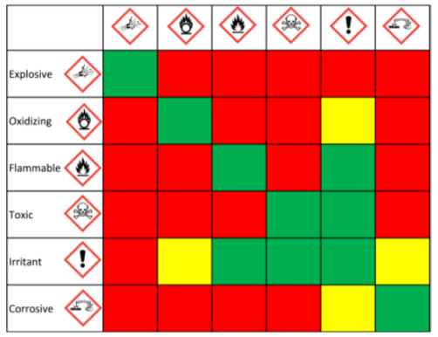
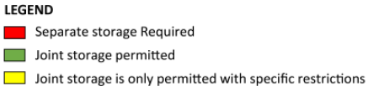
Hazardous Material Handling and Containment
Storage and transportation
Always keep the following types of chemicals stored apart from one another:
  Flammables, Oxidizers, Corrosives and Toxics
  A physical hazard outweighs a health hazard. For example, methanol antifreeze is flammable and toxic (store to flammable).
  Keep organic, oil-based chemicals away from inorganic chemicals.
EPO will inspect the storage areas and ensure storages and transportation of hazmat complies with HN standards.
Photo: You Spill, You Dig, 2018, Forces in Europe
Use rain covers or other forms of protection to minimize the amount of precipitation collected in secondary containment
Photo: Environmental Compliance Handbook, 2018, U.S. Army in Europe

Slide 11
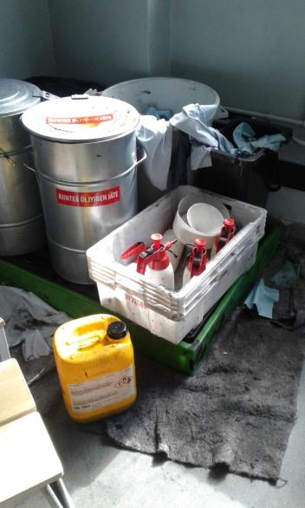
Hazardous Waste Management
Waste products that pose a threat to human health and the environment are considered hazardous wastes. A Hazardous Waste (HW) is any discarded material (either solid, liquid or gas) that exhibits characteristics that are potentially dangerous to humans, material, equipment, facilities and/or the environment.
Common Hazardous Wastes include:
• Used oil filters
• Soiled spill kit materials
• Used batteries
• Spent solvents, thinners, adhesives, paints, and resins
• Contaminated rags and wipes
• Contaminated soil
• Unused MRE Heaters
The EPO should know what the host nation expects (symbology, structure, vicinity) and how the SN is expected to execute the guidance (inspections, ensuring compliance, creating reports in accordance with the Host Nation standards)

Slide 12
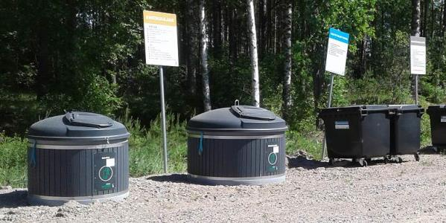
Solid Waste Disposal
Do not litter!!!
Inspect the deployment areas before, during and after use
Never burn trash with open fire or bury trash in the field
Collect all waste (including kitchen waste) in appropriate containers at approved collection points
  If the soldier living area have waste collection points and sorting areas, use it
  Be aware if the living area collection points differ from waste collection and sorting during exercises
  → Follow Host Nation sorting guidance
Use permanent or portable latrines for human waste
Brass recovery: track where there is a large amount of brass to recover it in the spring or summer
Elements of a Waste Hierarchy
most favored option
Reduce
Reuse
Segregation is a central element of waste management
Recycle
Recover
least favored option
Dispose

Slide 13


Cultural Property and Natural Resource Protection
See Map Recommendations (NATO standard symbology)
Understand and obey Host Nation restricted areas
Understand and obey Host Nation procedures for tactical digging and cutting of trees for camouflage
Don't cut of branches or trees for camouflage without permission
Don't dig holes without a permission
Cultural Properties and Resources:
Respect and do not damage grave sites, historical and archaeological sites (activities must be placed 200 m from the sites)
Sites may not be modified, destroyed or defaced
Do not collect artefacts as souvenirs
Nature Conservation areas
Respect the signs and restricted areas!
Water protection:
Use only approved water and river crossings
Protect all water sources from contamination
Wastewater is not to be disposed of in any waterway or wetland
Vehicle, generators, and camp activities must be placed 200 m from all water sources
Animals
Do not harass, capture, touch or kill fish and wildlife
Do not feed, adopt or buy wildlife
Report
Report the discovery of any artefacts
Report cultural/natural resource damages
Report injured animals

Slide 14
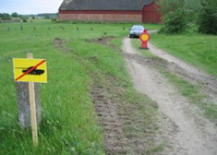





Vehicle Movement
Stay on established roads and trails within the training area. Remain inside the training area boundary. Follow exercise procedures for driving outside training areas
Avoid unnecessary destruction of vegetation
Be aware of potential risk of collision with wild animals
Observe posted traffic signs, obey traffic signs and obey speed limits
Wear seat belts; no riding in cargo compartments
Wear safety equipment (seat belts, gunner restraints and PPE)
Ensure all loads are secure and cargo covers are fully tied down
Report
Complaints from the landowners / civilians
Spills, accidents and damages
Damages to the property, land, roads, fences
Cultural/natural resource damage
Drivers must be licensed for the equipment they operate
Keep headlights on at all times while driving
Do a “360” check around vehicles prior to movement.
Use drip pans, chock blocks and antenna tie downs
Turn off vehicle engines when not moving

Slide 15

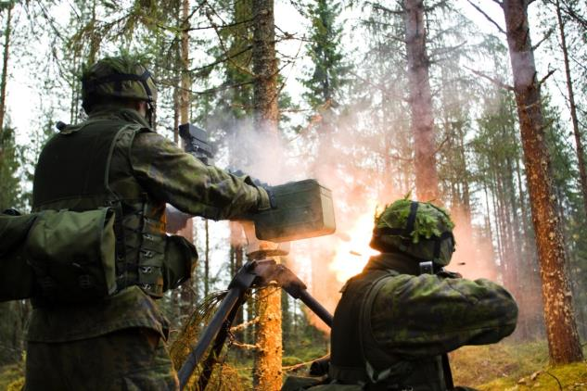
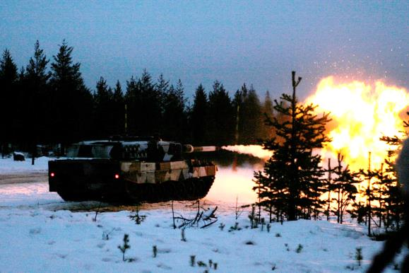
Noise Management
Try to manage heavy weapon noise
Plan helicopter operations to minimize noise effects to civilian communities and animal farms, etc.
Restrict use of training ammunition when operating near civilian premises (200 m from residential structures)

Slide 16
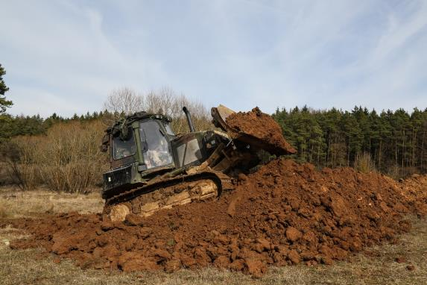
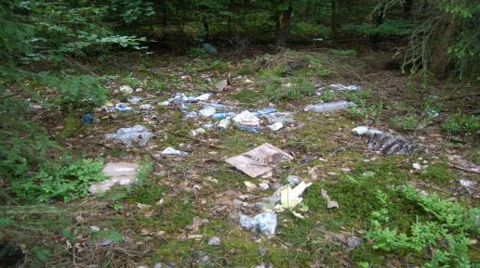
Redeployment Considerations
Only use designated vehicle and equipment wash facilities
Confirm fighting positions, foxholes, and trenches are properly closed and filled in
Collect communication, electrical and obstacle wires
Dispose of waste and litter
Mark and report unexploded munitions
Report contain and clean-up spills
Inspect all sites before departing
Cleaning up trash, police call/environmental walk
Complete Host Nation checklist prior to departure

