Slide 1
2017_ver 1.0

Slide 2
Technical Module
2017_ver 1.0
Water and Wastewater Management
2

Slide 3
Objectives
2017_ver 1.0
Understand the importance of water and wastewater management
Be familiar with common water and wastewater management procedures
Assemble data to make informed choices concerning water reuse, recycling and treatment
Be familiar with alternatives that are appropriate for camp conditions
Be aware of future technologies
Notes:
This slide lays out the main objectives for water and wastewater management.

Slide 4
Definitions
2017_ver 1.0
Potable water: water that is fit for human consumption and food preparation
Non-potable water: water that is not of drinking water quality
Untreated water: water from surface or aquifers that has not been treated
Wastewater: water changed in its characteristics by domestic, commercial, agricultural or other use
  Gray water: wastewater from laundry, showers, dining facilities, hand-washing devices, wash racks
  Black water: water contaminated with animal or human fecal matter
Notes:
There are two types of wastewater: gray water and black water. According to the NATO definition, wastewater is black water, gray water, and other water changed in its characteristics by domestic, commercial, agricultural or other use, excluding potable water.
Untreated water does not mean recycled water.
Water and wastewater management is described in STANAG 2582, Environmental Protection Best Practices and Standards for Military Camps in NATO Operations, AJEPP-2.

Slide 5
Significance and Benefits
2017_ver 1.0
Effective water and wastewater management can:
Act as a force multiplier: when fewer soldiers are needed to resupply water, more soldiers are available for the mission
Help meet mission requirements
Prevent health problems
Reduce water demand and wastewater generation, which decreases resupply risks and costs and increases security
Demonstrate good stewardship of water resources
Minimize legal liability
Promote good relations with the host nation (HN) and local communities
Notes:
There are a number of benefits which sound water management provides. This slide highlights such benefits.

Slide 6
Environmental Officer (EO) Responsibilities
2017_ver 1.0
Work with medical officer to evaluate water quality and potential use and reuse
Make recommendations on
  Suitable treatment technology
  Potable water source
  Water conservation practices
  Wastewater disposal options
Work with appropriate staff officers to integrate water considerations into camp master plan
Monitor wastewater to ensure it meets applicable effluent standards
Maintain records of disposal locations
Manage contracts as required
Notes:
In determining water quality, the environmental officer (EO) will provide the water for testing, but the medical officer is the only authority who can declare water safe for drinking purposes.
This slide lists a number of other EO responsibilities pertaining to water and wastewater.

Slide 7
Integrated Water and Wastewater Management
2017_ver 1.0
Water supply and wastewater treatment are interrelated and must be managed as a system
Wastewater reuse and recycling reduces water requirements
Once wastewater is treated, it can be reused for other purposes
  The specific use depends on the level of treatment
  The EO needs to coordinate with the commander and medical officer to determine the approved reuse
There are field-expedient sanitary waste options available, as described in the waste module, when no other options are available (e.g., latrines)
Notes:
Ways in which wastewater can be reused are explored later in this briefing.

Slide 8
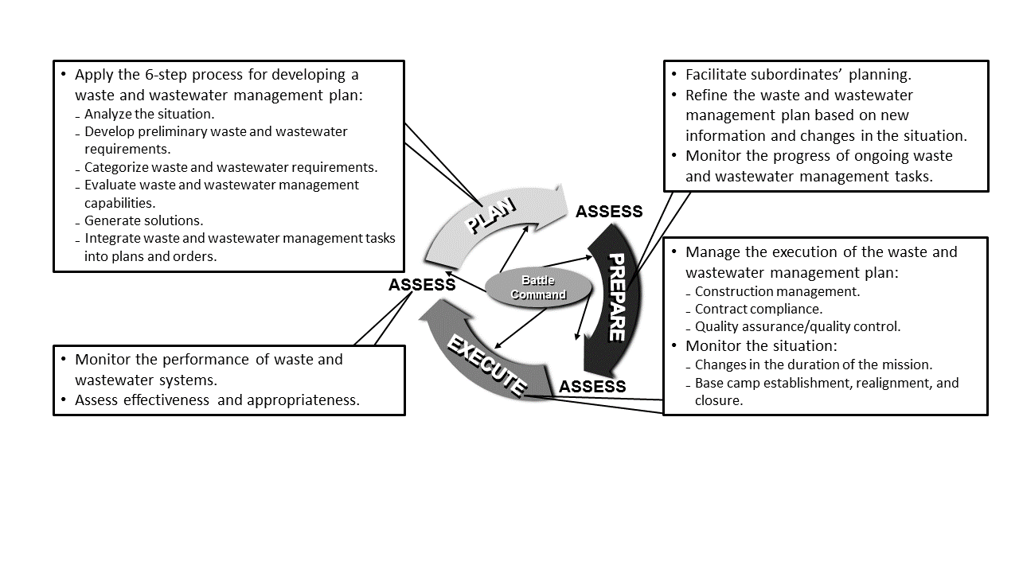
Water and Wastewater Management Process Overview
2017_ver 1.0
8
Notes:
This overview follows the standard ”plan, prepare, execute” process where you conduct assessments at each of the stages. The boxes list details within each step of the process.
The source for this image is the US Army Technical Manual 3-34.56/US Marine Corps Interim Publication 4-11.01, Waste Management for Deployed Forces, 19 July 2013.

Slide 9
Water and Wastewater Management Plan
2017_ver 1.0
The Water and Wastewater Management Plan is part of mission planning and must be mission-specific. The most effective Plan will minimize the logistical burden and use of manpower, be reliable and robust, and minimize any adverse impacts on the environment and local inhabitants.
The Plan must consider, as a minimum:
Planning and mission-specific conditions
Water and wastewater requirements and standards
Operation and maintenance of equipment
Monitoring and evaluation of water usage and wastewater generation (by type) to identify potential areas of concern or optimization opportunities
Water and wastewater camp closure requirements
9
Notes:
The aspects presented in this slide are in accordance with NATO’s AJEPP-2.
Water and wastewater management should be considered in all processes, such as camp construction and equipment purchases.

Slide 10
Six-Step Development Process
2017_ver 1.0
Initial considerations
Six-step development process
Analyze the situation: to include security level, location, duration, size, geology, possible water sources and economy
Develop preliminary water and wastewater estimates: potable, non-potable, gray and black water
Categorize water and wastewater requirements (time-scale): appropriate methods are based on mission duration
Evaluate water and wastewater management capabilities: HN and/or contractors’ abilities, equipment options, etc.
Generate solutions suitable for the mission: solutions must meet mission requirements
Integrate water and wastewater management tasks into plans and orders
Continue to monitor
10
Notes:
Water and wastewater management should not be pursued in an ad-hoc manner. For best results, water and wastewater management should be taken into consideration from the start and continuously updated thereafter.
When planning water and wastewater management systems, you should include risk assessment to determine best practices and methods.
Methods and systems for water and wastewater management should be chosen based on several factors for the specific operation such as geography; security, health and environmental considerations; and equipment options.
Evaluate water and wastewater management capabilities. What are the HN and/or contractors abilities for receiving and handling wastewater? What equipment and treatment capabilities do they have available?

Slide 11
Initial Planning Considerations
2017_ver 1.0
Start planning early
Fulfill current requirements and anticipate future needs
Site location
  Maximize gravity flow for wastewater collection systems
  Site wastewater collection, treatment and disposal downwind of inhabited areas
  For surface discharge, locate downstream of potable water intake and act in accordance with established standards
Efficient water distribution systems
  Create loop systems (instead of branched networks) to build in redundancy and minimize pumping requirements
11
Notes:
Initial considerations will vary based upon site characteristics and mission requirements. The examples on this slide are applicable for any military operation.

Slide 12
Analyze the Situation
2017_ver 1.0
Goal: identify the amount of water needed and where and how much wastewater will be generated by the unit
Considerations
  Availability of water
  Mission
  Local threat conditions
  Terrain and weather
  Troops and support available
  Time
  Civil considerations
  Available infrastructure
  Other
12
Notes:
In order to properly plan water and wastewater management, it is first important to determine both how much water will be needed and how much wastewater is likely to be generated. This slide lists a number of factors that will affect both the amount of water and wastewater and the possible solutions. For example, time considerations can include not only the mission duration but also the amount of time available prior to deployment and time available to meet mission requirements.
Other considerations include:
Risks to groundwater, surface water, and sources of potable water
Dust control and respiratory health hazards (dust abatement)
Vector and bird control
Grease traps at necessary locations (e.g. dining facility)
Some of these issues are addressed in more detail in the technical module’s “Introduction” briefing.

Slide 13
Water Usage Planning Factors
2017_ver 1.0
Function | Water Usage Factor (liters/person/day)
 | Short-term | Long-term
Potable Water
Drinking | 15 | 15
Personal Hygiene | 11 | 11
Shower | 11 | 55
Food Preparation | 15 | 20
Hospital | 4 | 8
Heat Treatment | 4 | 4
Nonpotable Water
Laundry | 19 | 53
Construction | 8 | 8
Graves Registration | 2 | 2
Vehicle Operations | 2 | 7
Aircraft Operations | 8 | 11
Firefighting | 8 | 15
Subtotal | 107 | 209
10% Loss Factor | 11 | 21
Total | 118 | 230
Notes:
This slide shows example planning factors from ATP 3.12.1.4, Deployed Force Infrastructure. Your unit’s water usage will vary based on location and mission requirements.
The “10% loss factor” accounts for potential losses in the water distribution network to include leaks from connections, pipes, and storage bladders.

Slide 14
Develop Preliminary Wastewater Estimates
2017_ver 1.0
Source | Liters per person per day
 | Short-term | Long-term
Latrines | 30 | 30
Showers | 19 | 57
Food Preparation | 15 | 19
Hospital | 4 | 4
Laundry | 8 | 53
Total | 76 | 163
Notes:
This slide shows example planning factors from ATP 3.12.1.4, Deployed Force Infrastructure, annex A for camps based on mission duration and water uses. Your unit’s wastewater generation will vary based on location and mission requirements.
This type of information is useful in planning for wastewater segregation requirements and reuse or recycling capability.

Slide 15
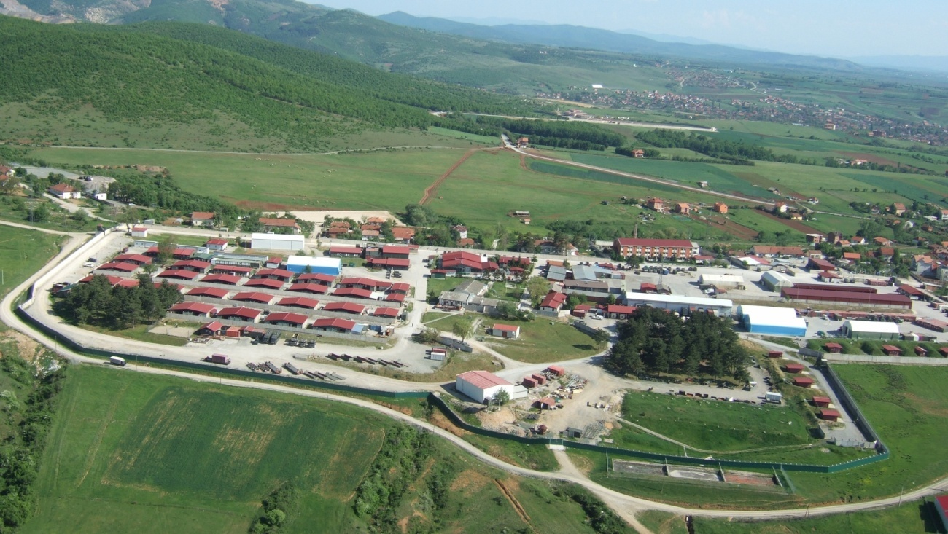
Consider Duration of Mission
2017_ver 1.0
Short (sustain operations for a minimum of 60 days)
Medium (approximately 60-180 days)
Long (more than 180 days)
Closing
15
Notes:
Expected mission duration will affect the choice of techniques and equipment used for water and wastewater management (recycling, reuse, treatment and disposal) options, as listed in the slides later in this presentation.
These modules focus on solutions and options as a follow-on to field expedient solutions required during initial deployment. The choice of methods are likely to become more complex as the camp matures or the mission changes.

Slide 16
Evaluate Wastewater Management Capabilities
2017_ver 1.0
Can your unit meet its water and wastewater requirements?
Does your unit have adequate resources to include:
  Manpower
  Equipment
  Materials
  Funding
Identify potential shortfalls
  What are HN and/or contractor capabilities to address these shortfalls?
16
Notes:
There are two ways to handle water and wastewater management responsibilities: within the unit or going outside the unit, relying on contractor or HN capabilities.
This slide first lists some of the factors to consider when determining if your unit will be able to meet water and wastewater management requirements. It then notes the option for outside assistance in addressing potential shortfalls.

Slide 17
Generate Solutions
2017_ver 1.0
Determine potential solutions that are:
  Feasible
  Suitable
  Sustainable
If contracting is required, ensure environmental considerations are included:
  Statement of work
  Monitoring and evaluation plan
Evaluate options and present at Environmental Management Board (EMB) for Commander’s decision on the approved course of action (COA)
17
Notes:
The feasibility of solutions is based on the availability of:
manpower (and skill sets)
equipment
materials
funding
contracted support
cost-benefit analysis
The suitability of solutions is based on:
terrain characteristics, such as soil composition, surface configuration, and slope
weather conditions, such as prevailing winds, humidity and precipitation
environmental conditions, including environmentally sensitive areas such as historical and cultural sites
health considerations in terms of health risk severity, probability of health risk, and the ability to mitigate risk
cost effectiveness in terms of both initial and sustainment costs
The sustainability of solutions is based on:
mission demands
environmental considerations
acceptance or tolerance of the local population, host nation
allowable design and construction standards
cost effectiveness in terms of both initial and sustainment costs
In some cases, the deploying force will not be able to address all water and wastewater requirements internally and will therefore have to rely on contractor support. It is important to incorporate environmental considerations into the contract specifications.
Once solutions have been identified and prioritized, the EO should present these for consideration by the EMB and the commander.

Slide 18
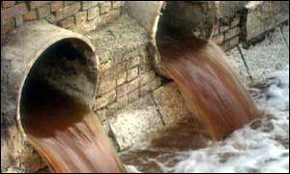
Integrate Water and Wastewater Management into Plans and Orders
2017_ver 1.0
Finalize the water and wastewater management plan that supports the approved COA
The plan should contain the who, what and when for each step in the process:
  Demand/reduction
  Recycling/Reuse
  Conveyance
  Treatment
  Disposal
18
Notes:
Water and wastewater management is the demand/reduction, recycling/reuse, conveyance, treatment, or disposal of water and wastewater in an effort to ensure a healthy and sanitary environment for base personnel, while preserving the environment and sustaining mission readiness. It also includes the measures and activities necessary for minimizing water use and wastewater generation.

Slide 19
Examples of Demand Reduction Practices and Equipment
2017_ver 1.0
Practices
  Water recycling and reuse
  Good maintenance of water lines and storage
  Rainwater collection
  Education and awareness
Technologies
  Low flow and timed shower heads
  Tankless water heaters
  Composting toilets (suitable for use in low demand areas)
  Plumbing with built-in waste segregation
  Waterless urinals
  Water meters - if you know how much you are using, you tend to conserve more
Notes:
Water is a precious resource. There are a number of ways to reduce water demand, both in terms of practices and the types of technologies used. Some examples are listed here.

Slide 20
Methods for Obtaining and Treating Water
2017_ver 1.0
Notes:
This briefing is limited to the most common methods of obtaining and treating water in current deployed operations. It also assumes that existing potable water systems are not in place.

Slide 21
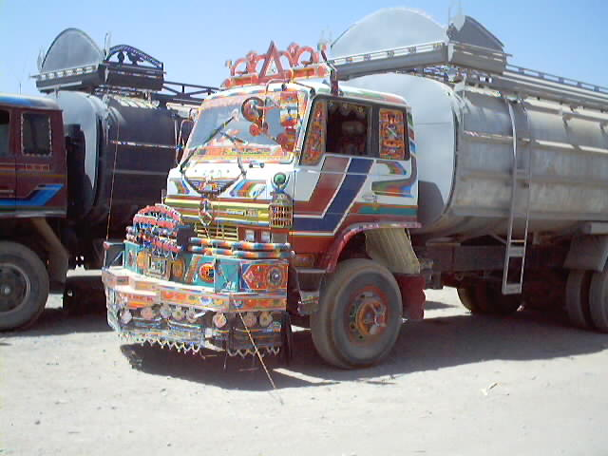
Bulk Water Delivery
2017_ver 1.0
Advantages
  Less packaging
Disadvantages
  Expensive
  Transportation cost/risk
Limitations
  May require additional treatment
  Limited community supplies may restrict availability
  Limited shelf life
Duration Suitability Index
Short | Medium | Long
Notes:
Sources for bulk water delivery could be from the host nation, from the lead nation or other sending forces.
More details about this water source option are outlined on the next slide.

Slide 22
Bulk Water Delivery
2017_ver 1.0
General Design Considerations | Protected storage bags or tanks Locate storage near points of use: showers, latrines, dining facilities, etc.
Limitations | Limited shelf life
Recordkeeping, Reporting | Water quality sampling records If provided by a contractor, contract management is required
Capital Costs | Storage containers (bladders, tanks)
Operations and Maintenance (O&M) requirements | Water quality sampling Maintenance of storage equipment Protection from freezing
Transfer/Closure Requirements | Removal of storage containers Terminate contract, if applicable

Slide 23
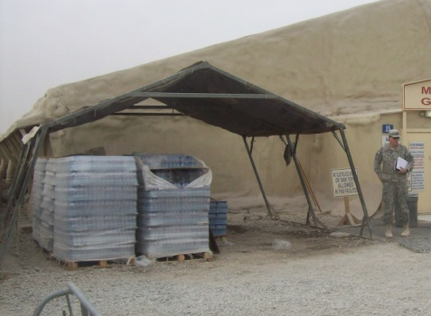
Bottled Water
2017_ver 1.0
Advantages
  No additional treatment
  Convenient for users
  Culturally acceptable
Disadvantages
  Expensive
  Transportation cost/risk
  Generates waste
Limitations
  Storage requirements
  Limited shelf life
Duration Suitability Index
Short | Medium | Long
Notes:
There is an underlying assumption that bottled water is potable. However, the way the plastic bottles are stored has an tremendous impact on its potability: if not adequately protected from the sun and heat, the degradation of the plastic negatively affects potability. The challenges of properly disposing of used water bottles obviously presents another major drawback to this option.
More details about this water source option are outlined on the next slide.

Slide 24
Bottled Water
2017_ver 1.0
General Design Considerations | Protected storage space (from UV or freezing) Disposal of plastic waste
Limitations | Limited shelf life Only a partial water demand solution (does not address showers, fire suppression, etc)
Recordkeeping, Reporting | Tracking of shelf life
Capital Costs | Storage facility
O&M Requirements | Materiel handling equipment Controlled storage Collection for recycling
Transfer/Closure Requirements | Terminate contract

Slide 25
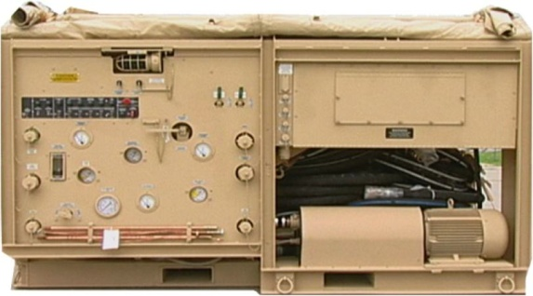
WATER TREATMENT
Mobile Reverse Osmosis (RO)
2017_ver 1.0
Advantages
  Effective with most sources
  Removes all contaminants and pathogens
  Short start up time
Disadvantages
  Energy inefficient
  Requires specialized training
Limitations
  Requires up to 3 units of untreated water to create 1 unit of potable
  Generates brine and wastewater streams
Duration Suitability Index
Short | Medium | Long
Notes:
Reverse osmosis (RO) can treat most types of contaminated water, to include nuclear, biologically, chemically (NBC)-contaminated water (with specialized attachment); however, it cannot treat oil-contaminated water. While a RO can treat chlorinated water, doing so will very quickly degrade the filter membranes.
Different countries have different RO systems and the water may need to be softened.
Maintenance and backwashing of RO requires approximately 4 hours per day.
The amount of untreated water needed to create one unit of potable water will depend on the specific equipment used as well as the quality of the water source.
More details about this water treatment option are outlined on the next slide.

Slide 26
Mobile Reverse Osmosis
2017_ver 1.0
General Design Considerations | Space for treatment unit, waste brine pit, storage Available power source Locate near water source
Limitations | Up to a 3:1 untreated to potable water Higher power requirements than standard treatment Generates large volumes of brine and wastewater Only a partial water demand solution (cost prohibitive for fire suppression, vehicle washing, and other non-potable uses)
Recordkeeping, Reporting | Water quality sampling records
Capital Costs | RO unit Storage tanks or bags Generator if no central power generation
O&M Requirements | Water quality sampling RO unit maintenance RO filter and membrane changes Maintenance of storage Waste brine disposal
Transfer/Closure Requirements | Removal of tanks Brine pit closure
References | Air Force Handbook 10-222, Volume 9,1 April 2011 Air Force Pamphlet 10-219, Volume 5, 30 March 2012

Slide 27
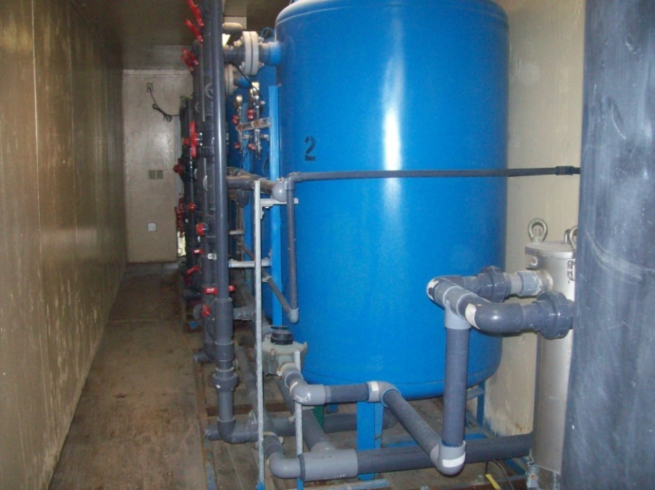
WATER TREATMENT
Fixed Facility
2017_ver 1.0
Advantages
  Common technology, available worldwide
  Purpose-built
    Treatment technology
    Volume
    Robustness
Disadvantages
  Capital cost
  Not mobile
  Contractor built/operated
Limitations
  Skilled operators required
  Construction time
Duration Suitability Index
Short | Medium | Long
Notes:
Filtration can include sand filters, granular activated carbon, or microfiltration. This focuses on aspects specifically related to a fixed, rather than mobile, facility.
More details about this water treatment option are outlined on the next slide.

Slide 28
Fixed Facility
2017_ver 1.0
General Design Considerations | Space for treatment unit, storage Available power source Locate near water source
Limitations | Requires skilled designers and operators, may not be suitable for tactical uses
Recordkeeping, Reporting | Water quality sampling records Contract management
Capital Costs | Construction of the facility, treatment tanks, piping, and other components Storage tanks or bags Generator, if no central power generation
O&M Requirements | Skilled operators Water quality sampling General Maintenance (e.g., storage tanks, filter and membrane changes)
Transfer/Closure Requirements | Removal/disposal of facility Contract close out

Slide 29
Wastewater Treatment and Disposal Methods
2017_ver 1.0

Slide 30
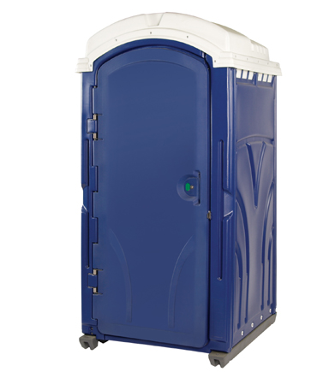
EXPEDIENT BLACK WATER TREATMENT: Chemical Toilet
2017_ver 1.0
Advantages
  Most hygienic expeditionary field method
  Can be relocated
Disadvantages
  Must be emptied frequently
  More expensive than other expeditionary methods
Limitations
  Contract support required
  Procurement timeline may not meet expeditionary timeline
Duration Suitability Index
Short | Medium | Long

Slide 31
Chemical Toilet
2017_ver 1.0
General Design Considerations | Number of toilets needed Locations to properly place toilets balancing personnel convenience and aesthetic requirements (downwind, far from inhabited areas, etc.)
Limitations | Contractor availability and capability
Recordkeeping, Reporting | Contract management
Capital Costs | May have to purchase toilets
O&M Requirements | Must be frequently emptied and serviced (by contractor)
Transfer/Closure Requirements | Remove toilets from site Terminate contract

Slide 32
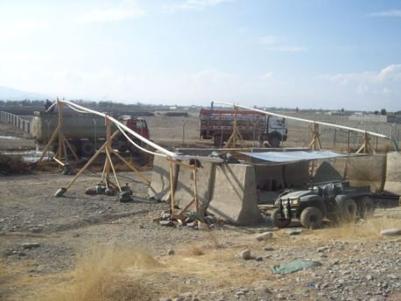
WASTEWATER TREATMENT:
Host Nation (HN) Treatment
2017_ver 1.0
Advantages
  Low capital costs, only storage tanks
  Low maintenance
  Could use either HN collection or connection to local sewer
Disadvantages
  Potential high contract costs
Limitations
  HN must have capability and capacity
  Lack of control over disposal
  Contract management requirements
  Quality assurance for compliance
Duration Suitability Index
Short | Medium | Long
Notes:
More details about this water treatment option are outlined on the next slide.
Before investigating more complex options, determine the capabilities of the Host Nation and whether that provides the most feasible disposal option.

Slide 33
HN Treatment
2017_ver 1.0
General Design Considerations | Daily wastewater volume May require waste transfer point Consider pumping to trucks outside fence line Temporary storage with pit, tanks or bags
Limitations | May not be suitable in non-permissive environment High contract costs and oversight requirements
Recordkeeping, Reporting | Daily effluent Contract management
Capital Costs | Construction of storage and transfer point Pumps
O&M Requirements | Transfer point maintenance Storage point maintenance
Transfer/Closure Requirements | Contract payment and close out

Slide 34
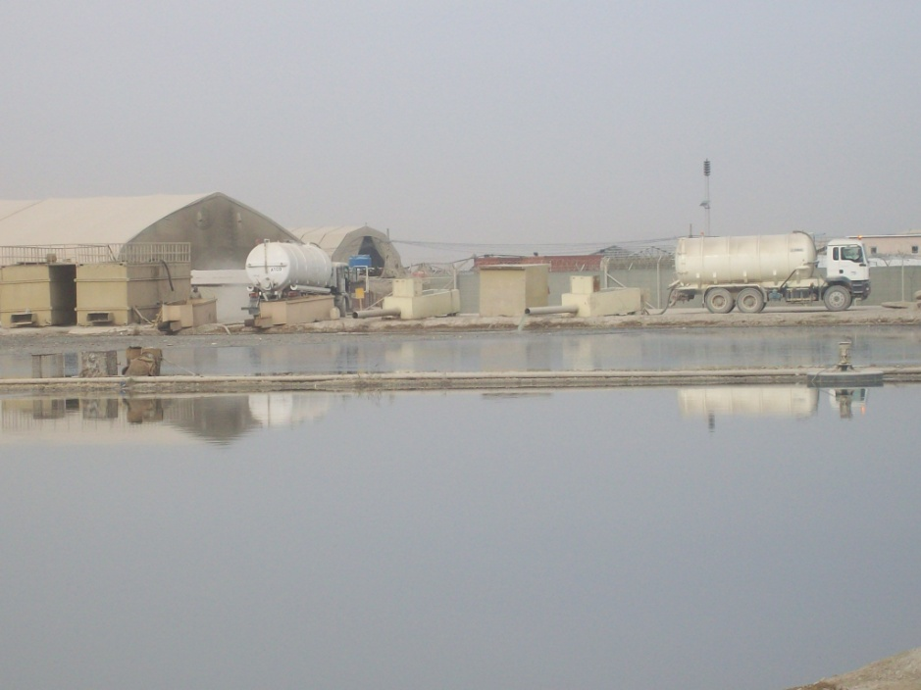
WASTEWATER TREATMENT:
Engineered Facultative Lagoon
2017_ver 1.0
Advantages
  Effective
  Low maintenance
  Least expensive for large volumes
Disadvantages
  Odor
  Large space requirement
  Can attract vectors or pests
Limitations
  Requires engineered design and monitoring to ensure proper functioning
  Aircraft bird strike hazard (site away from airfields)
  Temperature-dependent
Duration Suitability Index
Short | Medium | Long
Notes:
Lagoons are a low cost method of achieving acceptable treatment levels of wastewater effluent. Lagoons can typically treat to biochemical oxygen demand (measure of the organic content in wastewater) and total suspended solids (measure of the physical quality of wastewater) to a limited level.
Bacterial activity does not occur in colder temperatures.
Because of the large size of the lagoon needed, this can attract birds, which creates a bird strike hazard for aircraft. Thus, at an airbase, it is necessary to site the lagoon far away from the runway.
There are three methods of discharge from lagoons: complete retention (no discharge), controlled discharge (discharge 2-4 times per year) and continuous discharge. Method selection will be based on numerous factors to include land availability, climate and environmental impact.
Depth of facultative lagoon is 1.5 – 2.4 meters.
More details about this wastewater treatment option are outlined on the next slide.

Slide 35
Facultative Lagoon
Ver 2.0
General Design Considerations | Lagoon volume and area Consider making large enough for population expansion Retention time for wastewater Soil percolation rates Downwind from living areas for odor and vector control Effluent impact on base populace and surrounding communities Climate data to calculate evaporation rates
Limitations | Base footprint may limit lagoon size Effluent outflow may be limited
Recordkeeping, Reporting | Daily inflow Effluent sampling
Capital Costs | Earthmoving equipment for excavation Impermeable liner
O&M Requirements | Effluent sampling
Transfer/Closure Requirements | Drain effluent, remove liner (if applicable), remove and treat solids, spray with insecticide, backfill to allow drainage from site, install vegetative cover to prevent erosion Location marking or reporting
References | Wastewater Technology Fact Sheet, Facultative Lagoons, http://water.epa.gov/scitech/wastetech/upload/2002_10_15_mtb_faclagon.pdf

Slide 36
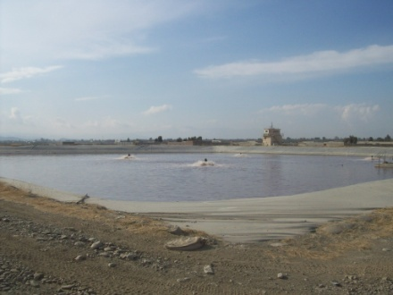
WASTEWATER TREATMENT
Aerobic Lagoon
2017_ver 1.0
Advantages
  Effective
  Low maintenance
  Inexpensive for large volumes
  Less odor than other lagoons
Disadvantages
  Large space requirement
  Can attract vectors or birds
  Needs impermeable liner or compaction
Limitations
  Aerator requires power
  Aircraft bird strike hazard (site away from airfields)
  Temperature-dependent
  Requires engineered design
Duration Suitability Index
Short | Medium | Long
Notes:
The depth of an aerobic lagoon is 0.6-1.5m. At this depth, it is necessary to use a liner to prevent plant growth.

Slide 37
Aerobic Lagoon
2017_ver 1.0
General Design Considerations | Pond volume and area Climatic data to calculate evaporation Consider making large enough for population expansion Residence time for wastewater Soil percolation rates Downwind from living areas for odor and vector control Effluent impact on base populace and surrounding communities
Limitations | Base footprint may limit pond size Effluent outflow may be limited
Recordkeeping, Reporting | Daily inflow Effluent sampling
Capital Costs | Earthmoving equipment for excavation Impermeable liner Aeration pumps and generators
O&M Requirements | Effluent sampling Power for aeration
Transfer/Closure Requirements | Drain effluent, remove liner, remove and treat solids, spray with insecticide, backfill to allow drainage from site, install vegetative cover to prevent erosion Location marking or reporting
References | Wastewater Technology Fact Sheet, Aerated, Partial Mix Lagoons http://water.epa.gov/scitech/wastetech/upload/2002_10_15_mtb_apartlag.pdf

Slide 38
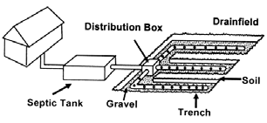
BLACK WATER TREATMENT:
Septic System
2017_ver 1.0
Advantages
  Effective
  Low maintenance
Disadvantages
  Large space requirement
Limitations
  Lower soil percolation requires more land area
  Dependent on water table height
  Land cannot be used for other purposes
Duration Suitability Index
Short | Medium | Long
Notes:
In addition to a septic system requiring a large amount of land, it has the further limitation that this land cannot be used for other purposes, including driving over it.
More details about this water treatment option are outlined on the next slide.

Slide 39
Septic System
2017_ver 1.0
General Design Considerations | Daily wastewater volume Soil percolation rates Available area for septic field Consider making large enough for population expansion
Limitations | Base footprint may limit septic field size Low permeable soils may make impractical Not suitable for high groundwater table areas
Recordkeeping, Reporting | Daily inflow
Capital Costs | Earthmoving equipment for excavation Septic tanks and perforated drain piping Flow measuring device
O&M Requirements | Septic tank cleaning and servicing
Transfer/Closure Requirements | Septic field closure Tank removal Location marking or reporting
References | Septic Drain Field Design and Maintenance http://www.sera17.ext.vt.edu/Documents/BMP_septic_drain_field.pdf

Slide 40
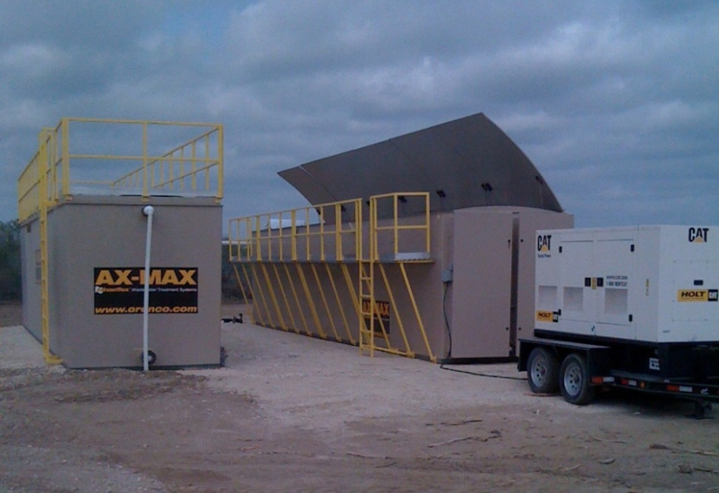
WASTEWATER TREATMENT
Mobile Treatment Plant
2017_ver 1.0
Advantages
  Meets discharge standards
  Smaller footprint than lagoon
Disadvantages
  High capital costs
  Long procurement time if not in the inventory
Limitations
  Must plan in advance if using for initial entry
  Contract oversight
Duration Suitability Index
Short | Medium | Long
Notes:
The suitability index for the short term is yellow because it would not be realistic to utilize this capability in 60 days or less.
More details about this wastewater treatment option are outlined on the next slide.

Slide 41
Mobile Treatment Plant
2017_ver 1.0
General Design Considerations | Daily wastewater volume Area for treatment unit and vehicle traffic Preparing or reinforcing area underneath the plant to protect from spillage May require area for sludge disposal Wastewater transport by pipes or vehicles Can add new units to accommodate population growth Downwind from living areas for odor and vector control Effluent location and impact on base populace and surrounding communities Requires dedicated power
Limitations | Effluent outflow may be limited Requires skilled operators
Recordkeeping, Reporting | Daily inflow Influent and effluent sampling Contract management
Capital Costs | High capital costs for plant
O&M Requirements | Influent and effluent flow volume and sampling Mechanical and biological maintenance Sludge disposal
Transfer/Closure Requirements | Unit removal Location reporting

Slide 42
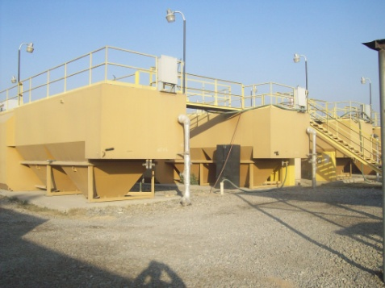
WASTEWATER TREATMENT
Fixed Treatment Plant
2017_ver 1.0
Advantages
  Meets discharge standards
  Smaller footprint than lagoon
Disadvantages
  High capital costs
  Long procurement time
Limitations
  Long-term camps only
  Contract oversight
Duration Suitability Index
Short | Medium | Long
Notes:
More details about this wastewater treatment option are outlined on the next slide.
The suitability index for the short and medium term is red because a fixed facility requires much more time to become operational than a mobile unit due to the time needed to award the contract and construct the facility.

Slide 43
Fixed Treatment Plant
2017_ver 1.0
General Design Considerations | Daily wastewater volume Area for treatment unit and vehicle traffic May require area for sludge disposal Wastewater transport by pipes or vehicles Consider making large enough for population expansion Downwind from living areas for odor and vector control Effluent location and impact on base populace and surrounding communities Requires dedicated power
Limitations | Effluent outflow may be limited Requires skilled operators
Recordkeeping, Reporting | Daily inflow Influent and effluent sampling Contract management
Capital Costs | High capital costs for plant Construction of treatment area
O&M Requirements | Influent and effluent flow volume and sampling Mechanical maintenance Sludge disposal
Transfer/Closure Requirements | Disposal, e.g. transfer to Host Nation

Slide 44
Gray Water Recycling and Reuse Methods
2017_ver 1.0

Slide 45
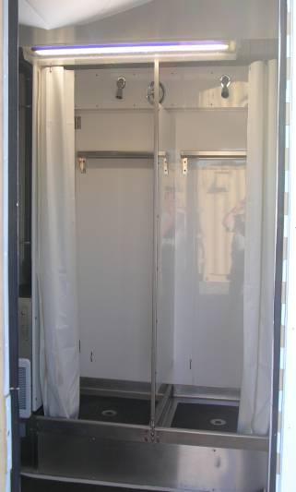
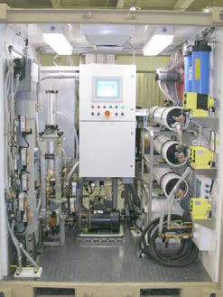
GRAY WATER REUSE
Shower Water Reuse System
2017_ver 1.0
Advantages
  Reuses up to 75-80% of gray water
  Multi-day unattended operation capability
Disadvantages
  Higher capital costs
  More maintenance than regular showers
  More power needed to operate RO unit
Limitations
  May not be widely available
Duration Suitability Index
Short | Medium | Long
Notes:
45,000 Liters Per Day capacity (150 LPM peak flow)
•75%-80% recovery
•Automated chlorine injection
•Self cleaning (air purge) pre-filter to remove solids (15 micron)
•Micro filters (.2 micron) to remove suspended solids w/auto backwash
•Saltwater RO membranes to remove organic materials, bacteria, virus and soap
•Carbon filtration after membrane
•Potable water quality per Tri-Service Standards contained in TB MED 577

Slide 46
Shower Water Reuse System
2017_ver 1.0
General Design Considerations | Capacity to service number of personnel On site water supply and storage Dedicated power
Limitations | Higher level use requires increased treatment, equipment, and trained, skilled personnel Units are not yet widely available
Recordkeeping, Reporting | Influent and effluent sampling
Capital Costs | Water storage tanks or bags Pumps, lines, treatment system
O&M Requirements | Mechanical maintenance
Transfer/Closure Requirements | Draining and repacking system

Slide 47
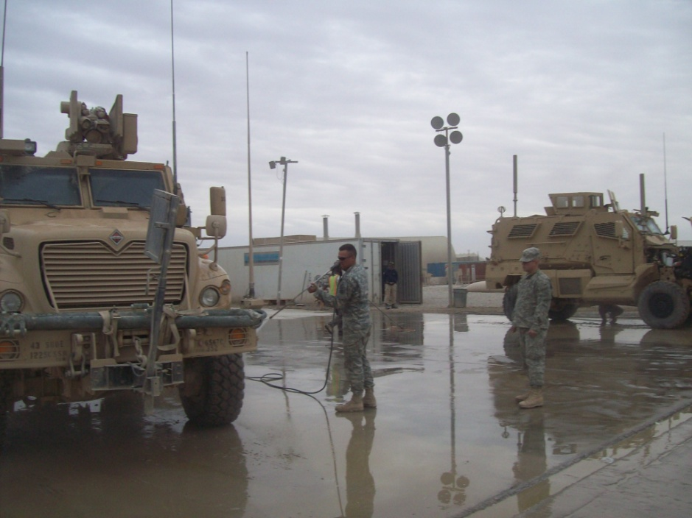
GRAY WATER REUSE
Vehicle Wash Rack
2017_ver 1.0
Advantages
  Reuses up to 50% of gray water
  Integrated units commercially available
  Can be constructed with ad-hoc equipment
Disadvantages
  High capital costs
  High maintenance
Limitations
  Commercial units require contractor operation
Duration Suitability Index
Short | Medium | Long
Notes:
Self contained units are available through many vendors – uses commercial car wash technology.
More details about this water treatment (and reuse) option are outlined on the next slide.

Slide 48
Vehicle Wash Rack
2017_ver 1.0
General Design Considerations | Vehicle types and numbers Wash requirements – muddy locales require increased washing frequency and generate greater silt volume Area for wash rack and settling ponds On site water storage Dedicated power
Limitations | Must have appropriate level of use for recycled water Higher level use requires increased treatment, equipment, and trained, skilled personnel
Recordkeeping, Reporting | Possible influent and effluent sampling
Capital Costs | Water storage tanks or bags Pumps, lines, treatment system
O&M Requirements | Mechanical maintenance
Transfer/Closure Requirements | Wash rack removal Location reporting

Slide 49
Conclusions
2017_ver 1.0
Effective water and wastewater management can:
Act as a force multiplier: when fewer soldiers are needed to resupply water, more soldiers are available for the mission
Help meet mission requirements
Prevent health problems
Reduce water demand and wastewater generation, which decreases resupply risks and costs and increases security
Demonstrate good stewardship of water resources
Minimize legal liability
Promote good relations with the HN and local communities

Slide 50
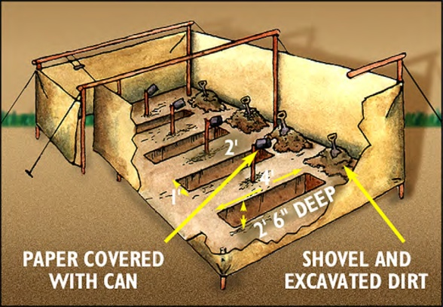
EXPEDIENT HUMAN WASTE DISPOSAL
2017_ver 1.0
Advantages
  Immediate implementation
  Simple system
Disadvantages
  Only when other options not available
  Only for short term use
  Can attract vectors or pests
Limitations
  Requires periodic relocation
Duration Suitability Index
Short | Medium | Long
50
Notes:
This and the next three slides are not treatment processes, but rather are ways of handling human waste in the event that no other options are available.
This picture is an example of a straddle trench latrine. The following two slides illustrate other forms of expedient latrines, all of which have the same advantages, disadvantages and limitations.
More details about this water treatment option are outlined in the following slides.

Slide 51
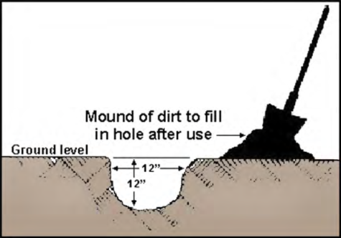

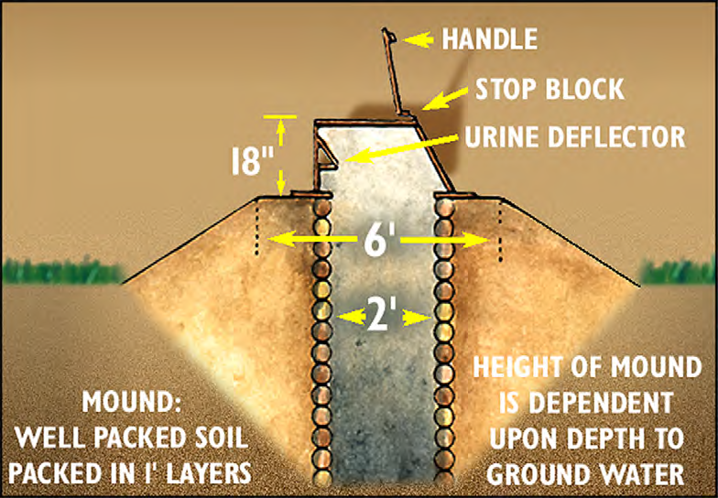
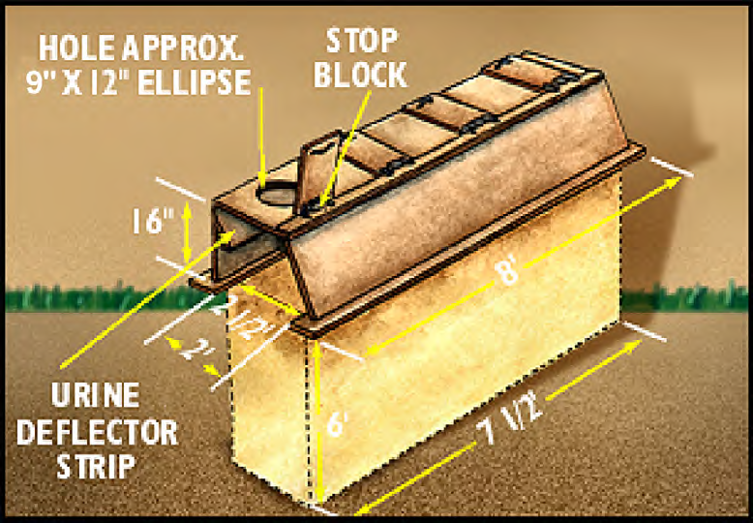
Expedient Latrines
2017_ver 1.0
Cat Hole Latrine
Cross Tree Latrine
Mound Latrine
Deep Pit Latrine
Notes:
The images on this slide are examples of below ground expedient latrines. Such disposal methods may be used in areas where possible groundwater contamination is not a concern.

Slide 52
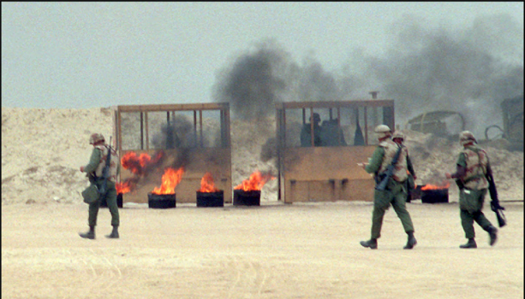
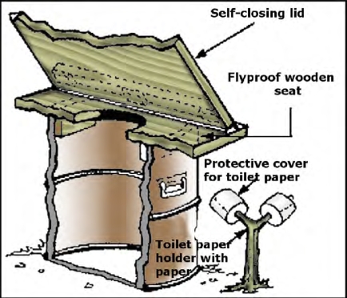
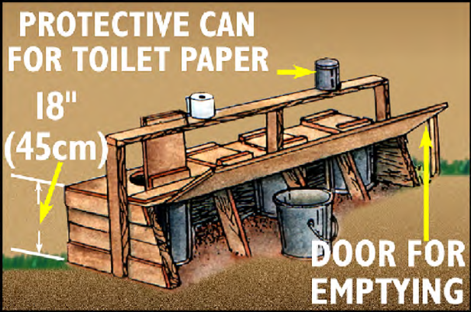
Expedient Latrines
2017_ver 1.0
Multiple-Station Burn Out Latrines
Burn Out Latrine
Typical Pail Latrines
Notes:
The images on this slide are examples of above ground expedient latrines. Such disposal methods may be required in areas with extremely high water tables to avoid groundwater contamination.

Slide 53
Latrines
2017_ver 1.0
General Design Considerations | Volume and area Soil percolation rates Downwind from living areas for odor and vector control
Limitations | Only for short term use Requires periodic relocation
Recordkeeping, Reporting | Latrine location
Capital Costs | Minimal
O&M Requirements | Lime for daily covering of waste Daily waste burning may be required
Transfer/Closure Requirements | Burial Location marking or reporting
References | U.S. Army, Guidelines for Field Waste Management, Technical Bulletin Medical (TB MED) 593, September 2006 Air Force Pamphlet 10-219, Volume 7, 9 June 2008

