Slide 1

Folk og Forsvar
Nordic Conference
Bergen 19 May
Colonel Asbjørn Lysgård
Commander Bergenhus Homeguard 09

Slide 2
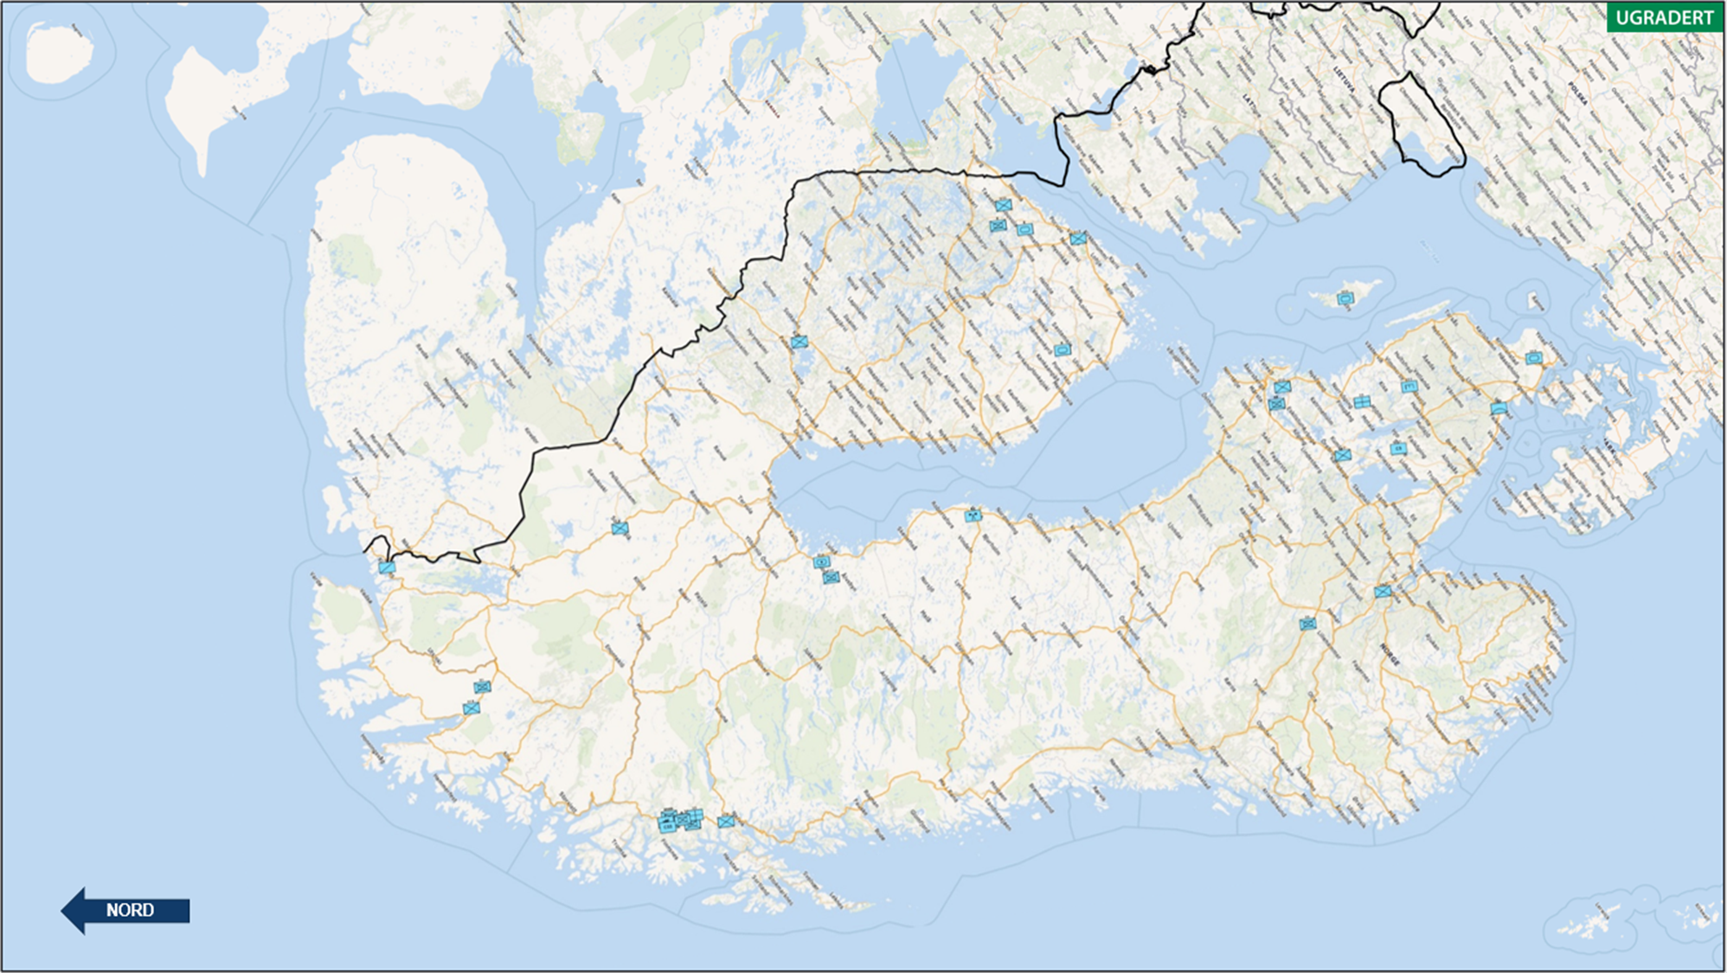
Kart

Slide 3
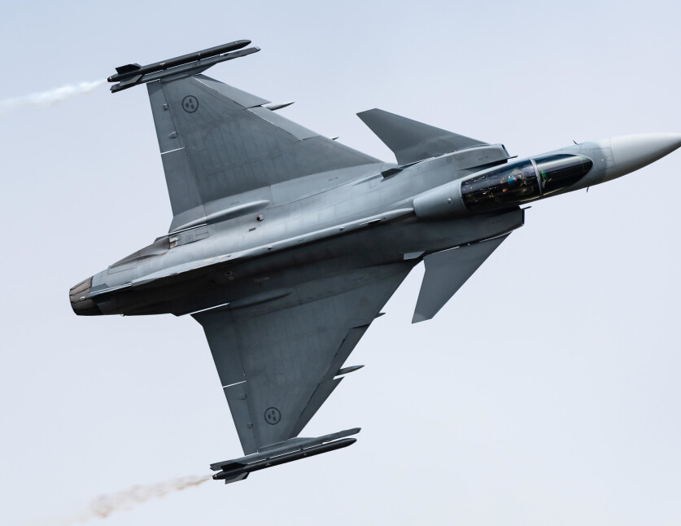
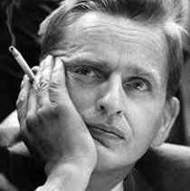

Historical Self-Image
Sweden and Finland
Non-alignment
Normative foreign policy
UN, aid, and global role
Swedish exceptionalism
Arms exporter

Slide 4
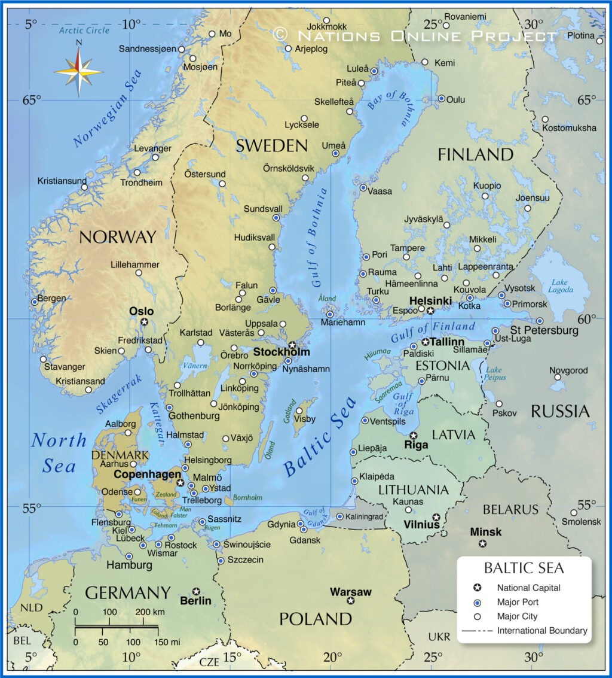
The Baltic Sea and the Immediate Region
Russia as the main challenge
Gotland as a strategic key
Finland and the Baltic states
Germany and Poland becoming more important
The Baltic Sea as a strategic area

Slide 5
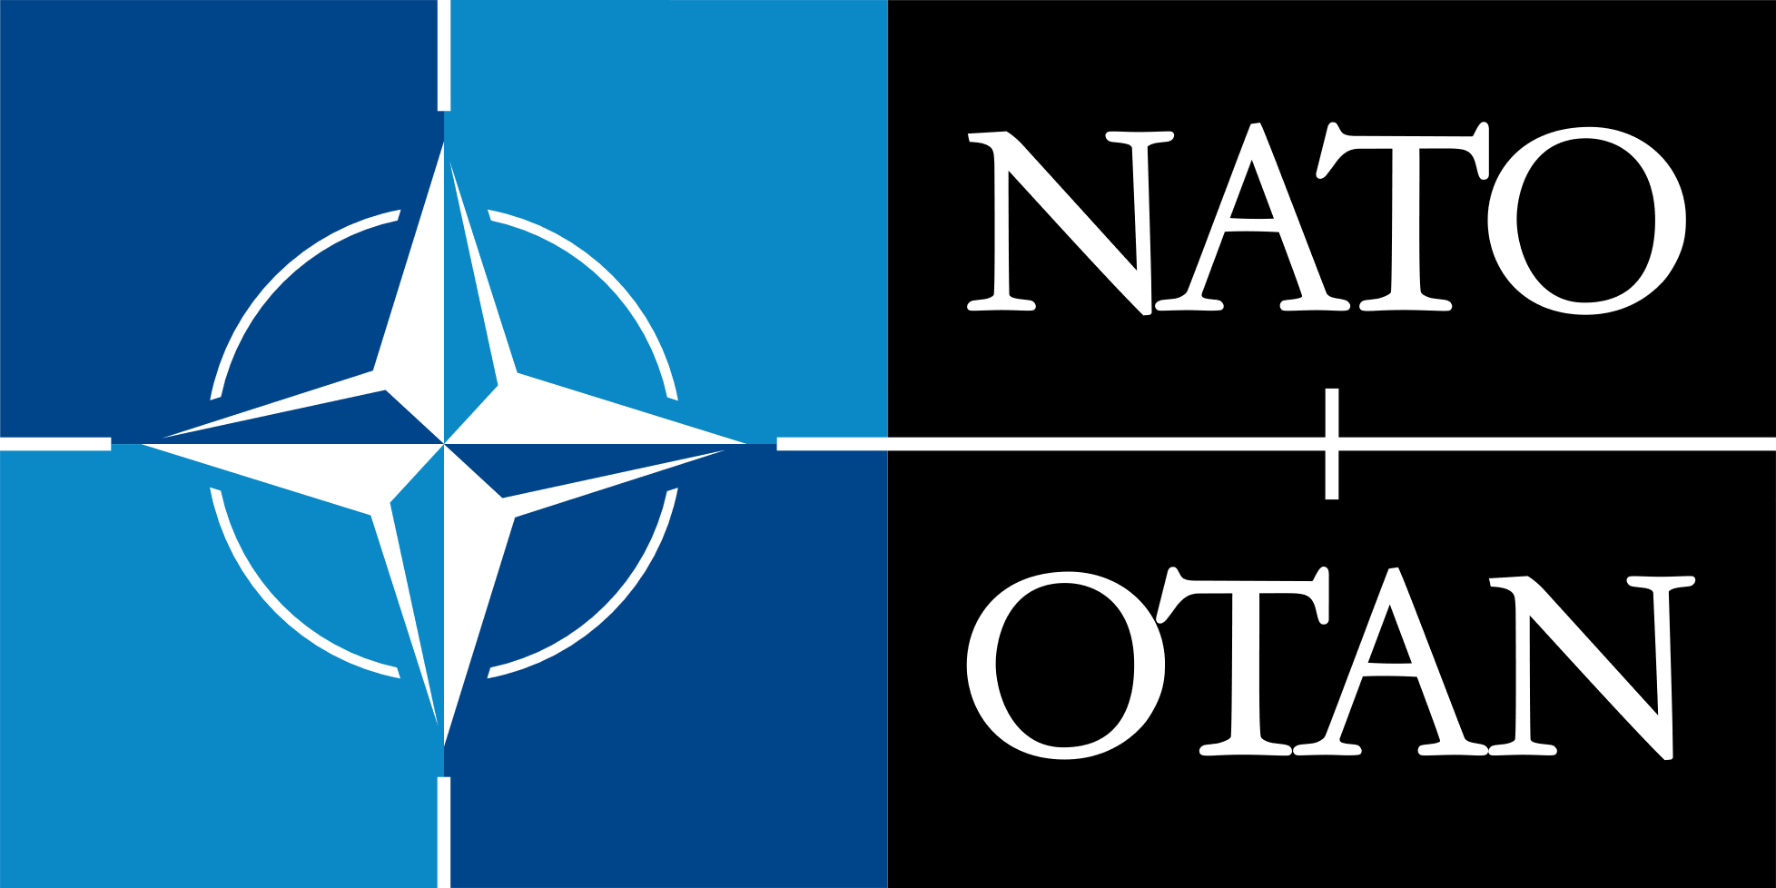
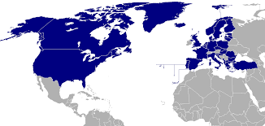
NATO / Security Policy
NATO members in 2023 and 2024
Break with 200 years of military non-alignment
Active role in NATO
Baltic Sentry
Air contributions in Poland and Iceland
FLF Latvia & FLF Finland
Norfolk and joint operational planning
The Nordic and Baltic region as a JOA

Slide 6
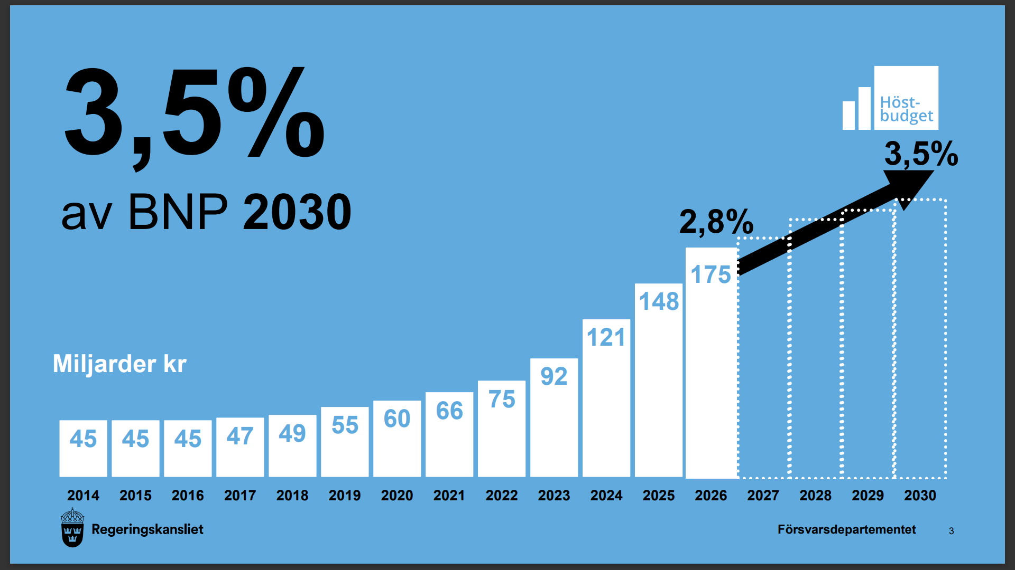
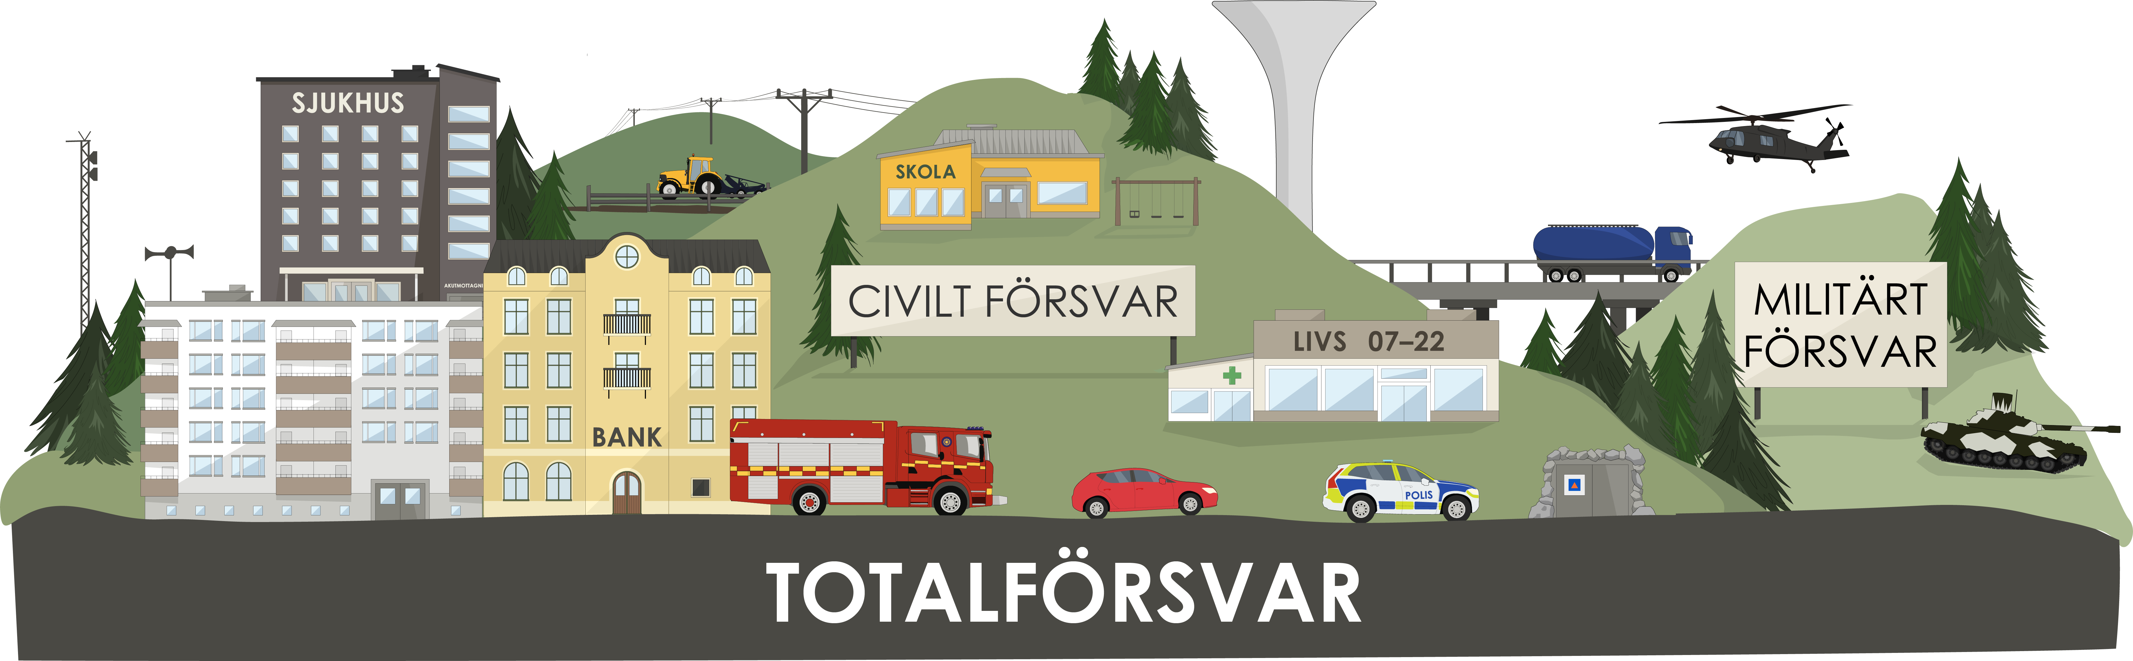
Swedish Defense and Long-Term Plan
Major budget increase, +300 billion SEK
Brigade structure
Baltic Sea focus
Total defense
NATO integration
Yesterday’s challenges?
New defense commission in 2026

Slide 7
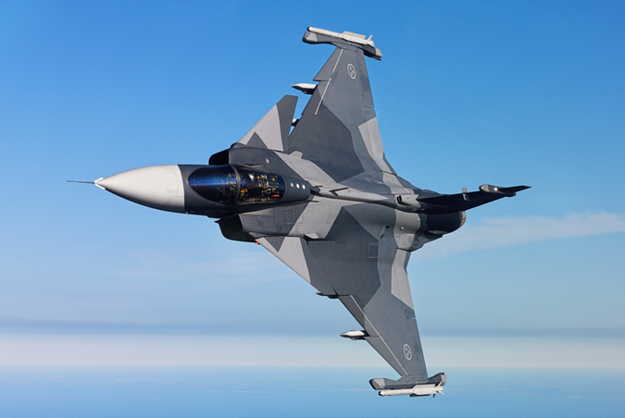

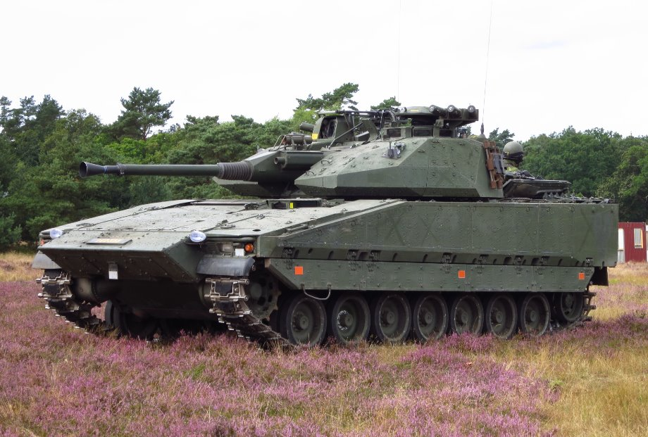
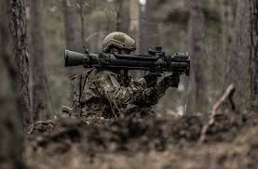
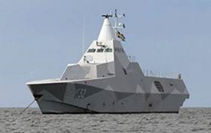
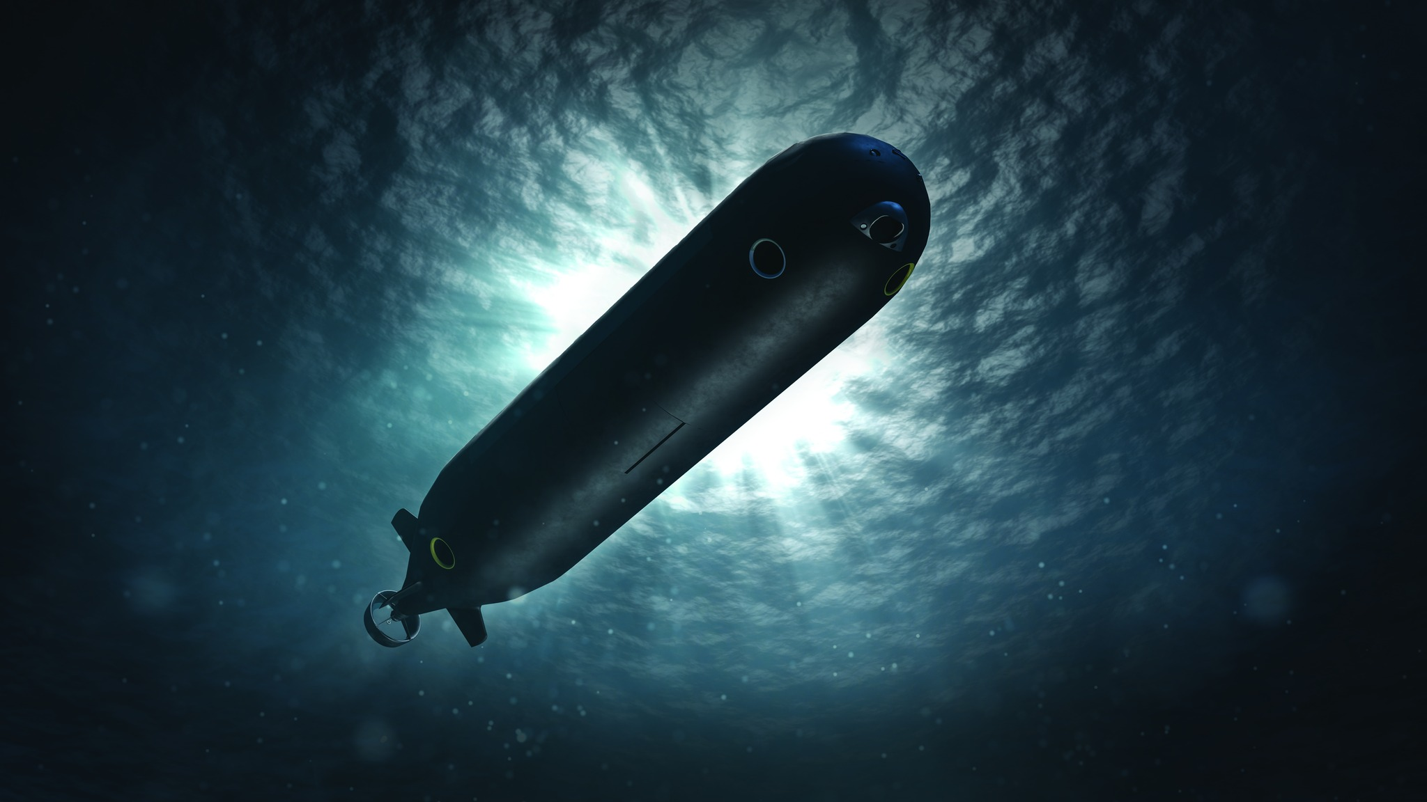
Swedish Defense Industry
Very important for Swedish (economy, innovation, settlement, identity)
Historically large defense industry from the Cold War era
Major actors dominate
Saab, submarines, fighter aircraft
Close connection between state–defense–industry
Export nation (35)
Strategic autonomy
Important in the EU and NATO

Slide 8
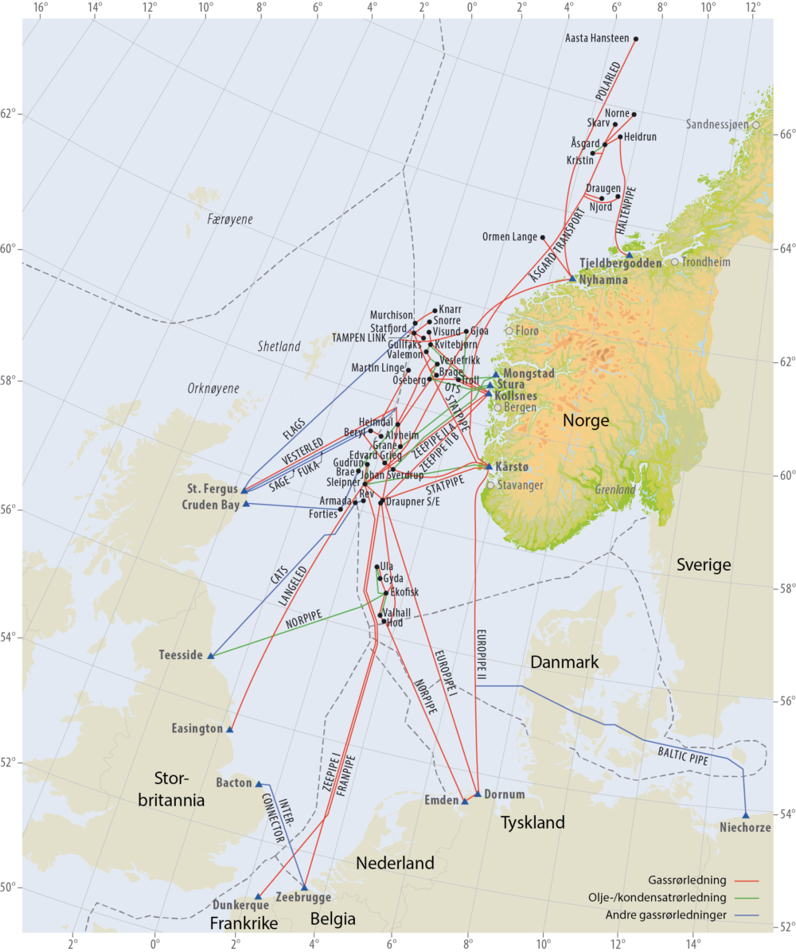

Slide 9
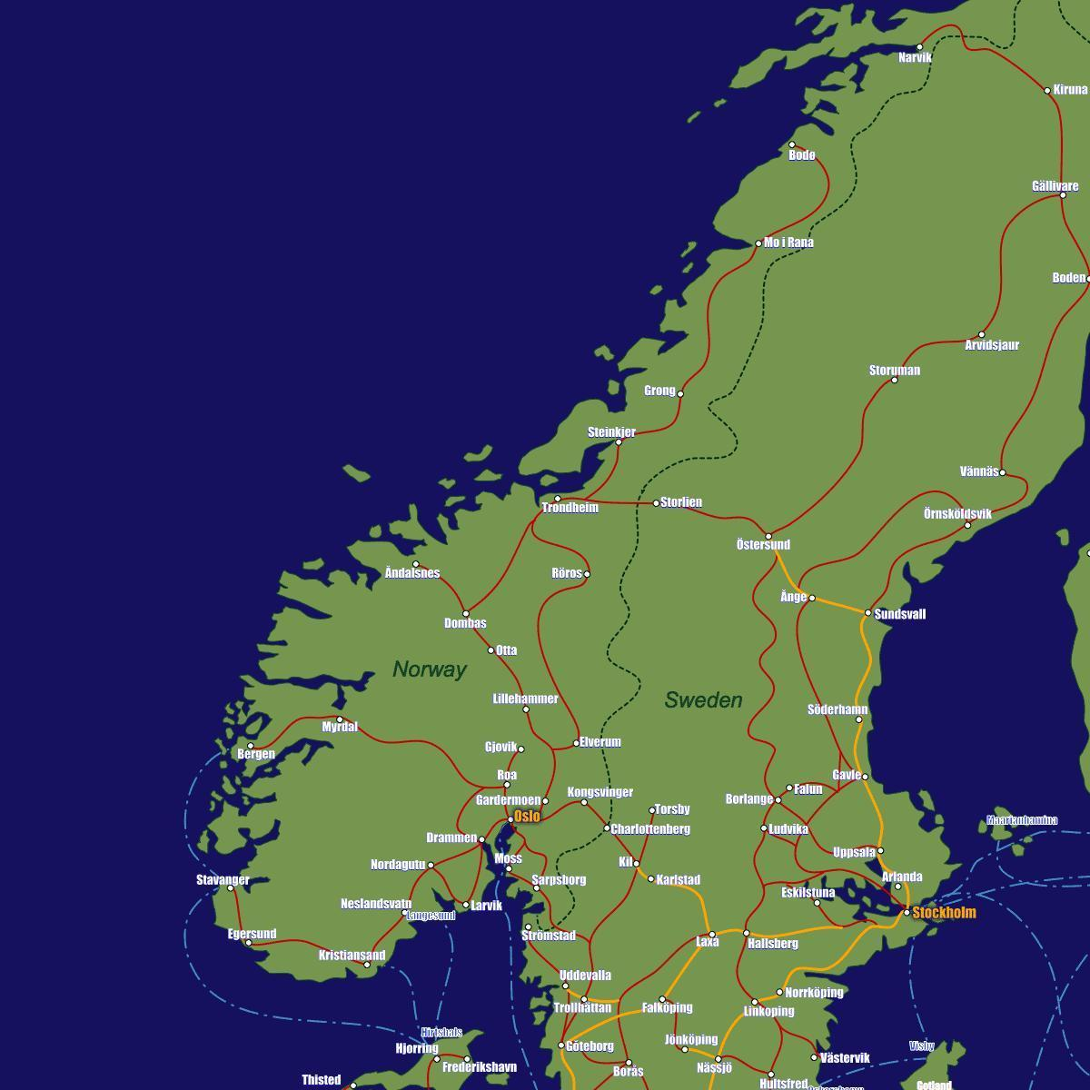

Slide 10
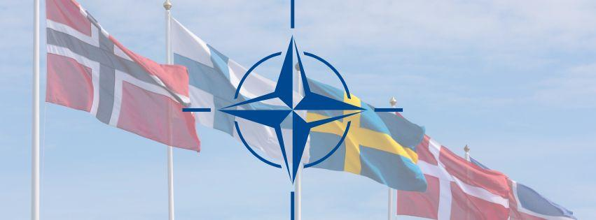
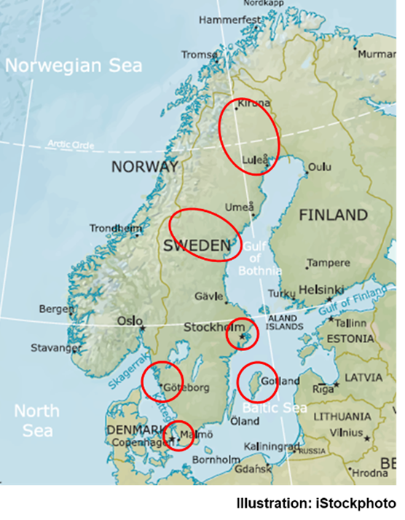
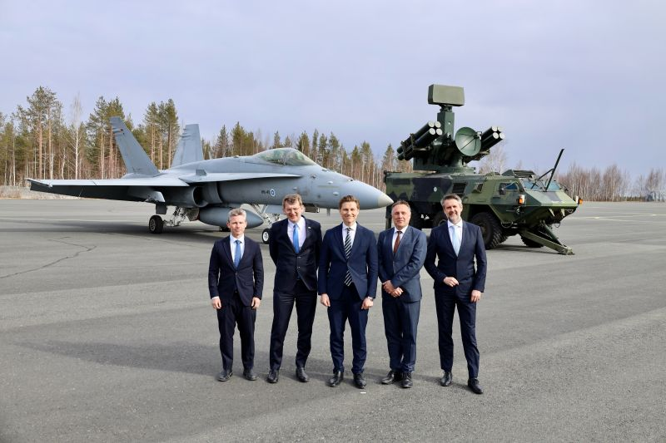
The Nordic Region as a Strategic Region
All Nordic countries in NATO
Joint operational area and NDC
Branch cooperation: air force, army, home guard, intelligence, etc.
Logistics and mobility
NB8, JEF, NORDEFCO
The Nordic region more important than before

Slide 11
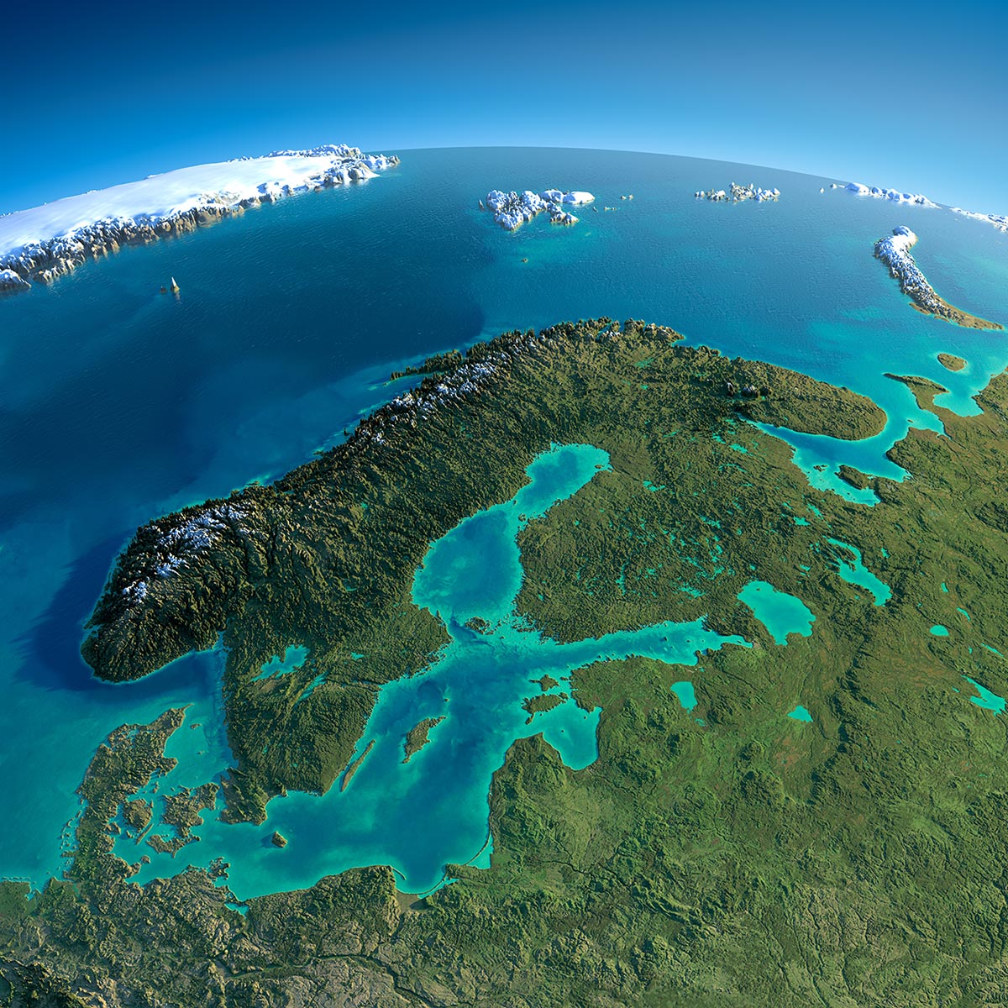
Significance for Norway
Sweden and Finland provides strategic depth
EU decisions without Norway
Important cooperation in the north
Sweden and Finland as an important partner for Norway
Norway will cover the High North and The VesternFlank

